Slide 2
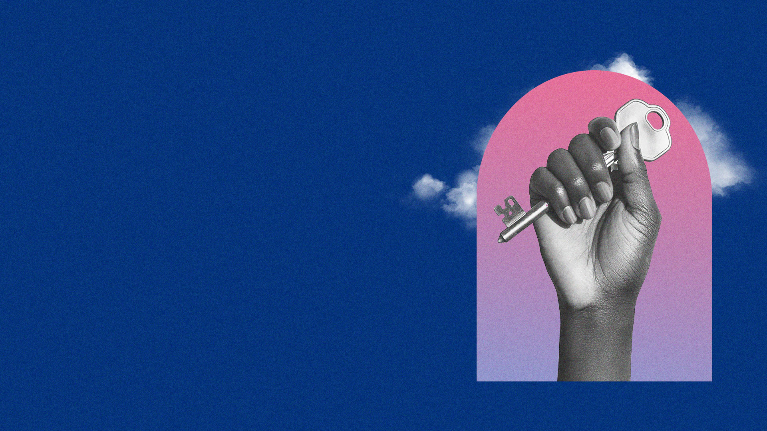
THE LORD JESUS WALKED IN SPIRITUAL AUTHORITY OVER SATAN AND DEMONS.

Slide 3
Matthew 4:24
Then His fame went throughout all Syria; and they brought to Him all sick people who were afflicted with various diseases and torments, and those who were demon-possessed, epileptics, and paralytics; and He healed them.

Slide 4
Matthew 8:16
When evening had come, they brought to Him many who were demon-possessed. And He cast out the spirits with a word, and healed all who were sick,

Slide 5
THE LORD JESUS DELEGATED THIS AUTHORITY TO HIS DISCIPLES.

Slide 6
Matthew 10:1,7,8
1 And when He had called His twelve disciples to Him, He gave them power over unclean spirits, to cast them out, and to heal all kinds of sickness and all kinds of disease.
7 And as you go, preach, saying, 'The kingdom of heaven is at hand.'
8 Heal the sick, cleanse the lepers, raise the dead, cast out demons. Freely you have received, freely give.

Slide 7
Luke 10:17-19
17 Then the seventy returned with joy, saying, "Lord, even the demons are subject to us in Your name."
18 And He said to them, "I saw Satan fall like lightning from heaven.
19 Behold, I give you the authority to trample on serpents and scorpions, and over all the power of the enemy, and nothing shall by any means hurt you.

Slide 8
Mark 9:38,39
38 Now John answered Him, saying, "Teacher, we saw someone who does not follow us casting out demons in Your name, and we forbade him because he does not follow us."
39 But Jesus said, "Do not forbid him, for no one who works a miracle in My name can soon afterward speak evil of Me.

Slide 9
1. OUR AUTHORITY IS IN THE NAME OF JESUS AND OUR RIGHT TO USE HIS NAME

Slide 10
Mark 16:17,18
17 And these signs will follow those who believe: In My name they will cast out demons; they will speak with new tongues;
18 they will take up serpents; and if they drink anything deadly, it will by no means hurt them; they will lay hands on the sick, and they will recover.

Slide 11
2. OUR AUTHORITY IS THROUGH THE POWER OF THE HOLY SPIRIT WHO IS WITH US

Slide 12
Matthew 12:28
But if I cast out demons by the Spirit of God, surely the kingdom of God has come upon you.

Slide 13
Acts 10:38
how God anointed Jesus of Nazareth with the Holy Spirit and with power, who went about doing good and healing all who were oppressed by the devil, for God was with Him.

Slide 14
3. OUR AUTHORITY OVER SATAN AND DEMONS IS BECAUSE OF THE TRIUMPH OF THE CROSS

Slide 15
Colossians 2:14,15
14 having wiped out the handwriting of requirements that was against us, which was contrary to us. And He has taken it out of the way, having nailed it to the cross.
15 Having disarmed principalities and powers, He made a public spectacle of them, triumphing over them in it.

Slide 16
4. CHRIST HAS RAISED ALL OF US TO SIT AT HIS RIGHT HAND IN A PLACE OF AUTHORITY

Slide 17
Ephesians 2:4-6
4 But God, who is rich in mercy, because of His great love with which He loved us,
5 even when we were dead in trespasses, made us alive together with Christ (by grace you have been saved),
6 and raised us up together, and made us sit together in the heavenly places in Christ Jesus,

Slide 18
WE EXERCISE OUR SPIRITUAL AUTHORITY BY SPEAKING WORDS OF COMMAND IN FAITH.

Slide 19
Matthew 17:19-21
19 Then the disciples came to Jesus privately and said, "Why could we not cast it out?"
20 So Jesus said to them, "Because of your unbelief; for assuredly, I say to you, if you have faith as a mustard seed, you will say to this mountain, 'Move from here to there,' and it will move; and nothing will be impossible for you.
21 However, this kind does not go out except by prayer and fasting."

Slide 20
SUMMARY

Slide 21
Basis for Our Authority:
1. The Name of Jesus
2. The Power of the Holy Spirit
3. The Triumph of the Cross
4. Our Position of Authority, Seated
with Christ
5. Speaking Words of Authority with
Faith and Boldness.

