Slide 1
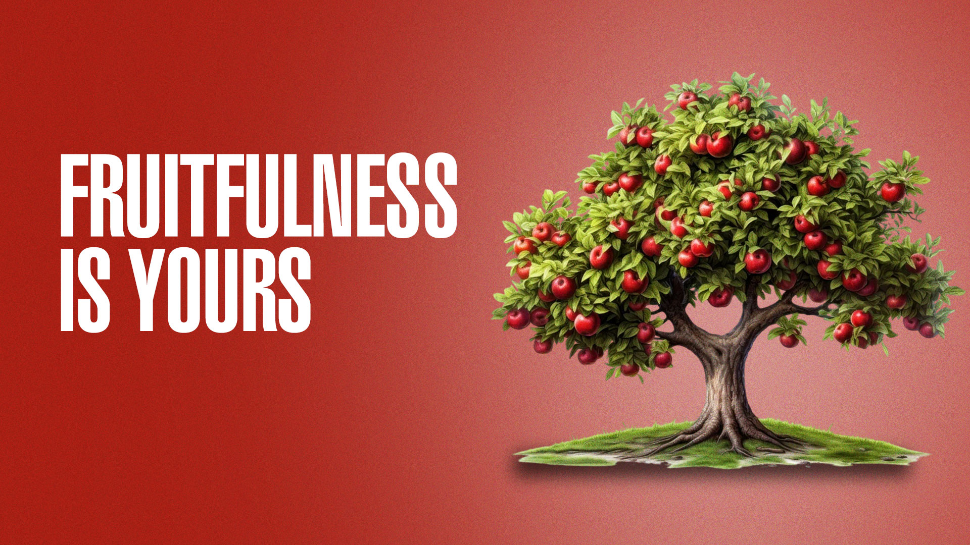

Slide 2
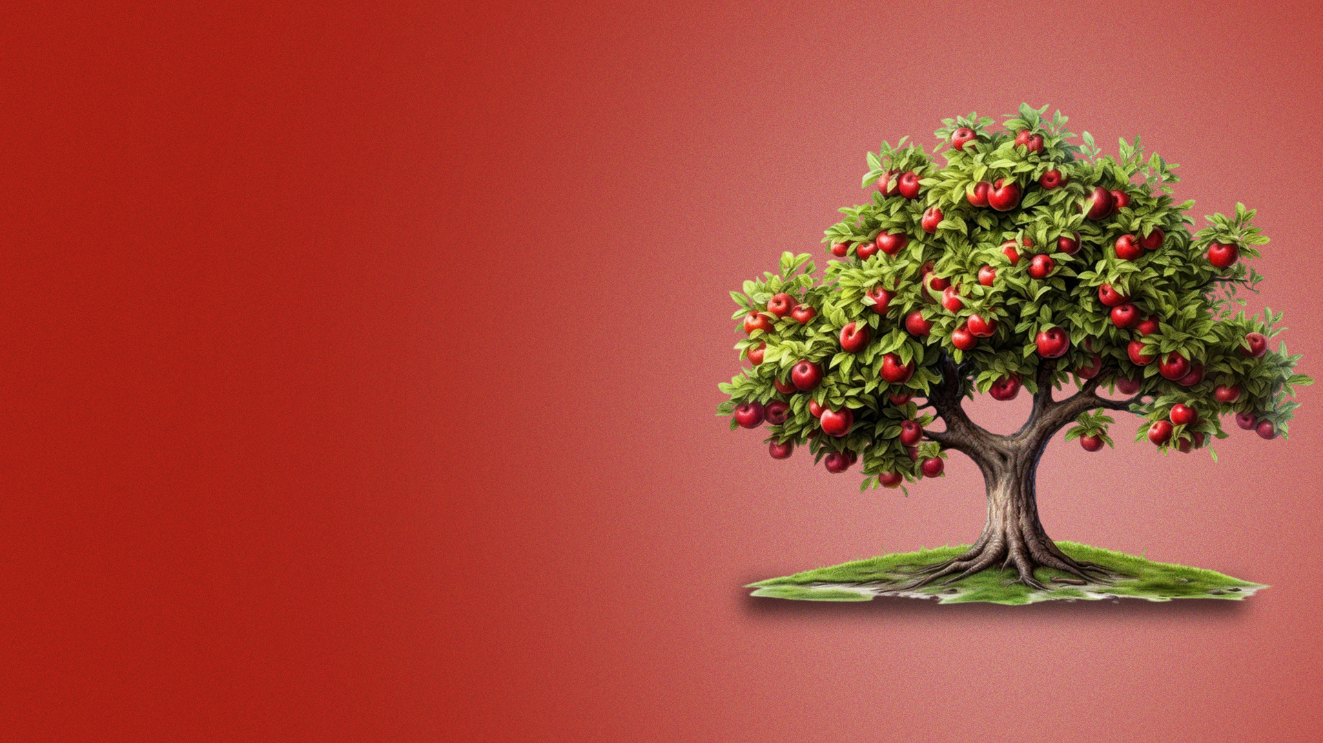
Psalm 1:1-3
1 Blessed is the man Who walks not in the counsel of the ungodly, Nor stands in the path of sinners, Nor sits in the seat of the scornful;
2 But his delight is in the law of the LORD, And in His law he meditates day and night.
3 He shall be like a tree Planted by the rivers of water, That brings forth its fruit in its season, Whose leaf also shall not wither; And whatever he does shall prosper.

Slide 3
Psalm 25:12,13
12 Who is the man that fears the LORD? Him shall He teach in the way He chooses.
13 He himself shall dwell in prosperity, And his descendants shall inherit the earth.

Slide 4
Psalm 128:1,2
1 Blessed is every one who fears the LORD, Who walks in His ways.
2 When you eat the labor of your hands, You shall be happy, and it shall be well with you.

Slide 5
Psalm 128:2 (GNB)
Your work will provide for your needs; you will be happy and prosperous.

Slide 6
John 15:8
By this My Father is glorified, that you bear much fruit; so you will be My disciples.

Slide 7
fruitful = to be successful, flourish, thrive,
prosper, increase, multiply

Slide 8
IS IT RIGHT TO DESIRE AND BE MOTIVATED TO BE FRUITFUL?

Slide 9
1. God proclaimed fruitfulness for us

Slide 10
2. God promised fruitfulness for us

Slide 11
We need to be assured in our hearts that our sincere desire and motivation to be fruitful in what God has called us to do is godly – aligned to God’s will and purpose.

Slide 12
BIBLICAL PRINCIPLES FOR FRUITFULNESS

Slide 13
1. The blessing of the Lord (Proverbs 10:22;
Genesis 26:12; Psalm 75:6,7)
2. Living by the Word of God (Joshua 1:8; Psalm 1:1-3)
3. Diligence (Proverbs 10:4; Proverbs 22:29)

Slide 14
4. Wisdom of God
(Ecclesiastes 10:10;
Proverbs 4:7-9;
Proverbs 8:12,18;
Proverbs 24:3,4)
5. Faithfulness in little things (Matthew 25:21,23; Job 8:6,7; Isaiah 60:22)

Slide 15
FRUITFULNESS DEMONSTRATES FAITHFULNESS

Slide 16
Matthew 25:21,23,29

Slide 17
Matthew 25:29
For to everyone who has, more will be given, and he will have abundance; but from him who does not have, even what he has will be taken away.

Slide 18
God rewards fruitfulness with greater fruitfulness

Slide 19
EXERCISE FAITH FOR FRUITFULNESS

Slide 20
THE PRAYER OF JABEZ—AGAINST ALL ODDS

Slide 21
1 Chronicles 4:9,10
9 Now Jabez was more honorable than his brothers, and his mother called his name Jabez, saying, "Because I bore him in pain."
10 And Jabez called on the God of Israel saying, "Oh, that You would bless me indeed, and enlarge my territory, that Your hand would be with me, and that You would keep me from evil, that I may not cause pain!" So God granted him what he requested.

