Slide 2
Self-image is how you see yourself, while self-esteem is how you feel about yourself.

Slide 3
WHY IS A POSITIVE SELF-IMAGE IMPORTANT?

Slide 4
A BIBLICAL APPROACH TO DEVELOPING A POSITIVE SELF-IMAGE AND BUILDING YOUR SELF-ESTEEM

Slide 5
1. BE ESTABLISHED IN YOUR IDENTITY IN CHRIST

Slide 6
Repaint your portrait based on your identity in Christ.

Slide 7
The Word of God is our spiritual mirror.

Slide 8
James 1:22-25
22 But be doers of the word, and not hearers only, deceiving yourselves.
23 For if anyone is a hearer of the word and not a doer, he is like a man observing his natural face in a mirror;

Slide 9
James 1:22-25
24 for he observes himself, goes away, and immediately forgets what kind of man he was.
25 But he who looks into the perfect law of liberty and continues in it, and is not a forgetful hearer but a doer of the work, this one will be blessed in what he does.

Slide 10
2 Corinthians 5:17
Therefore, if anyone is in Christ, he is a new creation; old things have passed away; behold, all things have become new.

Slide 12
2. CONSTANTLY ACKNOWLEDGE YOUR IDENTITY IN CHRIST

Slide 13
Agree with God and say what God says about who you are in Christ.

Slide 14
Proverbs 4:20,21a
20 My son, give attention to my words; Incline your ear to my sayings.
21 Do not let them depart from your eyes; ...

Slide 15
APC Church App: HOME screen

Slide 16
TOOLKIT screen

Slide 17
3. FOCUS ON YOUR COMPLETENESS THAT COMES FROM CHRIST

Slide 18
Recognize God's empowering through your life in Christ.

Slide 19
1 Corinthians 1:30
But of Him you are in Christ Jesus, who became for us wisdom from God—and righteousness and sanctification and redemption—

Slide 20
Colossians 2:9,10
9 For in Him dwells all the fullness of the Godhead bodily;
10 and you are complete in Him, who is the head of all principality and power.

Slide 21
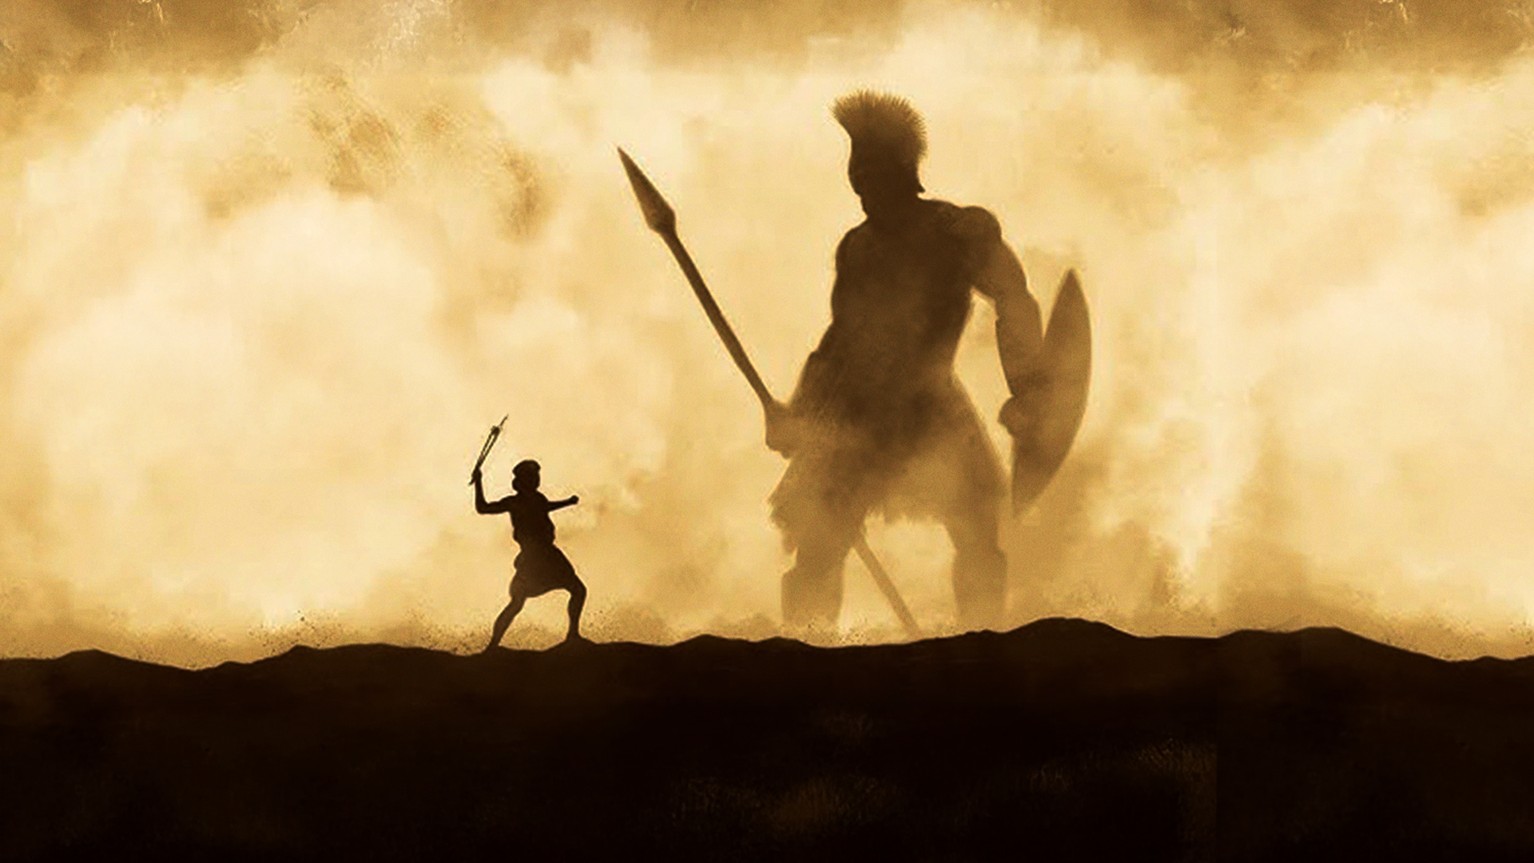

Slide 22
4. COUNTER AND DISCARD NEGATIVE THOUGHTS

Slide 23
Consciously counter and discard negative thoughts by declaring who you are in Christ.

Slide 24
2 Corinthians 10:4,5
4 For the weapons of our warfare are not carnal but mighty in God for pulling down strongholds,
5 casting down arguments and every high thing that exalts itself against the knowledge of God, bringing every thought into captivity to the obedience of Christ,

Slide 25
5. FELLOWSHIP WITH
LIKE-MINDED BELIEVERS

Slide 26
Spend time with believers who know their identity in Christ and who can uplift and encourage you.

Slide 27
Philemon 1:6
that the sharing of your faith may become effective by the acknowledgment of every good thing which is in you in Christ Jesus.

Slide 28
2 Corinthians 5:16,17
16 Therefore, from now on, we regard no one according to the flesh. Even though we have known Christ according to the flesh, yet now we know Him thus no longer.
17 Therefore, if anyone is in Christ, he is a new creation; old things have passed away; behold, all things have become new.

Slide 29
SUMMARY

Slide 30
1. BE ESTABLISHED IN YOUR
IDENTITY IN CHRIST
2. CONSTANTLY ACKNOWLEDGE YOUR IDENTITY IN CHRIST
3. FOCUS ON YOUR COMPLETENESS THAT COMES FROM CHRIST
4. COUNTER AND DISCARD NEGATIVE THOUGHTS
5. FELLOWSHIP WITH LIKE-MINDED BELIEVERS

