Slide 2
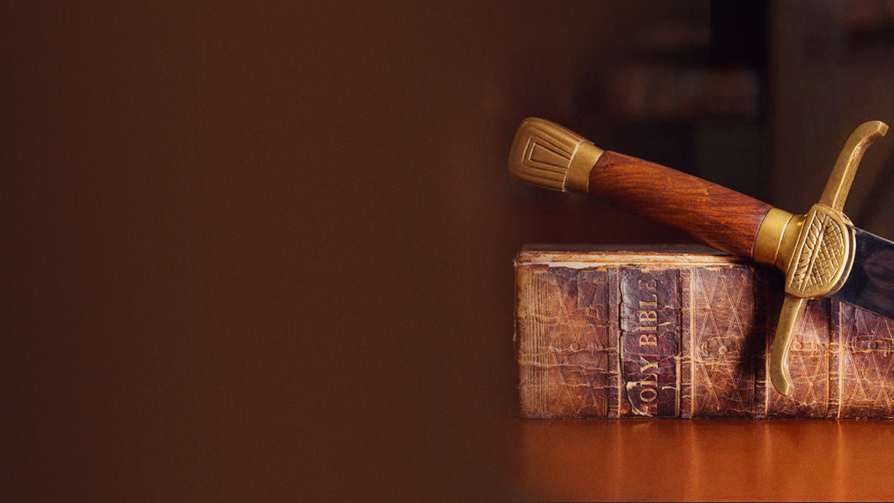
1 Timothy 6:12
Fight the good fight of faith, lay hold on eternal life, to which you were also called and have confessed the good confession in the presence of many witnesses.

Slide 3
Ephesians 6:16
above all, taking the shield of faith with which you will be able to quench all the fiery darts of the wicked one.

Slide 4
1 Peter 5:8,9
8 Be sober, be vigilant; because your adversary the devil walks about like a roaring lion, seeking whom he may devour.
9 Resist him, steadfast in the faith, knowing that the same sufferings are experienced by your brotherhood in the world.

Slide 5
WHY THIS FIGHT OF FAITH?

Slide 6
There is an enemy who wants to rob us of our faith.

Slide 7
Faith is how we please God
Faith is how we receive
from God
Faith is how we walk with God
Faith is how we overcome
Faith is how we minister to others
Faith is how we lay hold on eternal life

Slide 8
HOW THE ENEMY WORKS TO ROB US OF FAITH
Distractions
Lies, deceptions, questions, doubts
Difficult circumstances
Wrong theology

Slide 9
HOW TO FIGHT THE FIGHT OF FAITH?
Feed your faith with the Word
Speak your faith in the Word
Act your faith in the Word

Slide 10
WHAT TO FIGHT FOR?

Slide 11
Fight the fight of faith for God’s promises in every area of your life.

Slide 12
Fight the fight of faith for God’s call, purpose and plan for your life.

Slide 13
INVITATION

Slide 14
2 Corinthians 6:2
For He says: "IN AN ACCEPTABLE TIME I HAVE HEARD YOU, AND IN THE DAY OF SALVATION I HAVE HELPED YOU." Behold, now is the accepted time; behold, now is the day of salvation.

