Slide 2
Psalm 27:14
Wait for the Lord; be strong, and let your heart take courage; wait for the LORD!
Psalm 33:20,21
20 Our soul waits for the Lord; He is our help and our shield.
21 For our heart is glad in Him, because we trust in his holy name.

Slide 3
Psalm 130:5
I wait for the LORD, my whole being waits, and in his word, I put my hope.
Psalm 40:1
I waited patiently for the Lord; And He inclined to me, And heard my cry.

Slide 4
Isaiah 64:4
For since the beginning of the world men have not heard nor perceived by the ear, Nor has the eye seen any God besides You, Who acts for the one who waits for Him.
Isaiah 40:31
But they that wait upon the LORD shall renew their strength; they shall mount up with wings as eagles; they shall run, and not be weary; and they shall walk, and not faint.

Slide 5
Life Lessons from the Bible

Slide 6
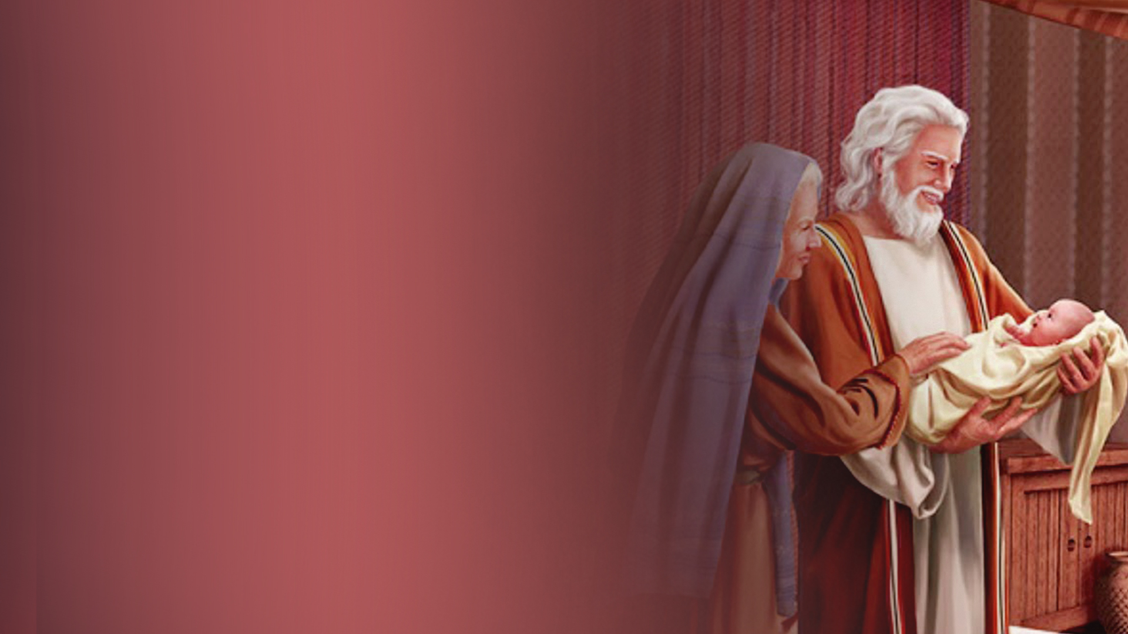
Abraham

Slide 7
Abraham and Sarah waited
25 years for the fulfillment
of God’s promise.

Slide 8
Key Insights from
Abraham’s Waiting:
1. Trust in God’s Timing
2. Faith in Action
3. Embracing Uncertainty

Slide 9
David

Slide 10
About 14 years of preparation from the time of his “calling” by the prophet Samuel to when he was “commissioned” to step into his call.

Slide 11
Key Insights from David's Waiting:
1. Anointing and Reality
2. Courage in Adversity
3. Development of Character

Slide 12
Paul

Slide 13
About 17 years after his encounter with the Lord that Paul stepped into his apostolic ministry.

Slide 14
Key Insights from Paul’s Waiting:
1. The Call and Preparation
2. Seeking God’s Guidance
3. Perseverance in Trials

Slide 15
Jesus

Slide 16
Jesus only began His ministry at age 30 demonstrating how even He, the Son of God, engaged in moments of patience and reliance on divine timing.

Slide 17
Why does God require that we wait?

Slide 18
1. To receive His clear direction
Psalm 119:105
Your word is a lamp to my feet And a light to my path.

Slide 19
2. To keep us in step with His timing
Psalm 32:8
I will instruct you and teach you in the way you should go; I will counsel you with my eye upon you.

Slide 20
3. To test our faith
James 1:2,3
2 My brethren, count it all joy when you fall into various trials,
3 knowing that the testing of your faith produces patience.

Slide 21
4. To strengthen our faith
Isaiah 41:10
Fear not, for I am with you; Be not dismayed, for I am your God. I will strengthen you, Yes, I will help you, I will uphold you with My righteous right hand.’

Slide 22
5. To sift the motives for our desires
Psalms 37:4
Delight yourself in the Lord, and he will give you the desires of
your heart.

Slide 23
How should we wait?

Slide 24
1. Patiently
Psalm 40:1-3
1 I waited patiently for the Lord; And He inclined to me, And heard my cry.
2 He also brought me up out of a horrible pit, Out of the miry clay, And set my feet upon a rock, And established my steps.
3 He has put a new song in my mouth— Praise to our God; Many will see it and fear, And will trust in the Lord.

Slide 25
2. Quietly
Psalm 62:5
My soul, wait in silence for God alone, for my hope is from Him.

Slide 26
3. Trusting
Proverbs 3:5,6
5 Trust in the Lord with all your heart,
And lean not on your own understanding;
6 In all your ways acknowledge Him,
And He shall direct your paths.

Slide 27
4. Expectantly
Jeremiah 29:11
For I know the thoughts that I think toward you, says the LORD, thoughts of peace and not of evil, to give you a future and a hope.

Slide 28
5. Courageously
Joshua 1:9
Have I not commanded you? Be strong and of good courage; do not be afraid, nor be dismayed, for the Lord your God is with you wherever you go.

Slide 29
6. Standing on God’s Word
Matthew 24:35
Heaven and earth will pass away, but My words will by no means pass away.

Slide 30
As we navigate our own seasons of waiting, let us remember to:
1. Hope in the Lord – renews
our strength.
2. Trust God’s timing – helps
us endure our trials.
3. Prayerful surrender – aligns
our will with His.
4. God’s faithfulness – assures
us of His presence.
5. Active waiting – empowers
us to serve others.

