Slide 2
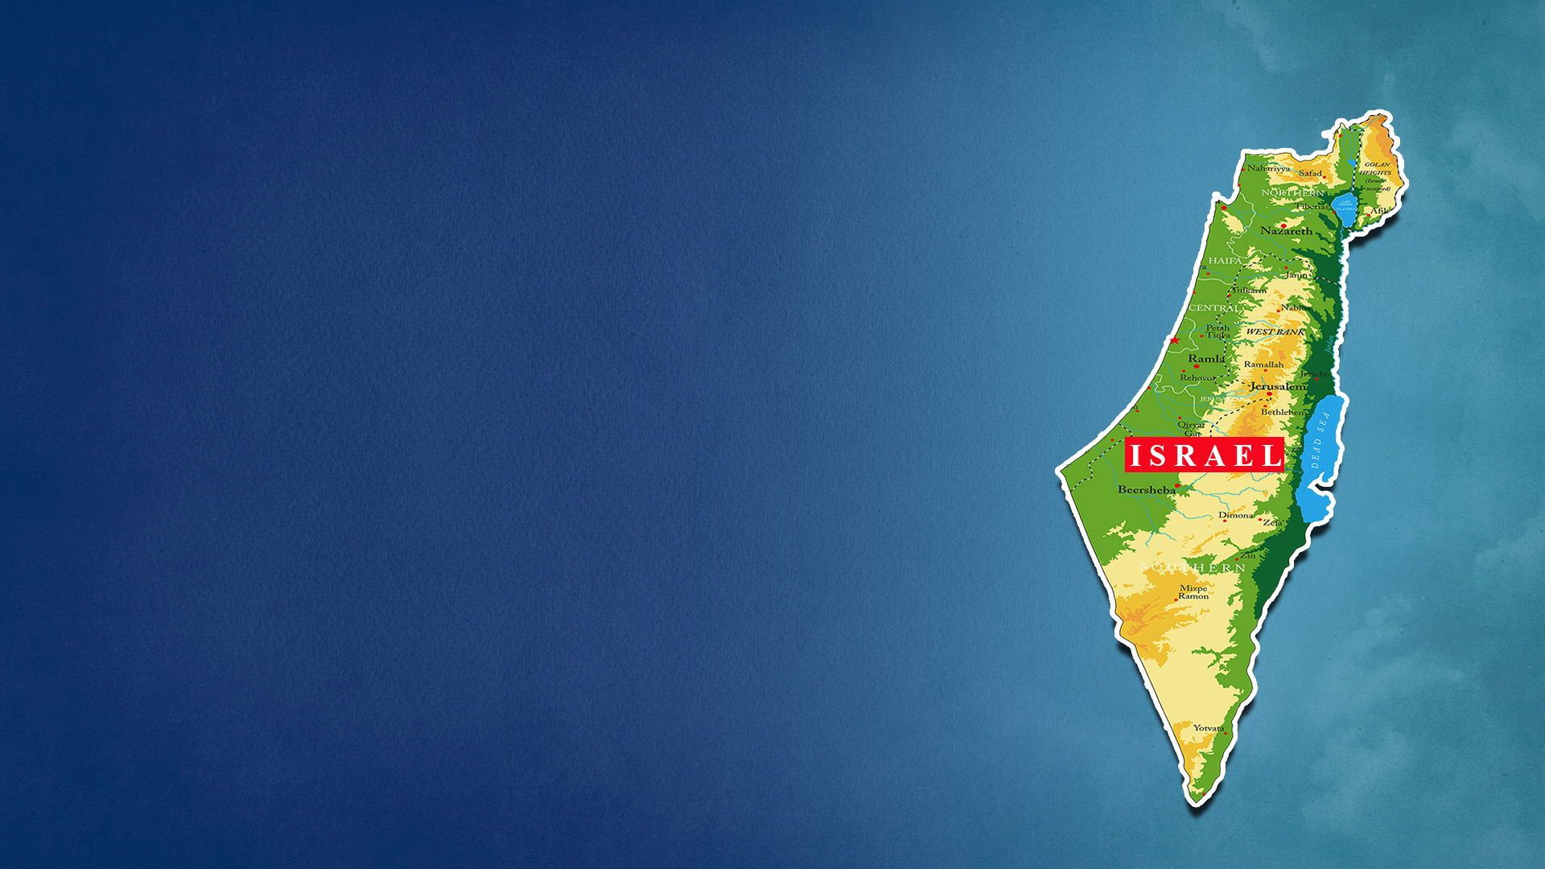
BUILD UP TO THE BATTLE OF ARMAGEDDON

Slide 3
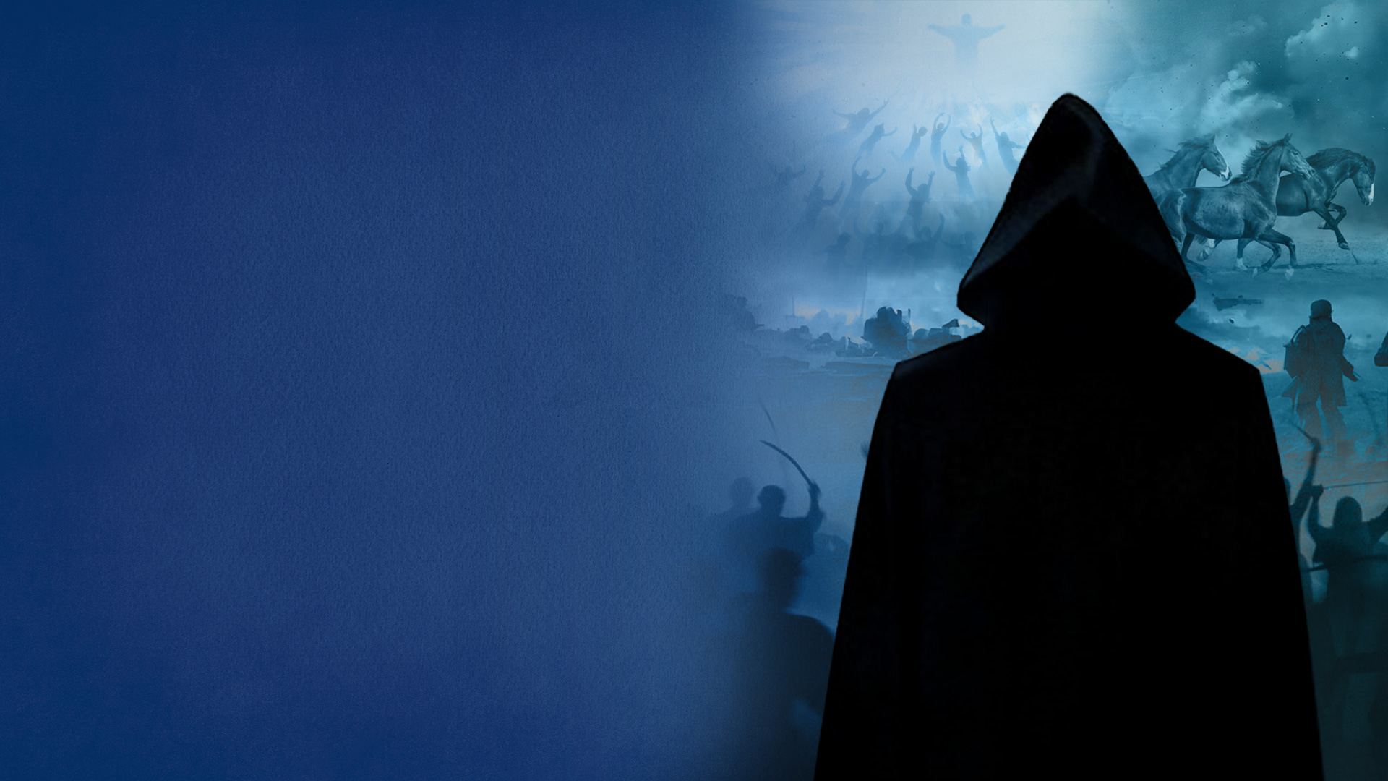
1. The Rise of the Antichrist
and his global influence
2. The Abomination of
Desolation
3. The Great Tribulation,
The Time of Jacob's Trouble

Slide 4
4. The Instigation of Nations
and the Gathering of Armies
(A) Russia and its allies invade
Israel (Ezekiel 38-39)
(B) Invasion of Israel by the
nations (Revelation 16:12-16)
5. The Final Event—The Second
Coming of Christ

Slide 5
1. THE RISE OF THE ANTICHRIST AND HIS GLOBAL INFLUENCE

Slide 6
Daniel 9:27
Then he shall confirm a covenant with many for one week; But in the middle of the week He shall bring an end to sacrifice and offering. And on the wing of abominations shall be one who makes desolate, Even until the consummation, which is determined, Is poured out on the desolate."

Slide 7
Revelation 13:7
It was granted to him to make war with the saints and to overcome them. And authority was given him over every tribe, tongue, and nation.

Slide 8
2. THE ABOMINATION OF DESOLATION

Slide 9
Matthew 24:15
Therefore when you see the 'ABOMINATION OF DESOLATION,' spoken of by Daniel the prophet, standing in the holy place" (whoever reads, let him understand),

Slide 10
2 Thessalonians 2:3,4
3 Let no one deceive you by any means; for that Day will not come unless the falling away comes first, and the man of sin is revealed, the son of perdition,
4 who opposes and exalts himself above all that is called God or that is worshiped, so that he sits as God in the temple of God, showing himself that he is God.

Slide 11
3. THE GREAT TRIBULATION, THE TIME OF JACOB’S TROUBLE

Slide 12
Jeremiah 30:7
Alas! For that day is great, So that none is like it; And it is the time of Jacob's trouble, But he shall be saved out of it.

Slide 13
Daniel 12:1
"At that time Michael shall stand up, The great prince who stands watch over the sons of your people; And there shall be a time of trouble, Such as never was since there was a nation, Even to that time. And at that time your people shall be delivered, Everyone who is found written in the book.

Slide 14
Matthew 24:21,22
21 For then there will be great tribulation, such as has not been since the beginning of the world until this time, no, nor ever shall be.
22 And unless those days were shortened, no flesh would be saved; but for the elect's sake those days will be shortened.

Slide 15
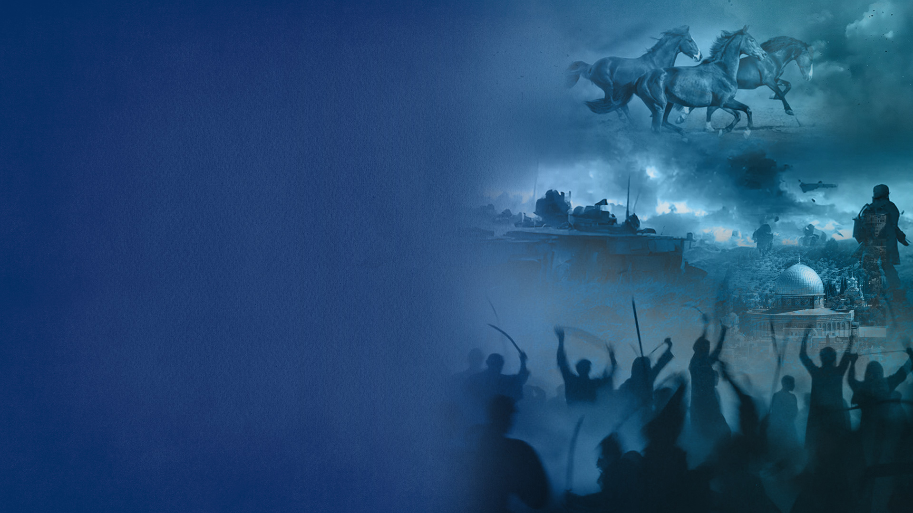
4. THE INSTIGATION OF NATIONS AND THE GATHERING OF ARMIES

Slide 16
Two stages:
(A) Russia and its allies invade
Israel (Ezekiel 38-39)
(B) Invasion of Israel by the
nations (Revelation 16:12-16)

Slide 17
(A) RUSSIA AND ITS ALLIES INVADE ISRAEL (EZEKIEL 38-39)

Slide 18
Ezekiel 38:1-8,15,16
1 Now the word of the LORD came to me, saying,
2 "Son of man, set your face against Gog, of the land of Magog, the prince of Rosh, Meshech, and Tubal, and prophesy against him,
3 and say, 'Thus says the Lord GOD: "Behold, I am against you, O Gog, the prince of Rosh, Meshech, and Tubal.

Slide 19
Ezekiel 38:1-8,15,16
4 I will turn you around, put hooks into your jaws, and lead you out, with all your army, horses, and horsemen, all splendidly clothed, a great company with bucklers and shields, all of them handling swords.
5 Persia, Ethiopia, and Libya are with them, all of them with shield and helmet;

Slide 20
Ezekiel 38:1-8,15,16
4 I will turn you around, put hooks into your jaws, and lead you out, with all your army, horses, and horsemen, all splendidly clothed, a great company with bucklers and shields, all of them handling swords.
5 Persia, Ethiopia, and Libya are with them, all of them with shield and helmet;

Slide 21
Ezekiel 38:1-8,15,16
6 Gomer and all its troops; the house of Togarmah from the far north and all its troops—many people are with you.

Slide 22
Ezekiel 38:1-8,15,16
7 "Prepare yourself and be ready, you and all your companies that are gathered about you; and be a guard for them.
8 After many days you will be visited. In the latter years you will come into the land of those brought back from the sword and gathered from many people on the mountains of Israel, which had long been desolate; they were brought out of the nations, and now all of them dwell safely.

Slide 23
Ezekiel 38:1-8,15,16
15 Then you will come from your place out of the far north, you and many peoples with you, all of them riding on horses, a great company and a mighty army.
16 You will come up against My people Israel like a cloud, to cover the land. It will be in the latter days that I will bring you against My land, so that the nations may know Me, when I am hallowed in you, O Gog, before their eyes."

Slide 24
Russia, and its allies: Iran, Turkey, Libya, Ethiopia, Sudan

Slide 25
Ezekiel 39:1-5
1 "And you, son of man, prophesy against Gog, and say, 'Thus says the Lord GOD: "Behold, I am against you, O Gog, the prince of Rosh, Meshech, and Tubal;
2 and I will turn you around and lead you on, bringing you up from the far north, and bring you against the mountains of Israel.
3 Then I will knock the bow out of your left hand, and cause the arrows to fall out of your right hand.

Slide 26
Ezekiel 39:1-5
4 You shall fall upon the mountains of Israel, you and all your troops and the peoples who are with you; I will give you to birds of prey of every sort and to the beasts of the field to be devoured.
5 You shall fall on the open field; for I have spoken," says the Lord GOD.

Slide 27
(B) INVASION OF ISRAEL BY THE NATIONS
(REVELATION 16:12-16)

Slide 28
Revelation 16:12-16
12 Then the sixth angel poured out his bowl on the great river Euphrates, and its water was dried up, so that the way of the kings from the east might be prepared.
13 And I saw three unclean spirits like frogs coming out of the mouth of the dragon, out of the mouth of the beast, and out of the mouth of the false prophet.

Slide 29
Revelation 16:12-16
14 For they are spirits of demons, performing signs, which go out to the kings of the earth and of the whole world, to gather them to the battle of that great day of God Almighty.
15 "Behold, I am coming as a thief. Blessed is he who watches, and keeps his garments, lest he walk naked and they see his shame."
16 And they gathered them together to the place called in Hebrew, Armageddon.

Slide 30
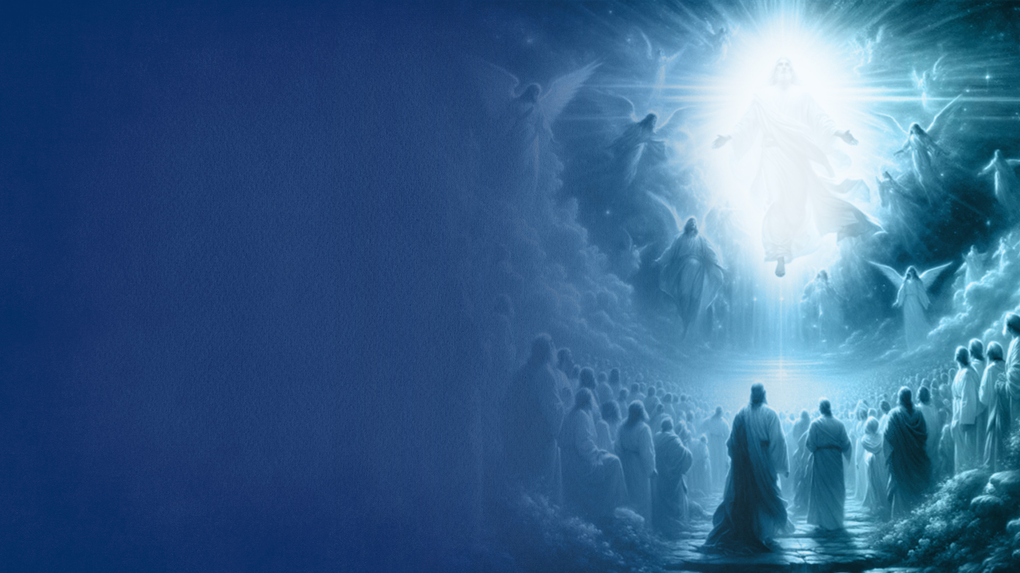
5. THE FINAL EVENT—THE SECOND COMING OF CHRIST

Slide 31
WHY THE FINAL BATTLE OF ARMAGEDDON?

Slide 32
1. To Fulfill God's Sovereign Judgment on the Nations—God’s Wrath and Vengeance
2. Nations Keen Intent On Destroying Israel
3. Satan’s Influence and Global Rebellion
4. Satan’s Ambition to Oppose the Return of Christ
5. The Antichrist’s Control and Deception

Slide 33
THE ALIGNMENT OF NATIONS

Slide 34
JESUS IS COMING BACK FOR A GLORIOUS CHURCH

