Slide 2
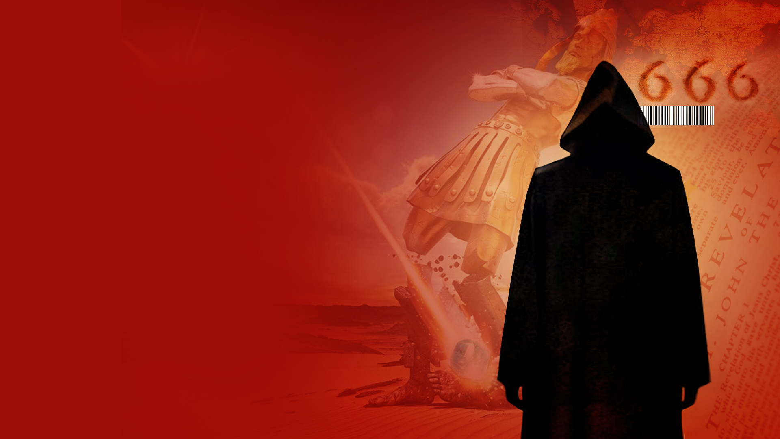
WHEN WILL THE ANTICHRIST BE REVEALED?

Slide 3
2 Thessalonians 2:6-8
6 And now you know what is restraining, that he may be revealed in his own time.
7 For the mystery of lawlessness is already at work; only He who now restrains will do so until He is taken out of the way.
8 And then the lawless one will be revealed, whom the Lord will consume with the breath of His mouth and destroy with the brightness of His coming.

Slide 4
Revelation 4:1
After these things I looked, and behold, a door standing open in heaven. And the first voice which I heard was like a trumpet speaking with me, saying, "Come up here, and I will show you things which must take place after this."

Slide 5
Revelation 6:1,2
1 Now I saw when the Lamb opened one of the seals; and I heard one of the four living creatures saying with a voice like thunder, "Come and see."
2 And I looked, and behold, a white horse. He who sat on it had a bow; and a crown was given to him, and he went out conquering and to conquer.

Slide 6
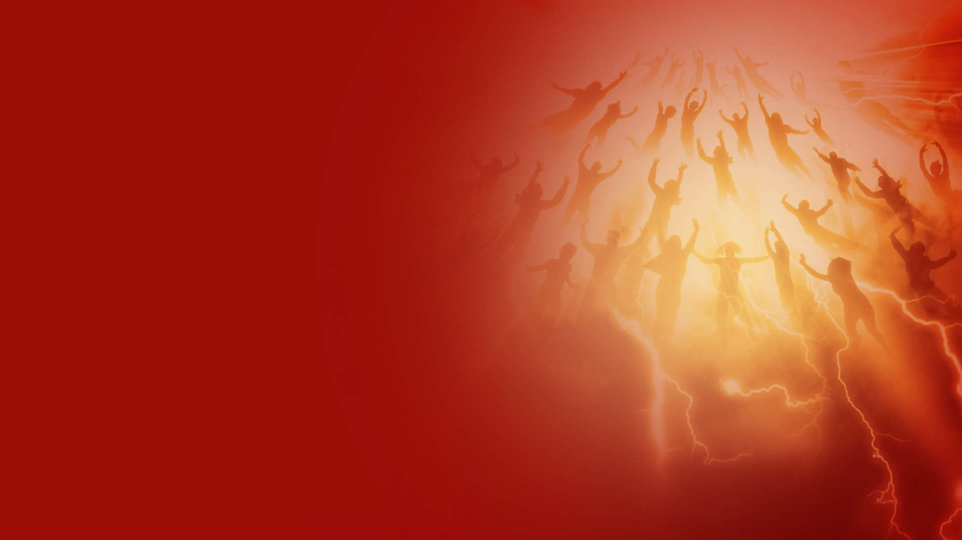
THE RAPTURE OF THE CHURCH

Slide 7
THE ANTICHRIST AND THE FALSE PROPHET

Slide 8
Revelation 13
1 Then I stood on the sand of the sea. And I saw a beast rising up out of the sea, having seven heads and ten horns, and on his horns ten crowns, and on his heads a blasphemous name.
2 Now the beast which I saw was like a leopard, his feet were like the feet of a bear, and his mouth like the mouth of a lion. The dragon gave him his power, his throne, and great authority.

Slide 9
Revelation 13
3 And I saw one of his heads as if it had been mortally wounded, and his deadly wound was healed. And all the world marveled and followed the beast.
4 So they worshiped the dragon who gave authority to the beast; and they worshiped the beast, saying, "Who is like the beast? Who is able to make war with him?"

Slide 10
Revelation 13
5 And he was given a mouth speaking great things and blasphemies, and he was given authority to continue for forty-two months.
6 Then he opened his mouth in blasphemy against God, to blaspheme His name, His tabernacle, and those who dwell in heaven.

Slide 11
Revelation 13
7 It was granted to him to make war with the saints and to overcome them. And authority was given him over every tribe, tongue, and nation.
8 All who dwell on the earth will worship him, whose names have not been written in the Book of Life of the Lamb slain from the foundation of the world.

Slide 12
Revelation 13
9 If anyone has an ear, let him hear.
10 He who leads into captivity shall go into captivity; he who kills with the sword must be killed with the sword. Here is the patience and the faith of the saints.

Slide 13
Revelation 13
11 Then I saw another beast coming up out of the earth, and he had two horns like a lamb and spoke like a dragon.
12 And he exercises all the authority of the first beast in his presence, and causes the earth and those who dwell in it to worship the first beast, whose deadly wound was healed.

Slide 14
Revelation 13
13 He performs great signs, so that he even makes fire come down from heaven on the earth in the sight of men.
14 And he deceives those who dwell on the earth—by those signs which he was granted to do in the sight of the beast, telling those who dwell on the earth to make an image to the beast who was wounded by the sword and lived.

Slide 15
Revelation 13
15 He was granted power to give breath to the image of the beast, that the image of the beast should both speak and cause as many as would not worship the image of the beast to be killed.
16 He causes all, both small and great, rich and poor, free and slave, to receive a mark on their right hand or on their foreheads,

Slide 16
Revelation 13
17 and that no one may buy or sell except one who has the mark or the name of the beast, or the number of his name.
18 Here is wisdom. Let him who has understanding calculate the number of the beast, for it is the number of a man: His number is 666.

Slide 17
WHO IS THE ANTICHRIST?

Slide 18
WHERE WILL THE ANTICHRIST COME FROM?

Slide 19
Daniel 2:36-44
36 "This is the dream. Now we will tell the interpretation of it before the king.
37 You, O king, are a king of kings. For the God of heaven has given you a kingdom, power, strength, and glory;

Slide 20
Daniel 2:36-44
38 and wherever the children of men dwell, or the beasts of the field and the birds of the heaven, He has given them into your hand, and has made you ruler over them all—you are this head of gold.
39 But after you shall arise another kingdom inferior to yours; then another, a third kingdom of bronze, which shall rule over all the earth.

Slide 21
Daniel 2:36-44
40 And the fourth kingdom shall be as strong as iron, inasmuch as iron breaks in pieces and shatters everything; and like iron that crushes, that kingdom will break in pieces and crush all the others.

Slide 22
Daniel 2:36-44
41 Whereas you saw the feet and toes, partly of potter's clay and partly of iron, the kingdom shall be divided; yet the strength of the iron shall be in it, just as you saw the iron mixed with ceramic clay.
42 And as the toes of the feet were partly of iron and partly of clay, so the kingdom shall be partly strong and partly fragile.

Slide 23
Daniel 2:36-44
43 As you saw iron mixed with ceramic clay, they will mingle with the seed of men; but they will not adhere to one another, just as iron does not mix with clay.

Slide 24
Daniel 2:36-44
44 And in the days of these kings the God of heaven will set up a kingdom which shall never be destroyed; and the kingdom shall not be left to other people; it shall break in pieces and consume all these kingdoms, and it shall stand forever.

Slide 25
Daniel 7:17, 23-25
17 'Those great beasts, which are four, are four kings which arise out of the earth.
23 "Thus he said: 'The fourth beast shall be A fourth kingdom on earth, Which shall be different from all other kingdoms, And shall devour the whole earth, Trample it and break it in pieces.

Slide 26
Daniel 7:17, 23-25
24 The ten horns are ten kings Who shall arise from this kingdom. And another shall rise after them; He shall be different from the first ones, And shall subdue three kings.

Slide 27
Daniel 7:17, 23-25
25 He shall speak pompous words against the Most High, Shall persecute the saints of the Most High, And shall intend to change times and law. Then the saints shall be given into his hand For a time and times and half a time.

Slide 28
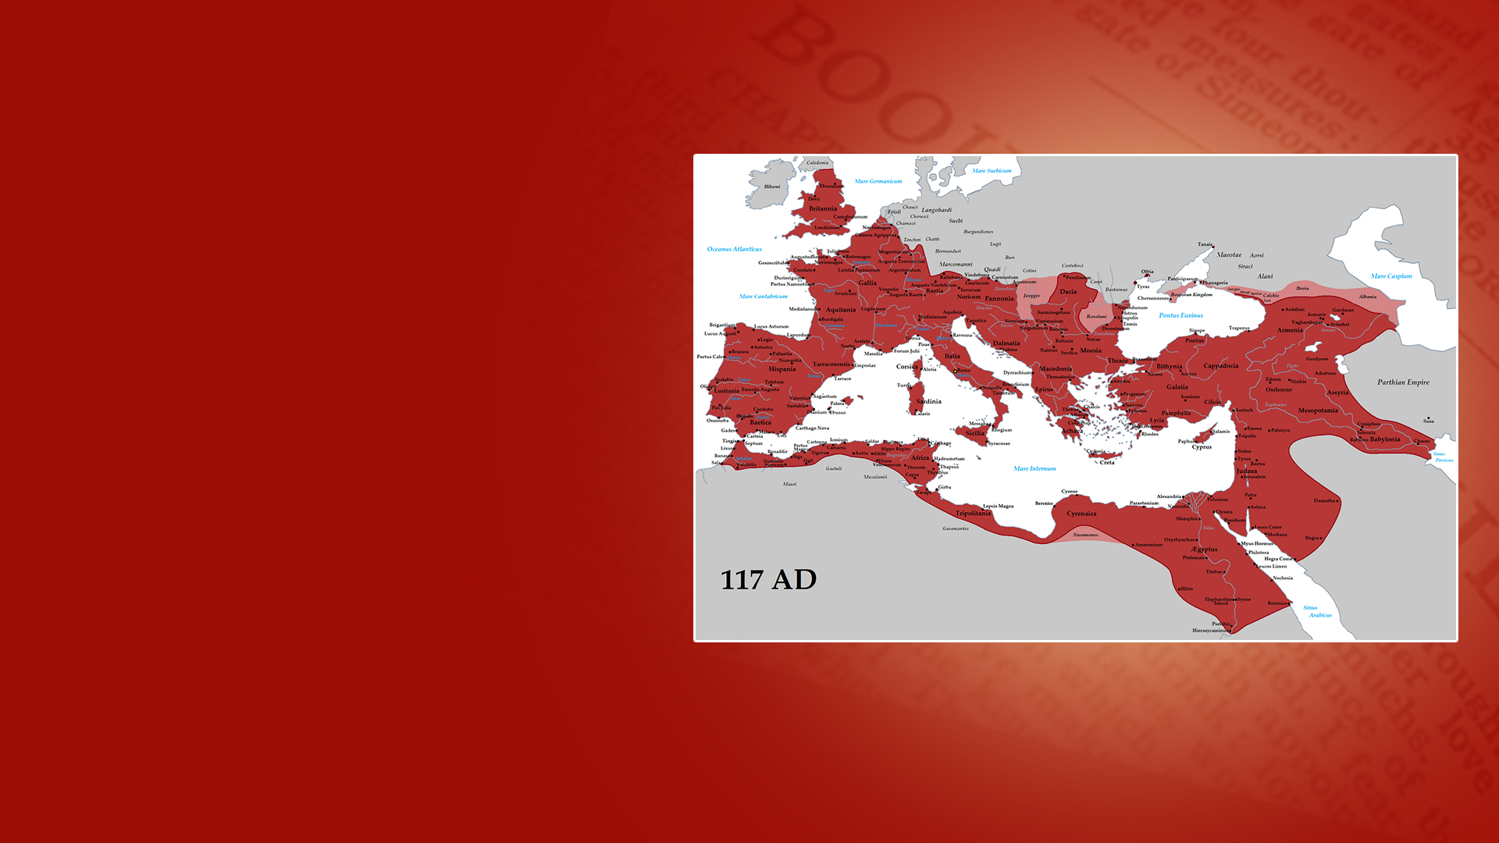
THE ROMAN EMPIRE AND MODERN EUROPE

Slide 29
Daniel 8:5,8,9,11
5 And as I was considering, suddenly a male goat came from the west, across the surface of the whole earth, without touching the ground; and the goat had a notable horn between his eyes.
8 Therefore the male goat grew very great; but when he became strong, the large horn was broken, and in place of it four notable ones came up toward the four winds of heaven.

Slide 30
Daniel 8:5,8,9,11
9 And out of one of them came a little horn which grew exceedingly great toward the south, toward the east, and toward the Glorious Land.
11 He even exalted himself as high as the Prince of the host; and by him the daily sacrifices were taken away, and the place of His sanctuary was cast down.

Slide 31
Daniel 8:19-25
19 And he said, "Look, I am making known to you what shall happen in the latter time of the indignation; for at the appointed time the end shall be.
20 The ram which you saw, having the two horns—they are the kings of Media and Persia.

Slide 32
Daniel 8:19-25
21 And the male goat is the kingdom of Greece. The large horn that is between its eyes is the first king.
22 As for the broken horn and the four that stood up in its place, four kingdoms shall arise out of that nation, but not with its power.

Slide 33
Daniel 8:19-25
23 "And in the latter time of their kingdom, When the transgressors have reached their fullness, A king shall arise, Having fierce features, Who understands sinister schemes.
24 His power shall be mighty, but not by his own power; He shall destroy fearfully, And shall prosper and thrive; He shall destroy the mighty, and also the holy people.

Slide 34
Daniel 8:19-25
25 "Through his cunning He shall cause deceit to prosper under his rule; And he shall exalt himself in his heart. He shall destroy many in their prosperity. He shall even rise against the Prince of princes; But he shall be broken without human means.

Slide 35
THE GREEK EMPIRE

Slide 36
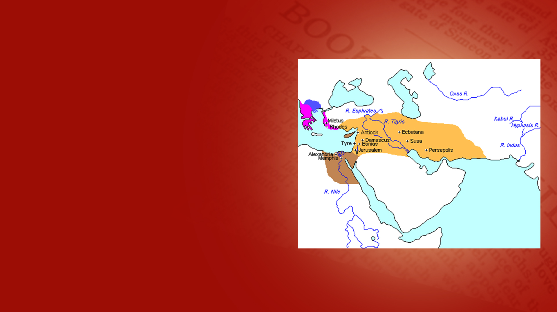
FOUR KINGDOMS AFTER THE DEATH OF ALEXANDER THE GREAT

Slide 37
WHO IS THE FALSE PROPHET?

Slide 38
WHAT WILL THE ANTICHRIST AND FALSE PROPHET DO?
GLOBAL LEADERSHIP INFLUENCE
GLOBAL RELIGIOUS SYSTEM
GLOBAL CURRENCY SYSTEM

Slide 39
GLOBAL LEADERSHIP
INFLUENCE

Slide 40
GLOBAL RELIGIOUS SYSTEM
THE IMAGE OF THE BEAST

Slide 41
GLOBAL FINANCIAL SYSTEM
THE MARK OF THE BEAST

Slide 42
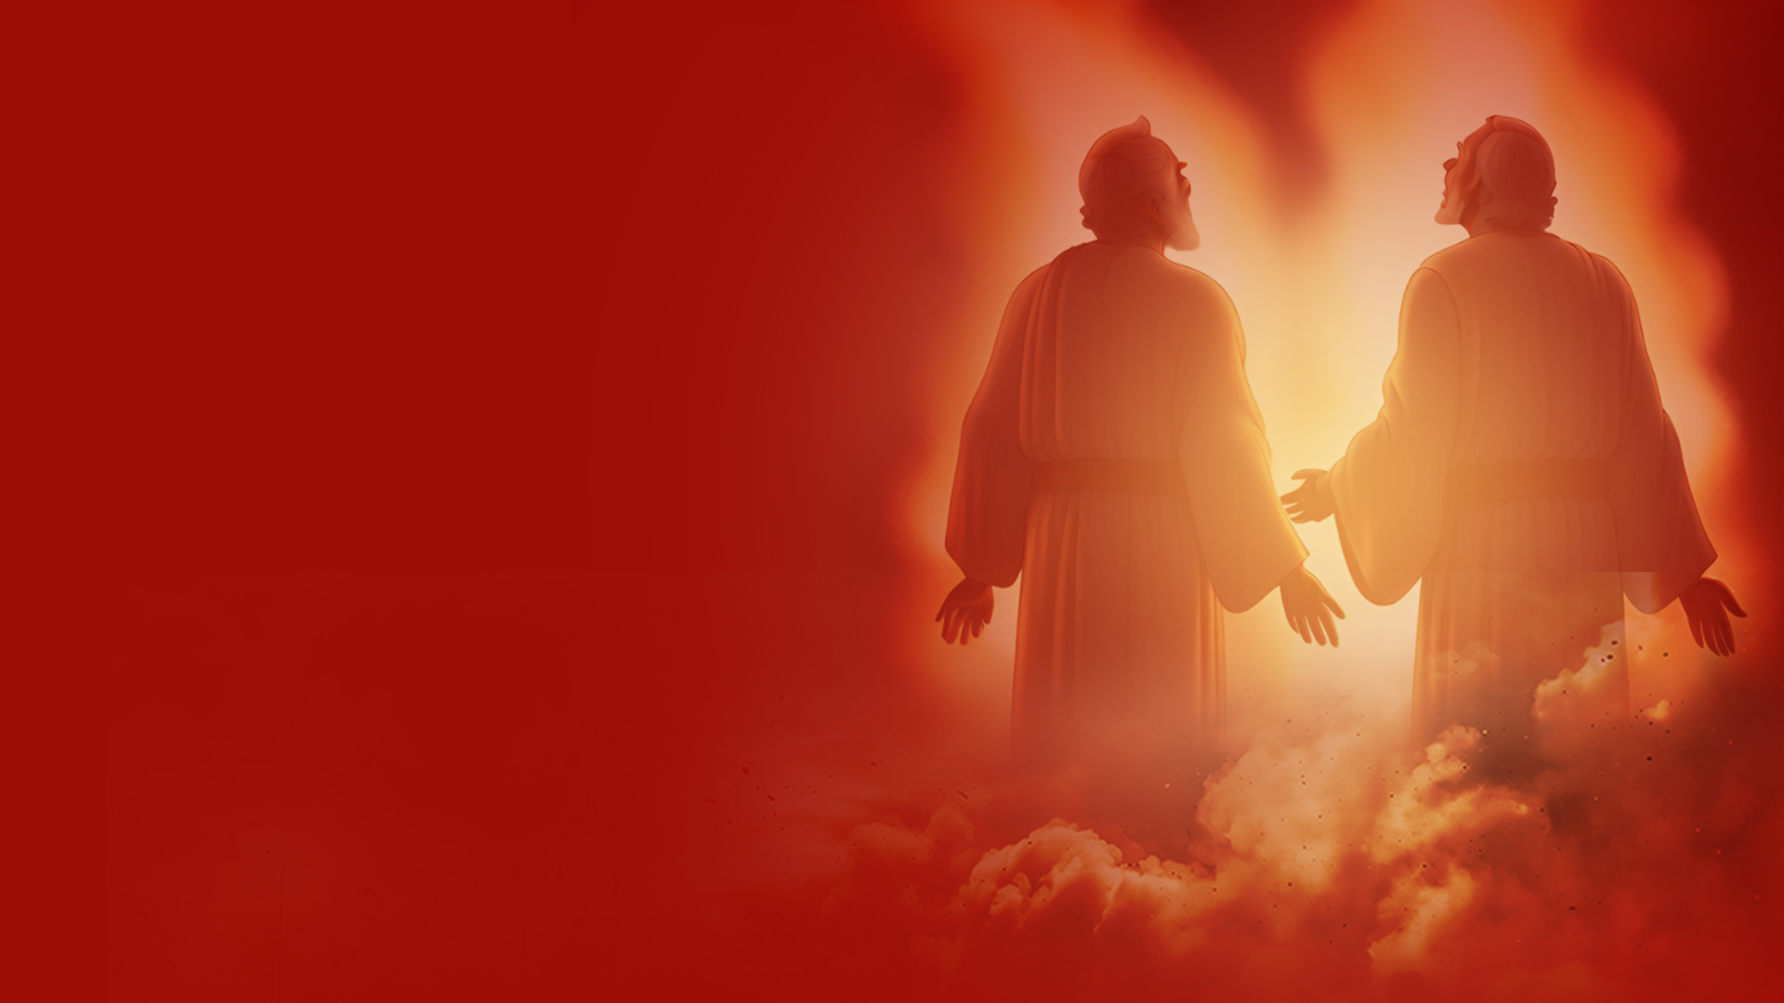
THE TWO WITNESSES

Slide 43
Revelation 11:7-11
7 When they finish their testimony, the beast that ascends out of the bottomless pit will make war against them, overcome them, and kill them.
8 And their dead bodies will lie in the street of the great city which spiritually is called Sodom and Egypt, where also our Lord was crucified.

Slide 44
Revelation 11:7-11
9 Then those from the peoples, tribes, tongues, and nations will see their dead bodies three-and-a-half days, and not allow their dead bodies to be put into graves.
10 And those who dwell on the earth will rejoice over them, make merry, and send gifts to one another, because these two prophets tormented those who dwell on the earth.

Slide 45
Revelation 11:7-11
11 Now after the three-and-a-half days the breath of life from God entered them, and they stood on their feet, and great fear fell on those who saw them.

Slide 46
THE CRASH OF THE GLOBAL RELIGIOUS AND GLOBAL FINANCIAL SYSTEMS
Revelation 17 & 18

Slide 47
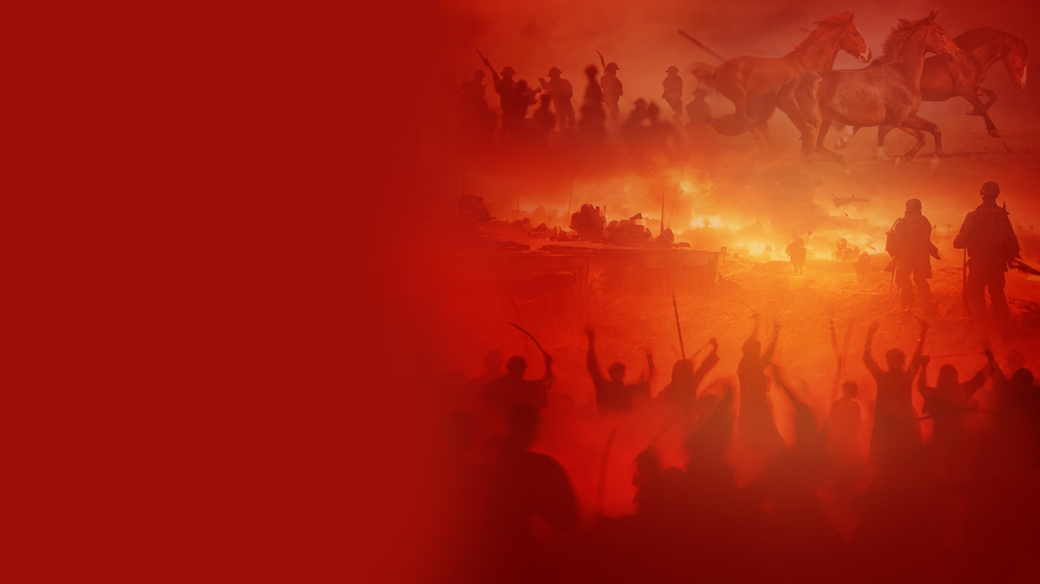
THE ANTICHRIST AND FALSE PROPHET MEET THEIR END AT THE BATTLE OF ARMAGEDDON

Slide 48
Revelation 19:19,20
19 And I saw the beast, the kings of the earth, and their armies, gathered together to make war against Him who sat on the horse and against His army.
20 Then the beast was captured, and with him the false prophet who worked signs in his presence, by which he deceived those who received the mark of the beast and those who worshiped his image. These two were cast alive into the lake of fire burning with brimstone.

Slide 49
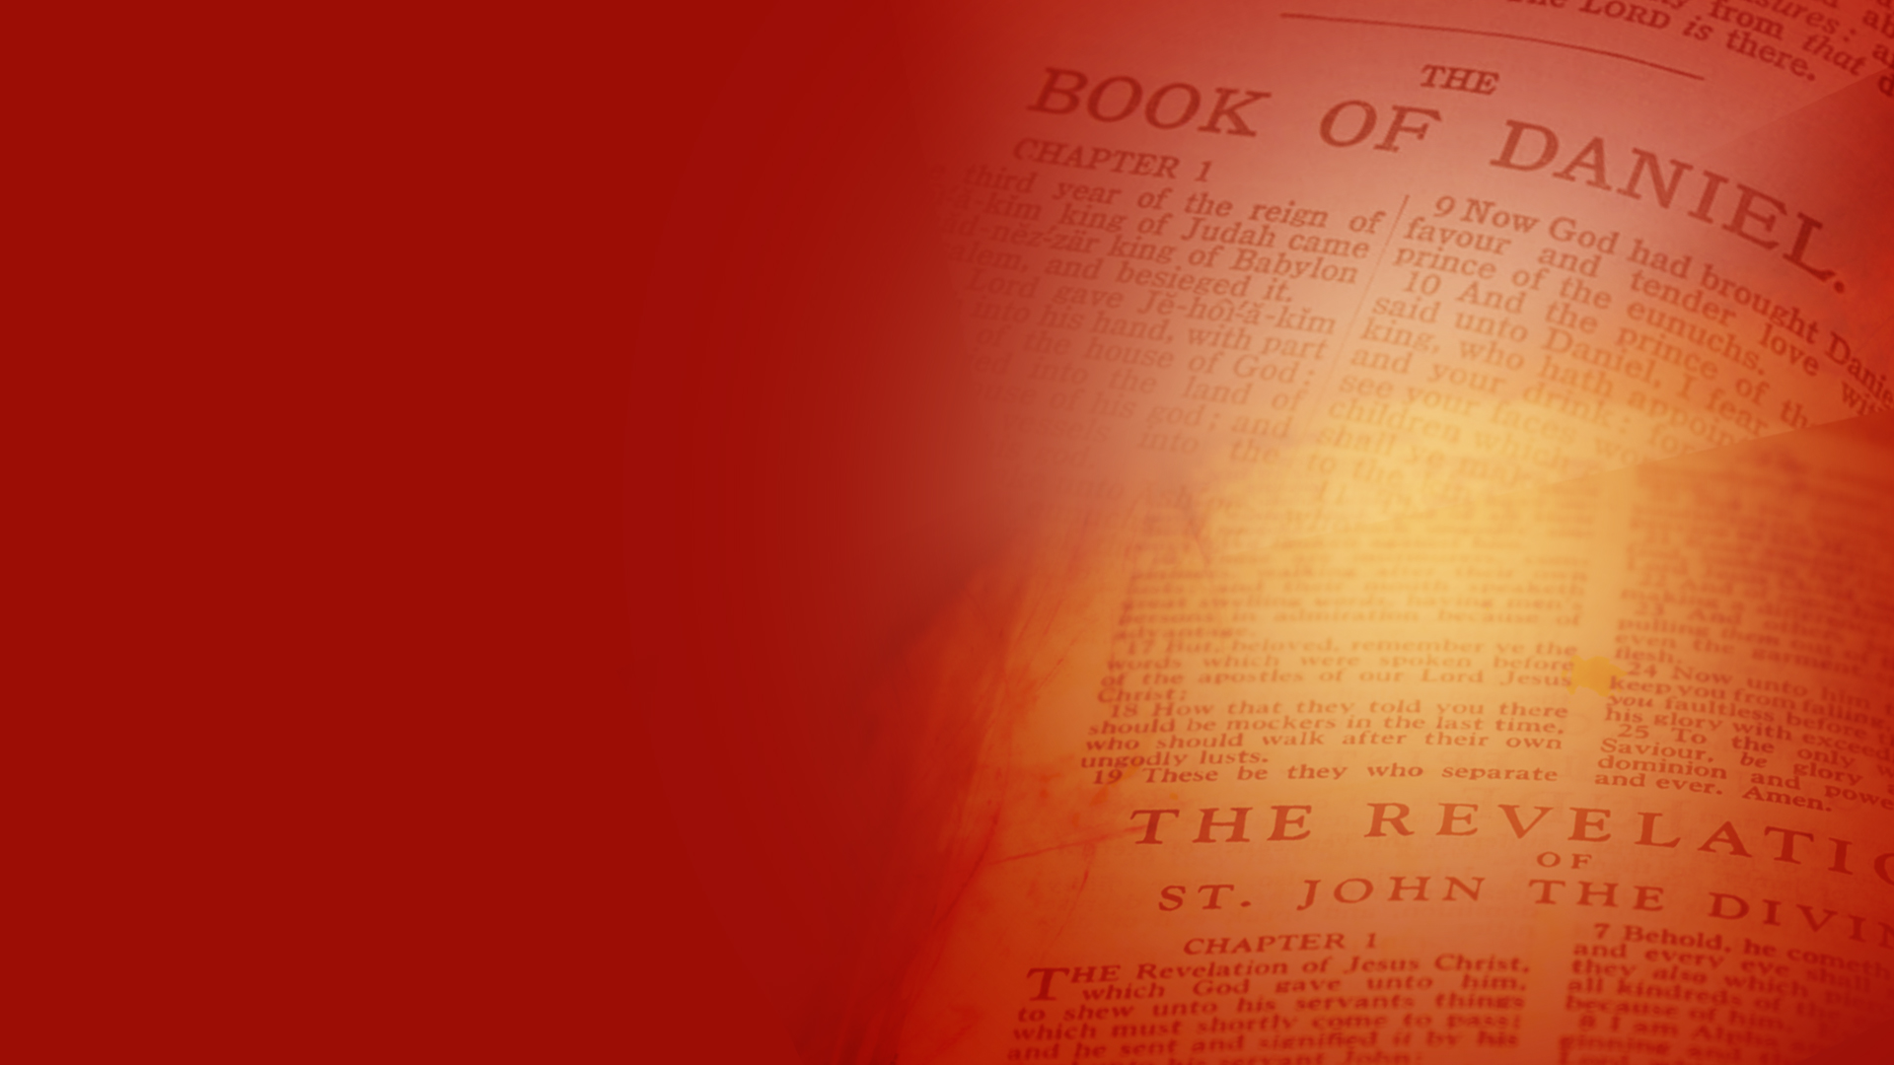
GOD HAS SPOKEN

Slide 50
FORETOLD OVER 2000 YEARS AGO, READY TO BE FULFILLED IN OUR DAY

