Slide 2
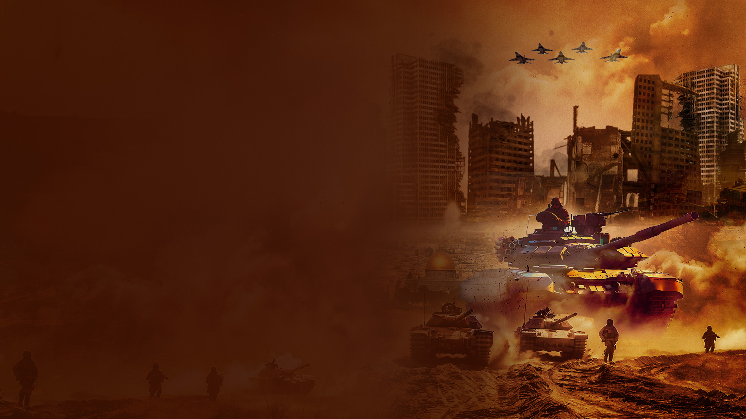
THE LAND

Slide 3
Genesis 15:18
On the same day the LORD made a covenant with Abram, saying: "To your descendants I have given this land, from the river of Egypt to the great river, the River Euphrates—

Slide 4
Deuteronomy 11:24
Every place on which the sole of your foot treads shall be yours: from the wilderness and Lebanon, from the river, the River Euphrates, even to the Western Sea, shall be your territory.

Slide 5
Joshua 1:4
From the wilderness and this Lebanon as far as the great river, the River Euphrates, all the land of the Hittites, and to the Great Sea toward the going down of the sun, shall be your territory.

Slide 6
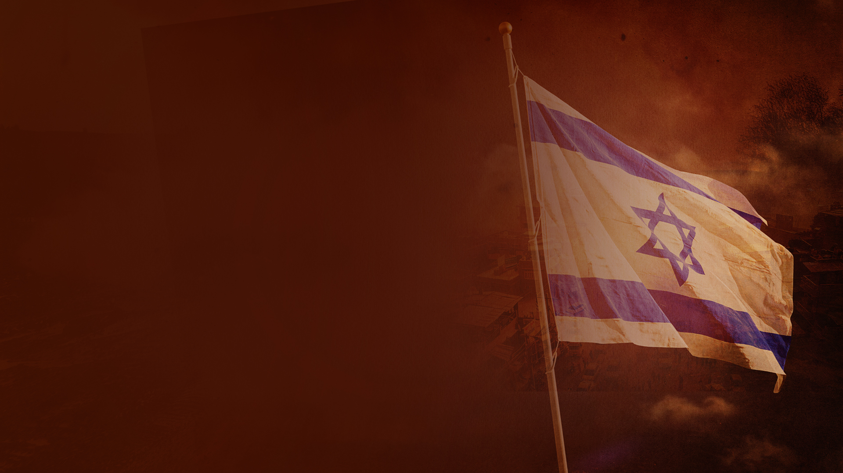
ISRAEL AS A NATION — FULFILLMENT OF
BIBLE PROPHECY

Slide 7
Isaiah 11:12
He will set up a banner for the nations, And will assemble the outcasts of Israel, And gather together the dispersed of Judah From the four corners of the earth.

Slide 8
Isaiah 66:8
Who has heard such a thing? Who has seen such things? Shall the earth be made to give birth in one day? Or shall a nation be born at once? For as soon as Zion was in labor, She gave birth to her children.

Slide 9
Ezekiel 36:10-12,24
10 I will multiply men upon you, all the house of Israel, all of it; and the cities shall be inhabited and the ruins rebuilt.
11 I will multiply upon you man and beast; and they shall increase and bear young; I will make you inhabited as in former times, and do better for you than at your beginnings. Then you shall know that I am the LORD.

Slide 10
Ezekiel 36:10-12,24
12 Yes, I will cause men to walk on you, My people Israel; they shall take possession of you, and you shall be their inheritance; no more shall you bereave them of children."
24 For I will take you from among the nations, gather you out of all countries, and bring you into your own land.

Slide 11
Ezekiel 37:21
"Then say to them, 'Thus says the Lord GOD: "Surely I will take the children of Israel from among the nations, wherever they have gone, and will gather them from every side and bring them into their own land;

Slide 12
THE ISRAEL-PALESTINIAN CONFLICT

Slide 13
Israel and its Neighbors

Slide 14
West Bank and Gaza

Slide 15
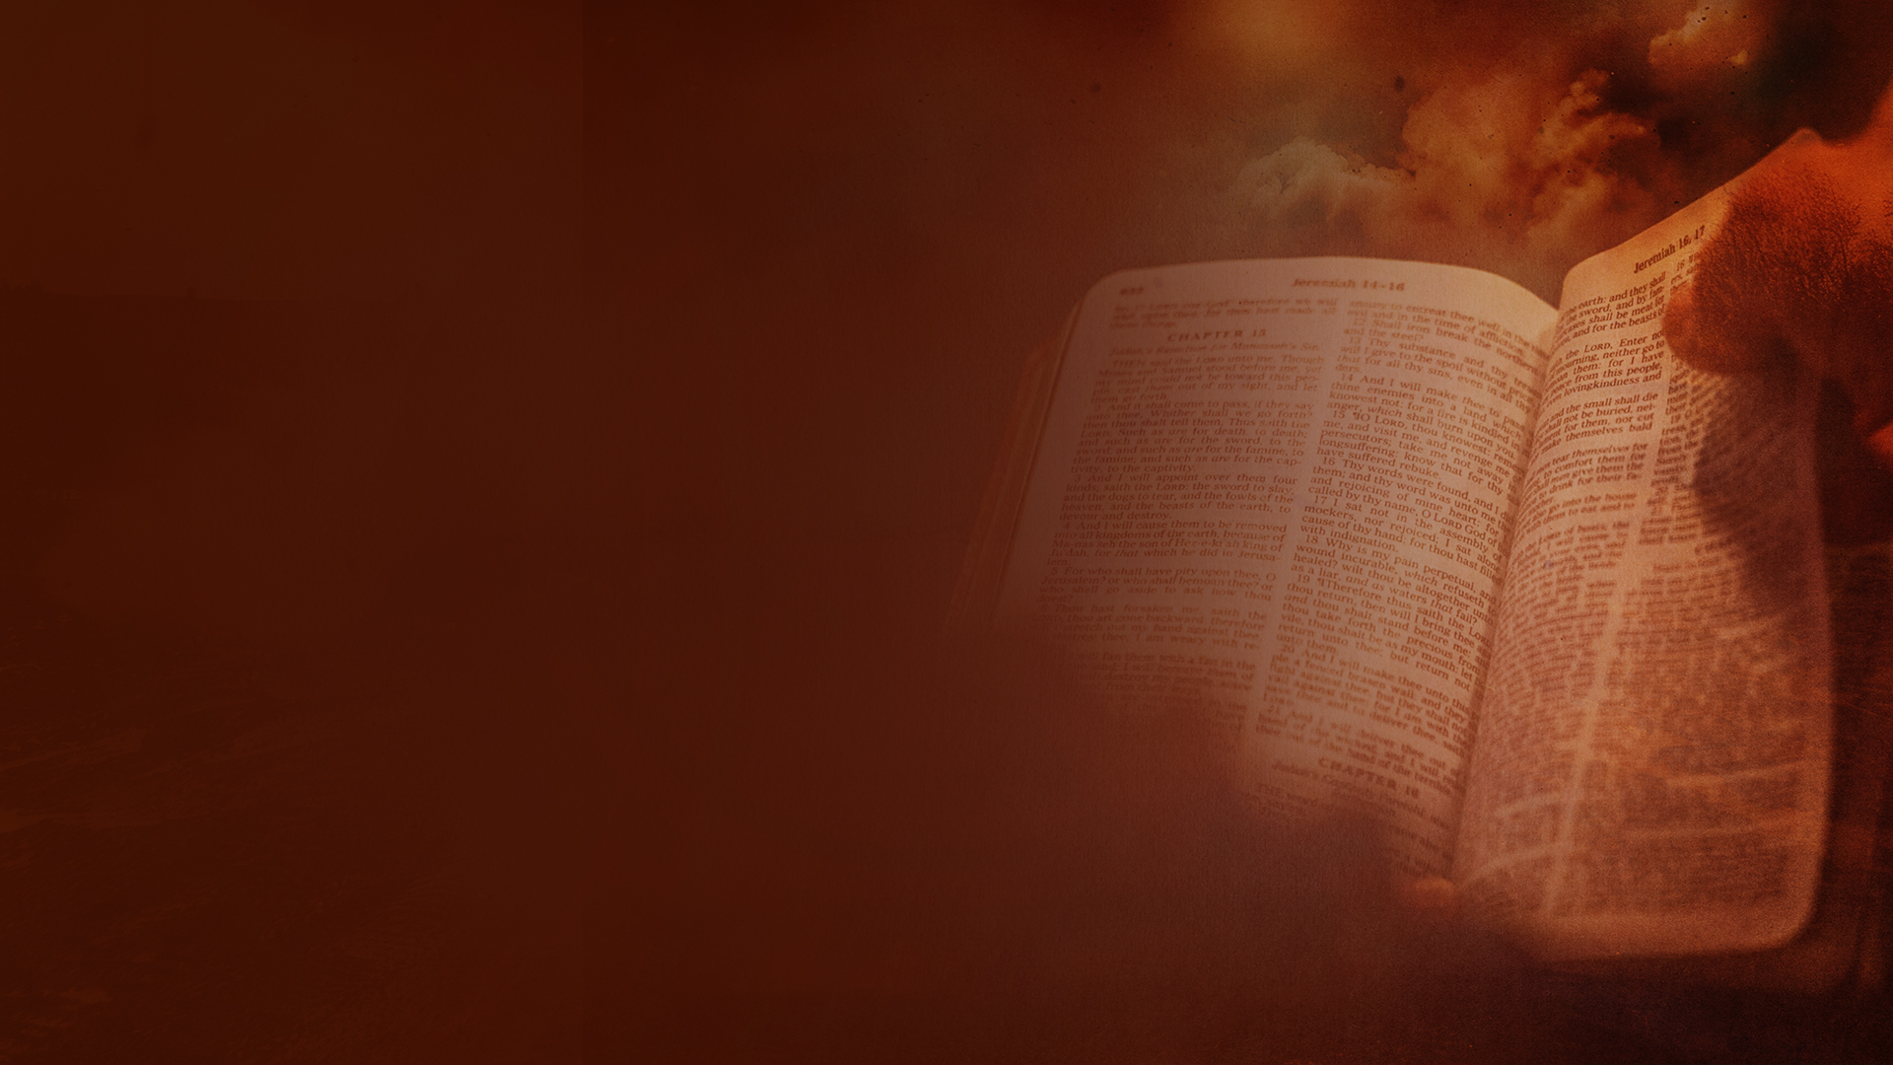
THE MIDDLE EAST CONFLICT — WHAT THE BIBLE SAYS

Slide 16
Joel 3:1,2
1 "For behold, in those days and at that time, When I bring back the captives of Judah and Jerusalem,
2 I will also gather all nations, And bring them down to the Valley of Jehoshaphat; And I will enter into judgment with them there On account of My people, My heritage Israel, Whom they have scattered among the nations; They have also divided up My land.

Slide 17
Joel 3:9-12
9 Proclaim this among the nations: "Prepare for war! Wake up the mighty men, Let all the men of war draw near, Let them come up.
10 Beat your plowshares into swords And your pruning hooks into spears; Let the weak say, 'I am strong.' "

Slide 18
Joel 3:9-12
11 Assemble and come, all you nations, And gather together all around. Cause Your mighty ones to go down there, O LORD.
12 "Let the nations be wakened, and come up to the Valley of Jehoshaphat; For there I will sit to judge all the surrounding nations.

Slide 19
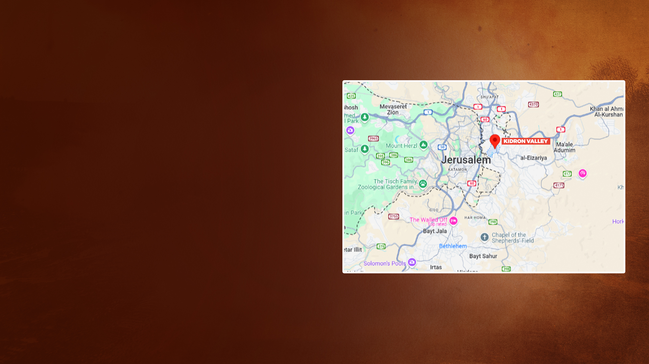
Valley of Jehoshaphat
(Joel 3:12)

Slide 20
Revelation 16:12-16
12 Then the sixth angel poured out his bowl on the great river Euphrates, and its water was dried up, so that the way of the kings from the east might be prepared.
13 And I saw three unclean spirits like frogs coming out of the mouth of the dragon, out of the mouth of the beast, and out of the mouth of the false prophet.

Slide 21
Revelation 16:12-16
14 For they are spirits of demons, performing signs, which go out to the kings of the earth and of the whole world, to gather them to the battle of that great day of God Almighty.
15 "Behold, I am coming as a thief. Blessed is he who watches, and keeps his garments, lest he walk naked and they see his shame."

Slide 22
Revelation 16:12-16
16 And they gathered them together to the place called in Hebrew, Armageddon.

Slide 23
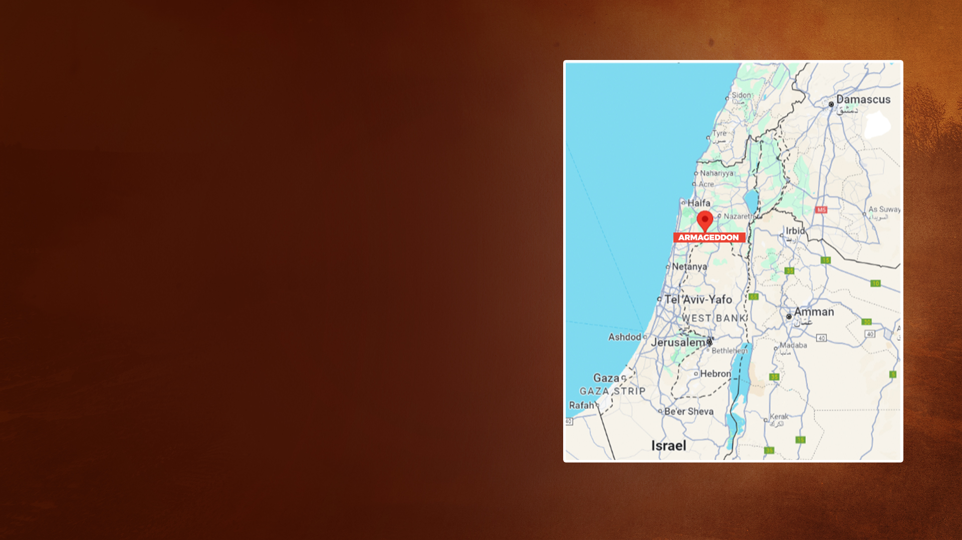
Armageddon
(Revelation 16:16)

Slide 24
THE CITY OF JERUSALEM

Slide 25
Zechariah 12:1-3
1 The burden of the word of the LORD against Israel. Thus says the LORD, who stretches out the heavens, lays the foundation of the earth, and forms the spirit of man within him:
2 "Behold, I will make Jerusalem a cup of drunkenness to all the surrounding peoples, when they lay siege against Judah and Jerusalem.

Slide 26
Zechariah 12:1-3
3 And it shall happen in that day that I will make Jerusalem a very heavy stone for all peoples; all who would heave it away will surely be cut in pieces, though all nations of the earth are gathered against it.

Slide 27
THE TEMPLE

Slide 28
The Temple Mount

Slide 29
Temple Mount — The Dome of the Rock

Slide 30
The Western Wall Plaza Adjoining the Temple Mount

Slide 31
Prayer at the
Western Wall

Slide 32
THE THIRD TEMPLE AND THE MILLENNIAL TEMPLE

Slide 33
THE ANTICHRIST AND THE DESECRATION OF THE THIRD TEMPLE

Slide 34
Daniel 8:11,12
11 He even exalted himself as high as the Prince of the host; and by him the daily sacrifices were taken away, and the place of His sanctuary was cast down.
12 Because of transgression, an army was given over to the horn to oppose the daily sacrifices; and he cast truth down to the ground. He did all this and prospered.

Slide 35
Daniel 9:27
Then he shall confirm a covenant with many for one week; But in the middle of the week He shall bring an end to sacrifice and offering. And on the wing of abominations shall be one who makes desolate, Even until the consummation, which is determined, Is poured out on the desolate."

Slide 36
Matthew 24:15,21
15 "Therefore when you see the 'ABOMINATION OF DESOLATION,' spoken of by Daniel the prophet, standing in the holy place" (whoever reads, let him understand),
21 For then there will be great tribulation, such as has not been since the beginning of the world until this time, no, nor ever shall be.

Slide 37
2 Thessalonians 2:1-8
1 Now, brethren, concerning the coming of our Lord Jesus Christ and our gathering together to Him, we ask you,
2 not to be soon shaken in mind or troubled, either by spirit or by word or by letter, as if from us, as though the day of Christ had come.

Slide 38
2 Thessalonians 2:1-8
3 Let no one deceive you by any means; for that Day will not come unless the falling away comes first, and the man of sin is revealed, the son of perdition,
4 who opposes and exalts himself above all that is called God or that is worshiped, so that he sits as God in the temple of God, showing himself that he is God.

Slide 39
2 Thessalonians 2:1-8
5 Do you not remember that when I was still with you I told you these things?
6 And now you know what is restraining, that he may be revealed in his own time.

Slide 40
2 Thessalonians 2:1-8
7 For the mystery of lawlessness is already at work; only He who now restrains will do so until He is taken out of the way.
8 And then the lawless one will be revealed, whom the Lord will consume with the breath of His mouth and destroy with the brightness of His coming.

Slide 41
Revelation 11:1,2
1 Then I was given a reed like a measuring rod. And the angel stood, saying, "Rise and measure the temple of God, the altar, and those who worship there.
2 But leave out the court which is outside the temple, and do not measure it, for it has been given to the Gentiles. And they will tread the holy city underfoot for forty-two months.

Slide 42
Revelation 13:5,6
5 And he was given a mouth speaking great things and blasphemies, and he was given authority to continue for forty-two months.
6 Then he opened his mouth in blasphemy against God, to blaspheme His name, His tabernacle, and those who dwell in heaven.

Slide 43
LOOK AT THE NATIONS

Slide 44
THE TIME OF THE END
IS NEAR

