Slide 2
ACTS CHAPTER 27
(59-60 AD)

Slide 3
Paul's Voyage to Rome
(59-60 AD)

Slide 4
Late August to Early September AD 59: Departure from
Caesarea

Slide 5
September to
November AD 59: Encounter with the
Storm and Shipwreck
in Malta

Slide 6
December to February
AD 59-60: Paul and Companions Spend
Winter in Malta

Slide 7
March to Early
April AD 60:
Arrival in Rome

Slide 8
Paul’s Conduct During a Tumultuous Voyage

Slide 9
“Men, I Perceive that this voyage will end with disaster…” (Acts 27:10)

Slide 10
God to Whom I Belong and Whom I Serve (Acts 27:21-26)

Slide 11
Shipwrecked on Malta
(Acts 27:27-44)

Slide 12
September to
November AD 59: Encounter with the
Storm and Shipwreck
in Malta

Slide 13
When Everybody Is Down You Cheer Them Up (Acts 27:35,36)

Slide 14
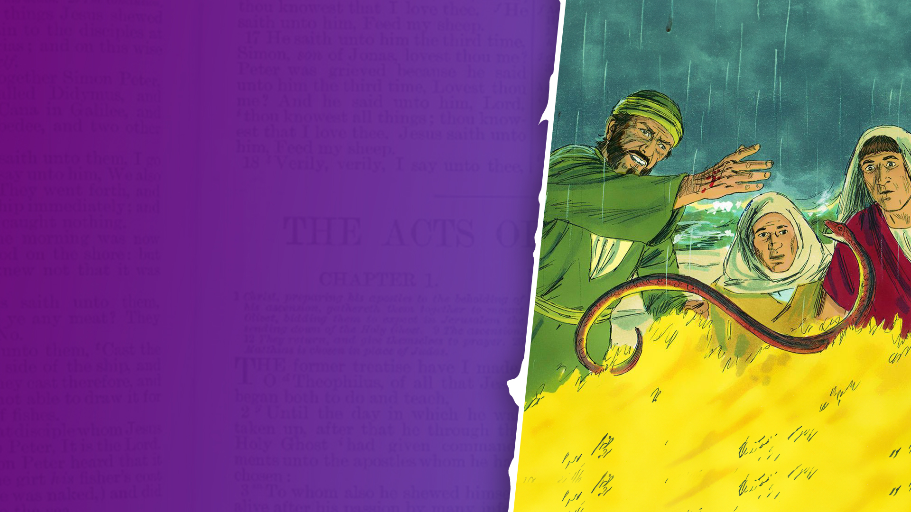
ACTS CHAPTER 28
(60-62 AD)

Slide 15
Miracles in Malta
(Acts 28:1-10)

Slide 16
December to February
AD 59-60: Paul and Companions Spend
Winter in Malta

Slide 17
How Do You Conduct Yourself in the Middle of a Storm?

Slide 18
Can You Be Calm in the Middle of a Storm?

Slide 19
Can You Bring the Mind of God in the Middle of a Storm?

Slide 20
Can You Display the Goodness and Glory of God in the Middle of a Storm?

Slide 21
Can You Bring Good Cheer When Everybody Seems Down?

Slide 22
Can You Believe God for Miracles When everything Has Fallen Apart?

Slide 23
Arrival at Rome
(Acts 28:11-15)

Slide 24
March to Early
April AD 60:
Arrival in Rome

Slide 25
First Roman Imprisonment
60-62 AD (Acts 28:16)

Slide 26
Paul's Ministry in Rome
60-62 AD (Acts 28:17-31)

Slide 27
Financial Aid from Philippi

Slide 28
Writing the Prison Epistles: Philippians, Colossians, Ephesians, Philemon (60-62 AD)

Slide 29
Paul May Have Written Hebrews (60-68 AD)

Slide 30
Hebrews 13:23,24
23 Know that our brother Timothy has been set free, with whom I shall see you if he comes shortly.
24 Greet all those who rule over you, and all the saints. Those from Italy greet you.

Slide 31
Visitors During His First Roman Imprisonment

Slide 32
What Happened After
Acts 28?

Slide 33
Paul's Release from First
Roman Imprisonment (62 AD)

Slide 34
Paul's Post-Release
Travels (63-65 AD)

Slide 35
Writing of 1 Timothy and Titus (63-65 AD)

Slide 36
The Reign of Emperor Nero
(54-68 AD)

Slide 37
Peter at Rome

Slide 38
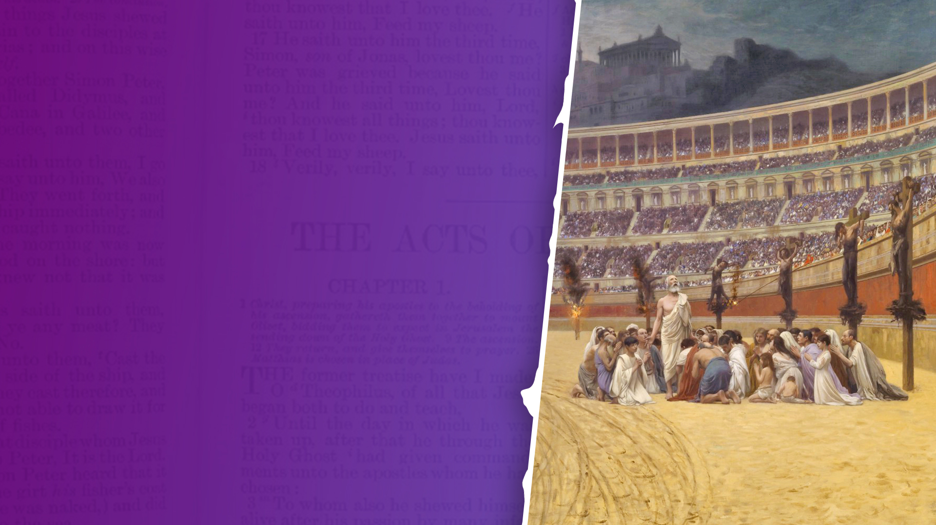
The Great Fire of Rome and Persecution of Christians
(64 AD)

Slide 39
Peter Writes 1 Peter
(62-64 AD)

Slide 40
Death of Simon the Zealot
- A Martyr (65 AD)

Slide 41
Paul's Second Roman Imprisonment
(66-67 AD)

Slide 42
Visitors During Paul's Second Imprisonment (66-67 AD)

Slide 43
Writing of 2 Timothy
(66-67 AD)

Slide 44
Simon Peter Writes 2 Peter
(65-68 AD)

Slide 45
Paul's Death—Beheaded in Rome as a Martyr (68 AD)

Slide 46
Death of Simon Peter—Crucified Upside Down as a Martyr (68 AD)

Slide 47
Jewish Revolts and the Destruction of the
Second Temple (66-70 AD)

Slide 48
The Writing of the Gospels and Acts (65-85 AD)
Gospel of Mark: 65-70 AD
Gospel of Matthew: 70-80 AD
Gospel of Luke: 70-85 AD
Acts of the Apostles: 70-85 AD

Slide 49
The Writings of John and Jude (85-96 AD)
1 John: 85-95 AD
2 John: 85-95 AD
3 John: 85-95 AD
Jude: 60-80 AD
Gospel of John: 90-100 AD
Revelation: 95-96 AD

