Slide 2
Reflections and Lessons from the Fallout Between Barnabas and Paul

Slide 3
ACTS CHAPTER 17
(49-52 AD)

Slide 4
Amphipolis and Apollonia, Greece (Acts 17:1-3)

Slide 5
Via Egnatia

Slide 6
Thessalonica, Greece
(Acts 17:1-9)

Slide 7
Financial Help from Philippi

Slide 8
Berea, Greece
(Acts 17:10-14)

Slide 9
Athens, Greece
(Acts 17:15-34)

Slide 10
Mars’ Hill (Aeropagus)

Slide 11
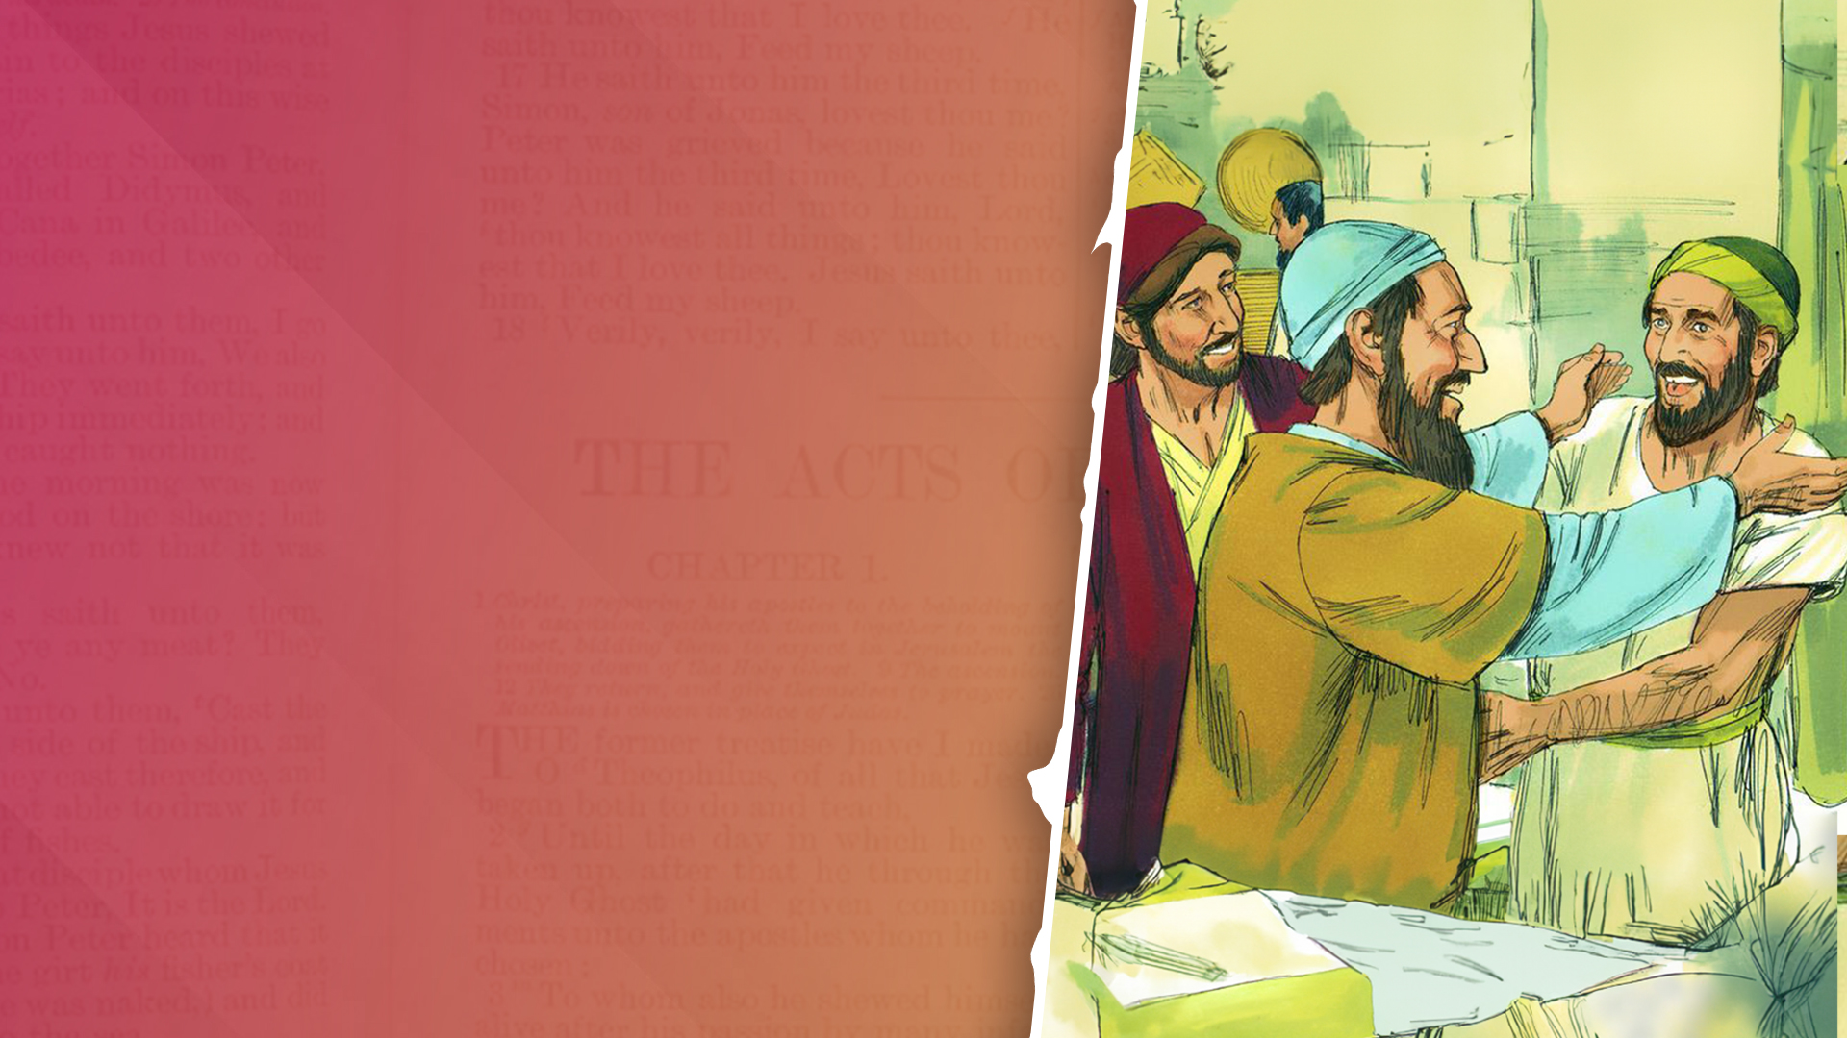
ACTS CHAPTER 18
(49-52 AD)

Slide 12
Corinth, Greece
(Acts 18:1-18)

Slide 13
Apostle, Church Planter, Tentmaker (Acts 18:3)

Slide 14
Financial Help from Philippi

Slide 15
From Corinth Paul Writes to the Thessalonians

Slide 16
The Bema Seat in Corinth, Greece

Slide 17
Cenchrea, Greece
(Acts 18:18)

Slide 18
Ephesus, Turkey
(Acts 18:19-21)

Slide 19
The Site of the Temple of Artemis in Ephesus

Slide 20
Brief Time at Jerusalem and Antioch (Acts 18:22,23)

Slide 21
Start of Paul’s Third Missionary Journey (Acts 18:23)

Slide 22
Apollos from Alexandria
(Acts 18:24-28)

Slide 23
Review: Paul’s Second Missionary Journey

Slide 24
1. Paul traveled through main highways and sea routes.

Slide 25
2. Paul traveled and spent time in large cities.

Slide 26
3. Paul began in synagogues.

Slide 27
4. Paul engaged people in the marketplaces (Agora).

Slide 28
5. Paul reasoned and demonstrated the power of the Gospel.

Slide 29
6. Paul and his team established local churches and made the effort to nurture them.

