Slide 2
ACTS CHAPTER 13
(46-48 AD)

Slide 3
The Church in Antioch

Slide 4
Cyprus

Slide 5
Perga

Slide 6
Antioch in Pisidia

Slide 7
We turn to the Gentiles (vs 46)

Slide 8
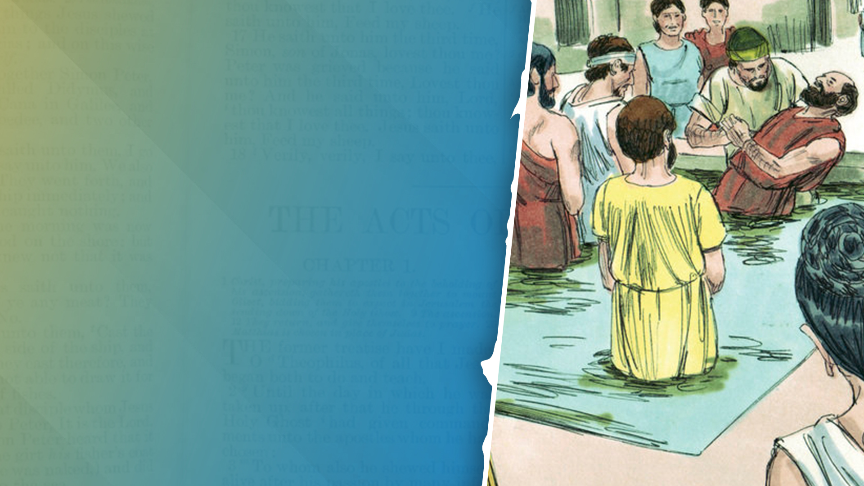
As many as had been appointed to eternal life (vs 48)

Slide 9
Iconium

Slide 10
ACTS CHAPTER 14
(46-48 AD)

Slide 11
Iconium

Slide 12
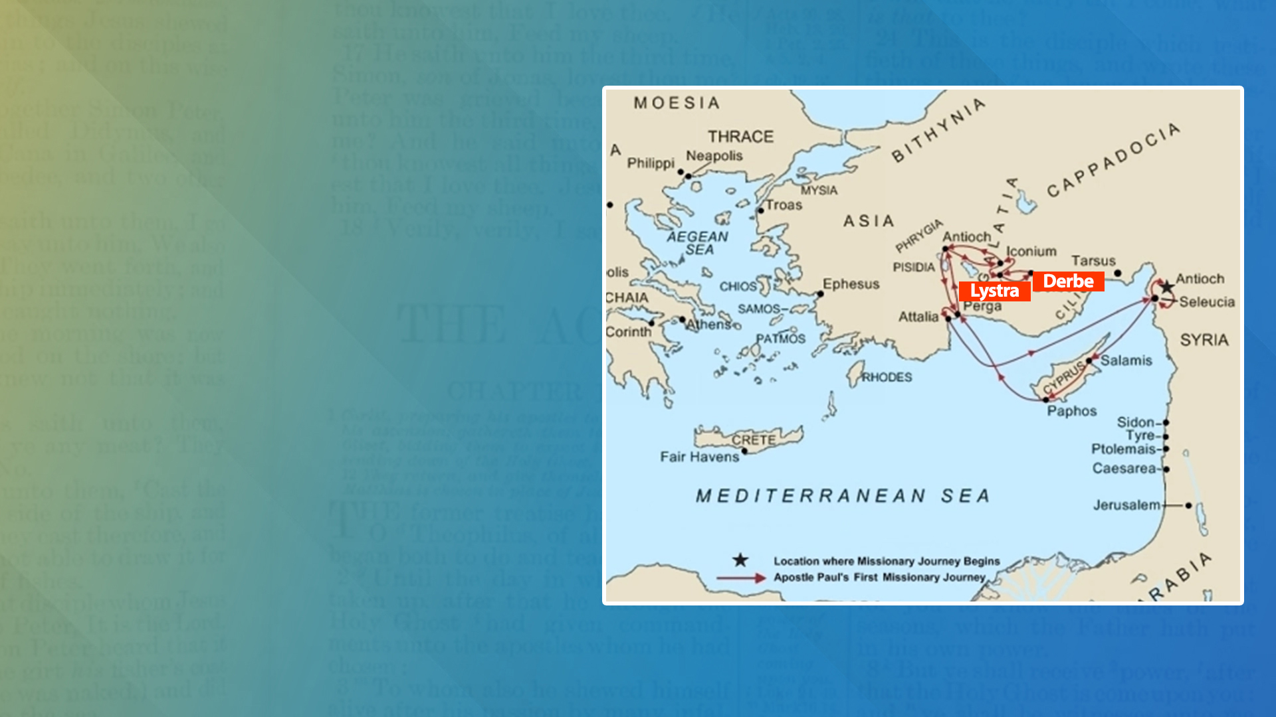
Lystra and Derbe

Slide 13
Lame man at Lystra – had faith to be healed (vs 9)

Slide 14
The apostles Barnabas and Paul (vs 14)

Slide 15
Paul’s supernatural healing (vs 19,20)

Slide 16
Appointed elders in every church (vs 23)

Slide 17
Reported to their home church (vs 26-28)

