Slide 2
ACTS CHAPTER 11

Slide 3
Peter: "Who Was I to Try and Stop God" (Acts 11:1-18)

Slide 4
The Church in Antioch
(Acts 11:19-26)

Slide 6
A Prophetic Word and Material Help (Acts 11:27-30)

Slide 7
ACTS CHAPTER 12

Slide 8
James - The First Apostle to Be Martyred (Acts 12:1-5)

Slide 9
Peter's Second Angelic
Jailbreak (Acts 12:6-19)

Slide 10
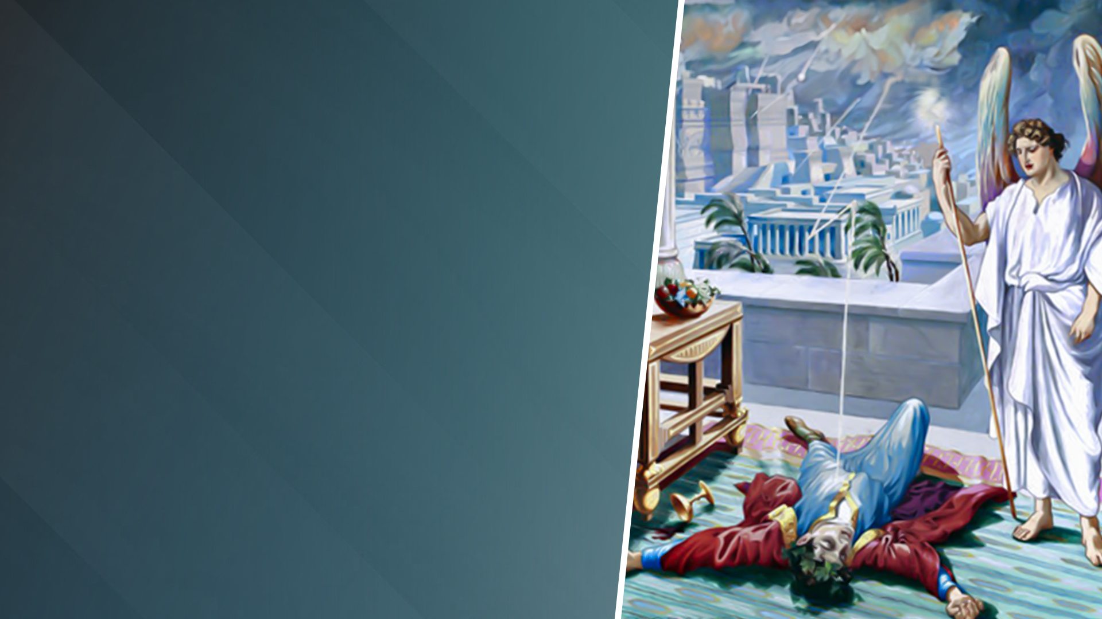
Herod's End - When a Man Exalts Himself as God
(Acts 12:20-23)

