Slide 2
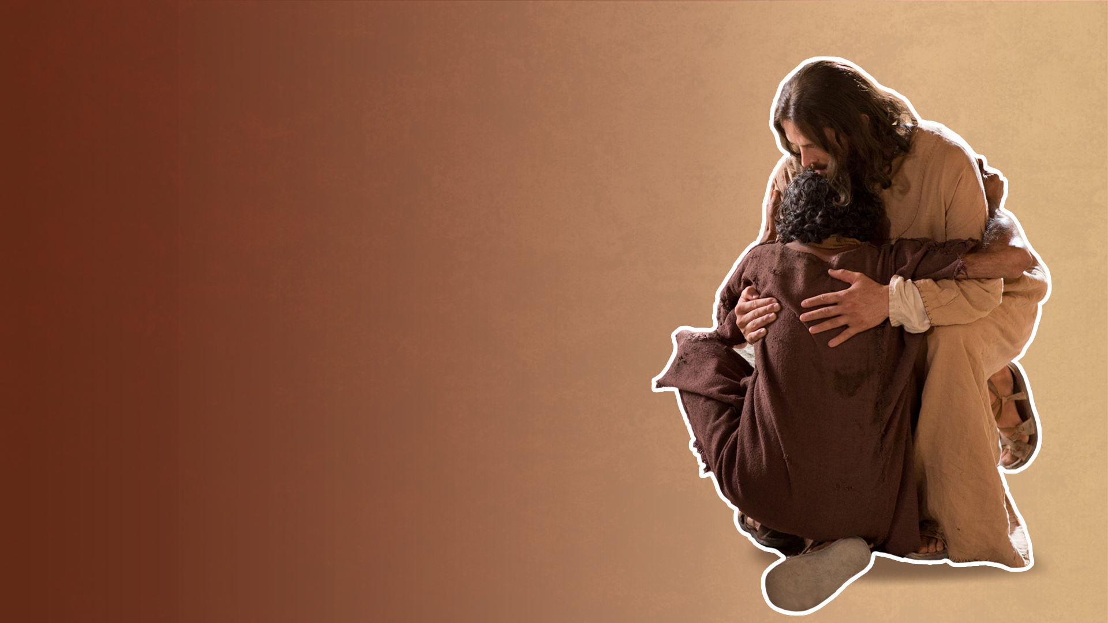
Wholeness includes healing of the total person - spirit, soul and body.

Slide 3
JESUS HEALS THE
BROKEN-HEARTED

Slide 4
Luke 4:18,19
18 “The Spirit of the Lord is upon me, Because He has anointed me To preach the gospel to the poor; He has sent me to heal the brokenhearted, To proclaim liberty to the captives And recovery of sight to the blind, To set at liberty those who are oppressed;
19 To proclaim the acceptable year of the Lord.”

Slide 5
JESUS DIED TO MAKE US WHOLE

Slide 6
Isaiah 53:5
But He was wounded for our transgressions, He was bruised for our iniquities; The chastisement for our peace (shalom = wholeness) was upon Him, And by His stripes we are healed

Slide 7
JESUS IS LORD OVER DEATH

Slide 8
He raised the dead.

Slide 9
Jairus’ daughter
(Matthew 9:18; Mark 5:22; Luke 8:40)

Slide 10
Widow’s son (Luke 7:11-17)

Slide 11
Lazarus (John 11:1-44)

Slide 12
He conquered death, hell, and the grave.

Slide 13
He still gives life to the dead.

Slide 14
He still resurrects broken lives, wounded lives, shattered dreams, and the dead.

