Slide 2
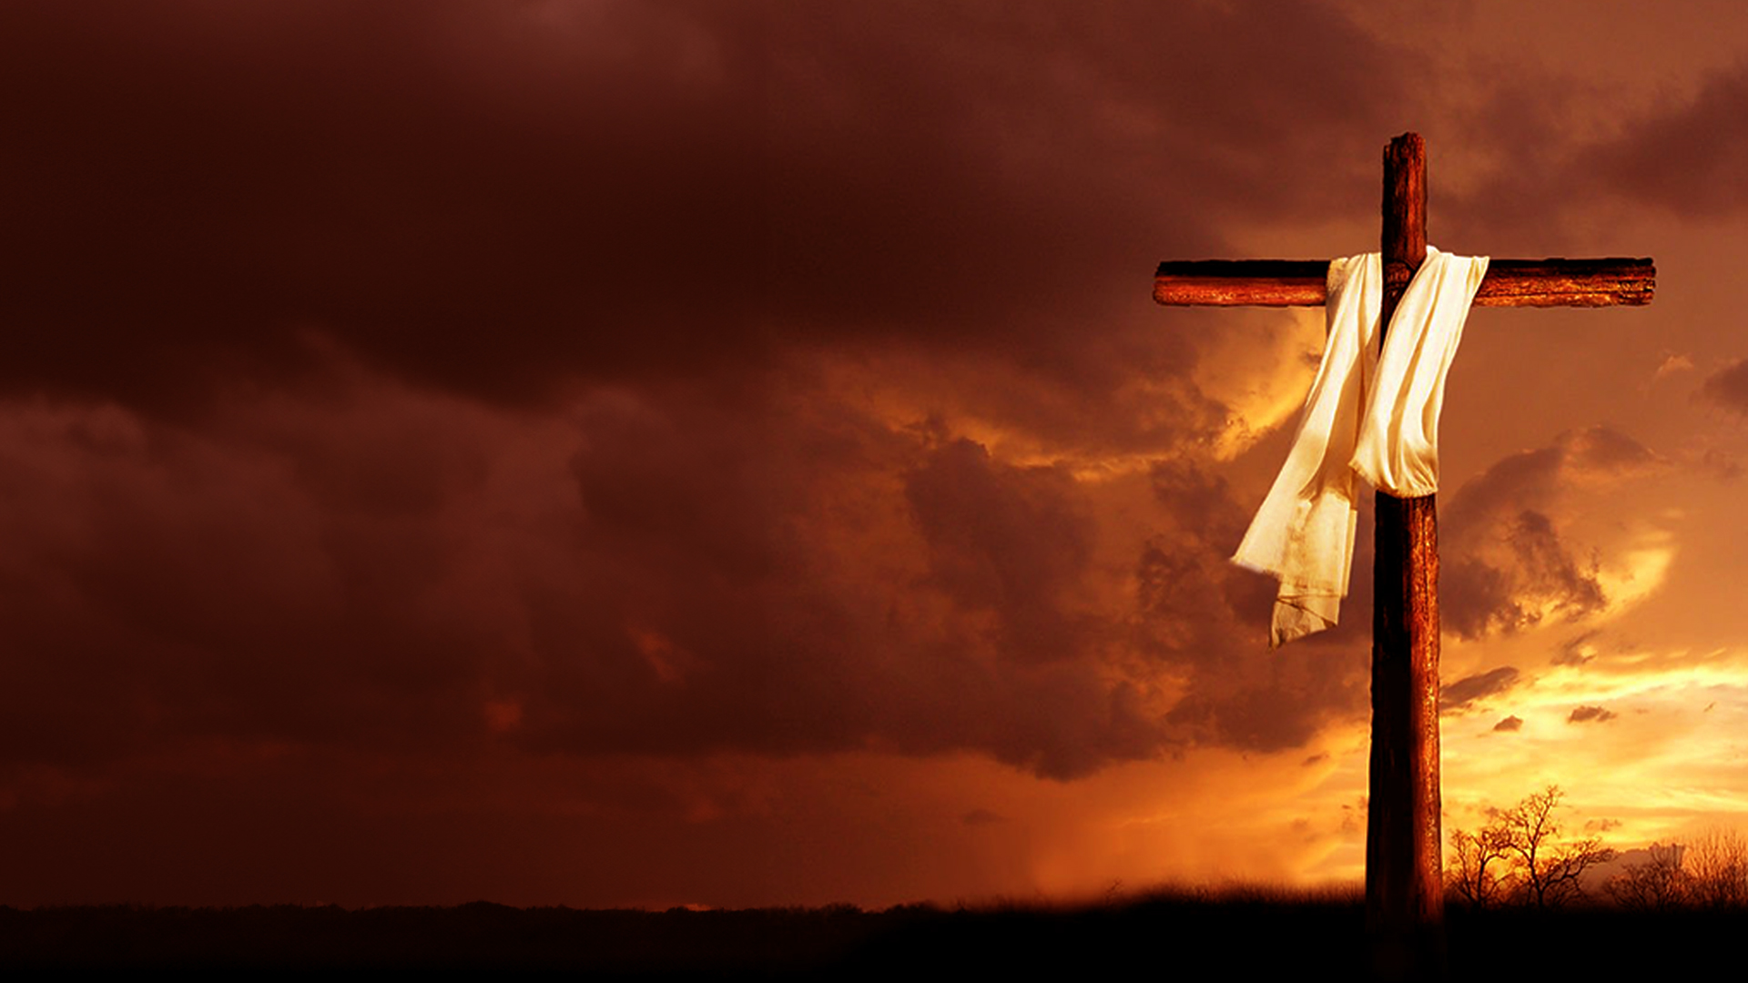
WHY IS BLOOD NECESSARY?

Slide 3
Romans 6:23
For the wages of sin is death, but the gift of God is eternal life in Christ Jesus our Lord.

Slide 4
THE BLOOD MAKES ATONEMENT FOR THE SOUL

Slide 5
Leviticus 17:11
For the life of the flesh is in the blood, and I have given it to you upon the altar to make atonement for your souls; for it is the blood that makes atonement for the soul.'

Slide 6
THE BLOOD OF BIRDS AND ANIMALS

Slide 7
Hebrews 10:3,4
3 But in those sacrifices there is a reminder of sins every year.
4 For it is not possible that the blood of bulls and goats could take away sins.

Slide 8
THE BLOOD OF THE SINLESS PERFECT SON OF GOD

Slide 9
Hebrews 9:11,12
11 But Christ came as High Priest of the good things to come, with the greater and more perfect tabernacle not made with hands, that is, not of this creation.
12 Not with the blood of goats and calves, but with His own blood He entered the Most Holy Place once for all, having obtained eternal redemption.

Slide 10
THE BLOOD – THE PRICE PAID IN FULL

Slide 11
THE BLOOD SEALED OUR COMPLETE REDEMPTION

Slide 12
1 Peter 1:18,19
18 knowing that you were not redeemed with corruptible things, like silver or gold, from your aimless conduct received by tradition from your fathers,
19 but with the precious blood of Christ, as of a lamb without blemish and without spot.

Slide 13
THE POWER OF THE BLOOD

Slide 14
WE TESTIFY TO THE BLOOD

Slide 15
Revelation 12:11
And they overcame him by the blood of the Lamb and by the word of their testimony, and they did not love their lives to the death.

Slide 16
TO WALK IN THE POWER OF THE BLOOD OF JESUS, WE BOLDLY PROCLAIM, ANNOUNCE, OR TESTIFY TO WHAT THE BLOOD OF JESUS HAS ALREADY DONE FOR US!

