Slide 2
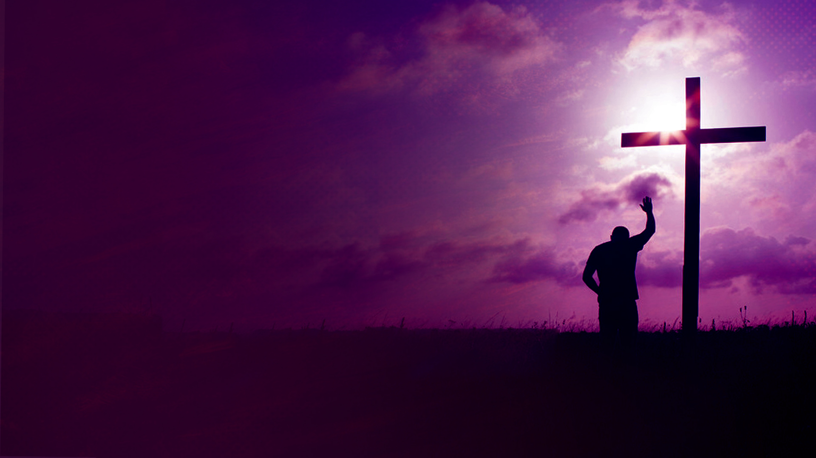
Stewardship is our responsible management and use of the blessings entrusted to us by God.

Slide 3
We are all stewards.

Slide 4
God is the owner of all things.

Slide 5
Genesis 1:1
In the beginning God created the heavens and the earth.

Slide 6
Genesis 1:28
Then God blessed them, and God said to them, "Be fruitful and multiply; fill the earth and subdue it; have dominion over the fish of the sea, over the birds of the air, and over every living thing that moves on the earth."

Slide 7
Our lives in totality belongs to Christ.

Slide 8
PURPOSE OF STEWARDSHIP

Slide 9
1. TO BRING GOD GLORY

Slide 10
Matthew 5:16
Let your light so shine before men, that they may see your good works and glorify your Father in heaven.

Slide 11
2. TO SERVE OTHERS AND ADVANCE THE KINGDOM OF GOD

Slide 12
1 Peter 4:10
As each one has received a gift, minister it to one another, as good stewards of the manifold grace of God.

Slide 13
1 Corinthians 3:9,10
9 For we are God's fellow workers; you are God's field, you are God's building.
10 According to the grace of God which was given to me, as a wise master builder I have laid the foundation, and another builds on it. But let each one take heed how he builds on it.

Slide 14
3. FOR AN ETERNAL INHERITANCE

Slide 15
Colossians 3:23,24 (NIV)
23 Whatever you do, work at it with all your heart, as working for the Lord, not for human masters,
24 since you know that you will receive an inheritance from the Lord as a reward. It is the Lord Christ you are serving.

Slide 16
Revelation 22:12
"And behold, I am coming quickly, and My reward is with Me, to give to everyone according to his work.

Slide 17
STEWARDING GOD’S GRACE IS:

Slide 18
An Act of Worship

Slide 19
1 Corinthians 10:31
… whatever you do, do all to the glory of God.

Slide 20
A Sacrifice

Slide 21
Mark 10:45
For even the Son of Man did not come to be served, but to serve, and to give His life a ransom for many."

Slide 22
Pleases God

Slide 23
1 Thessalonians 2:4
But as we have been approved by God to be entrusted with the gospel, even so we speak, not as pleasing men, but God who tests our hearts.

Slide 24
Requires Discipline

Slide 25
1 Corinthians 9:25 (TPT)
A true athlete will be disciplined in every respect, practicing constant self-control in order to win a laurel wreath that quickly withers. But we run our race to win a victor’s crown that will last forever.

Slide 26
OUR GREATEST CALL TO STEWARDSHIP IS TO STEWARD THE GOSPEL

Slide 27
Colossians 1:24-29
24 I now rejoice in my sufferings for you, and fill up in my flesh what is lacking in the afflictions of Christ, for the sake of His body, which is the church,
25 of which I became a minister according to the stewardship from God which was given to me for you, to fulfill the word of God,
26 the mystery which has been hidden from ages and from generations, but now has been revealed to His saints.

Slide 28
Colossians 1:24-29
27 To them God willed to make known what are the riches of the glory of this mystery among the Gentiles: which is Christ in you, the hope of glory.
28 Him we preach, warning every man and teaching every man in all wisdom, that we may present every man perfect in Christ Jesus.
29 To this end I also labor, striving according to His working which works in me mightily.

Slide 29
Each of us are stewards of the mysteries of God.

