Slide 2
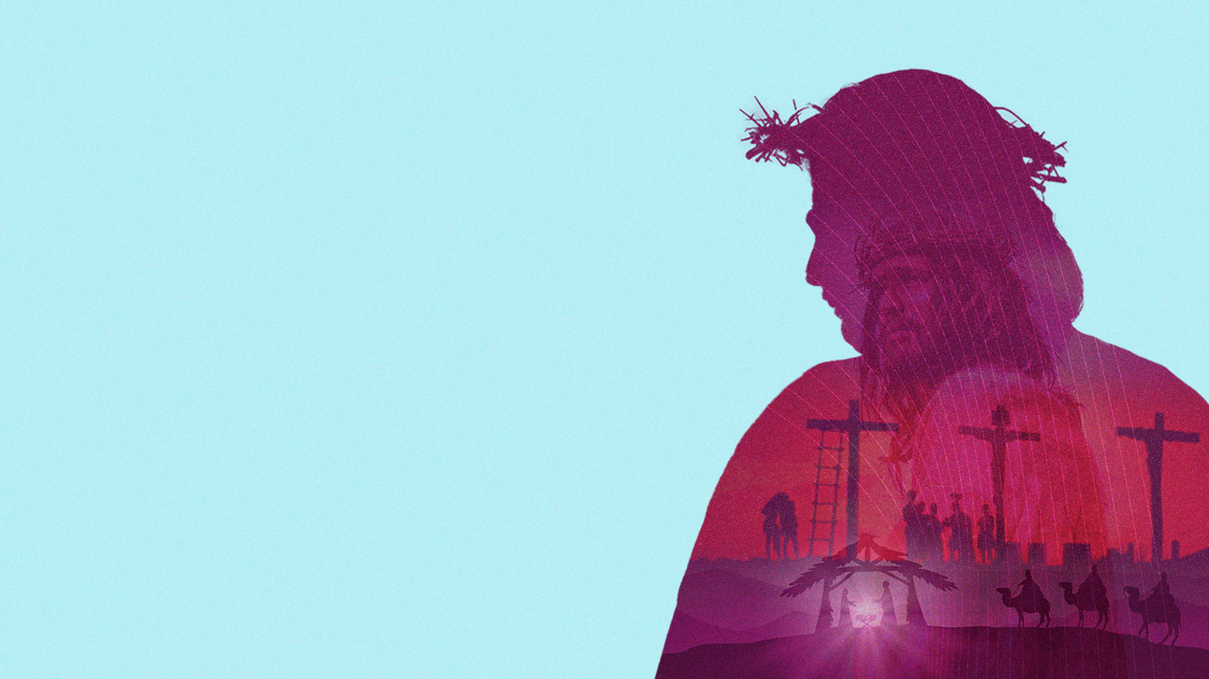
WHAT DID THE PROPHETS FORETELL ABOUT THE MESSIAH?

Slide 3
WHY DOES THE MESSIAH MATTER TO US?

Slide 4
THE MESSIAH WAS GOD'S ANOINTED NOT JUST FOR THE JEWISH PEOPLE, BUT FOR ALL PEOPLE OF ALL NATIONS.

Slide 5
CHRIST THE MESSIAH

Slide 6
HOW DID THE DISCIPLES RECOGNIZE THE MESSIAH?

Slide 7
WHY DID RELIGIOUS LEADERS FAIL TO RECOGNIZE THE MESSIAH?

Slide 8
THE EARLY CHURCH PREACHED THAT JESUS IS THE MESSIAH.

Slide 9
WHAT DOES JESUS THE MESSIAH DO FOR YOU AND ME TODAY?

Slide 10
JESUS CAME TO BE MESSIAH,
THE ANOINTED ONE, IN OUR LIVES.

Slide 11
HE IS GOD'S FINAL WORD TO YOU AND ME!

Slide 12
WILL YOU RECEIVE JESUS CHRIST?

Slide 13
THE MESSIAH IS COMING!

