Slide 2
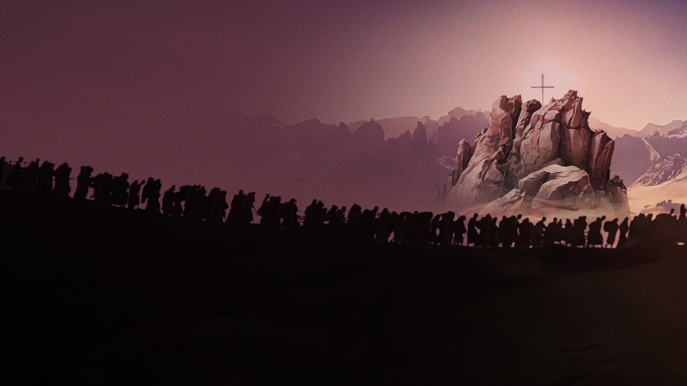
1 Corinthians 10:1-4
1 Moreover, brethren, I do not want you to be unaware that all our fathers were under the cloud, all passed through the sea,
2 all were baptized into Moses in the cloud and in the sea,
3 all ate the same spiritual food,
4 and all drank the same spiritual drink. For they drank of that spiritual Rock that followed them, and that Rock was Christ.

Slide 3
CHRIST IS THE SPIRITUAL ROCK

Slide 4
ROCK – IMMOVABLE, UNCHANGABLE, STRONG AND RELIABLE

Slide 5
STRIKE THE ROCK

Slide 6
Exodus 17:4-7
4 So Moses cried out to the LORD, saying, "What shall I do with this people? They are almost ready to stone me!"
5 And the LORD said to Moses, "Go on before the people, and take with you some of the elders of Israel. Also take in your hand your rod with which you struck the river, and go.

Slide 7
Exodus 17:4-7
6 Behold, I will stand before you there on the rock in Horeb; and you shall strike the rock, and water will come out of it, that the people may drink." And Moses did so in the sight of the elders of Israel.
7 So he called the name of the place Massah and Meribah, because of the contention of the children of Israel, and because they tempted the LORD, saying, "Is the LORD among us or not?"

Slide 8
A FIRM FOUNDATION

Slide 9
A PLACE OF REFUGE

Slide 10
A SOURCE THAT MEETS EVERY NEED

Slide 11
SPEAK TO THE ROCK

Slide 12
Numbers 20:6-8
6 So Moses and Aaron went from the presence of the assembly to the door of the tabernacle of meeting, and they fell on their faces. And the glory of the LORD appeared to them.
7 Then the LORD spoke to Moses, saying,

Slide 13
Numbers 20:6-8
8 "Take the rod; you and your brother Aaron gather the congregation together. Speak to the rock before their eyes, and it will yield its water; thus you shall bring water for them out of the rock, and give drink to the congregation and their animals."

Slide 14
YOUR SPIRITUAL ROCK IS STILL WITH YOU IN BETWEEN YOUR DIVINE ENCOUNTERS

Slide 15
KEY TAKEAWAYS

Slide 16
Christ is the spiritual Rock who accompanies you.

Slide 17
He is your firm foundation, your place of refuge and your source of all things.

Slide 18
Speak to Him.

Slide 19
Your spiritual Rock is with you in between your divine encounters.

