Slide 2
LIFE HAS ITS CHALLENGES

Slide 3
John 16:33
These things I have spoken to you, that in Me you may have peace. In the world you will have tribulation; but be of good cheer, I have overcome the world."

Slide 4
BUILD ON THE ROCK - HEAR AND DO THE SAYINGS OF JESUS

Slide 5
Matthew 7:24-27
24 "Therefore whoever hears these sayings of Mine, and does them, I will liken him to a wise man who built his house on the rock:
25 and the rain descended, the floods came, and the winds blew and beat on that house; and it did not fall, for it was founded on the rock.

Slide 6
Matthew 7:24-27
26 "But everyone who hears these sayings of Mine, and does not do them, will be like a foolish man who built his house on the sand:
27 and the rain descended, the floods came, and the winds blew and beat on that house; and it fell. And great was its fall."

Slide 7
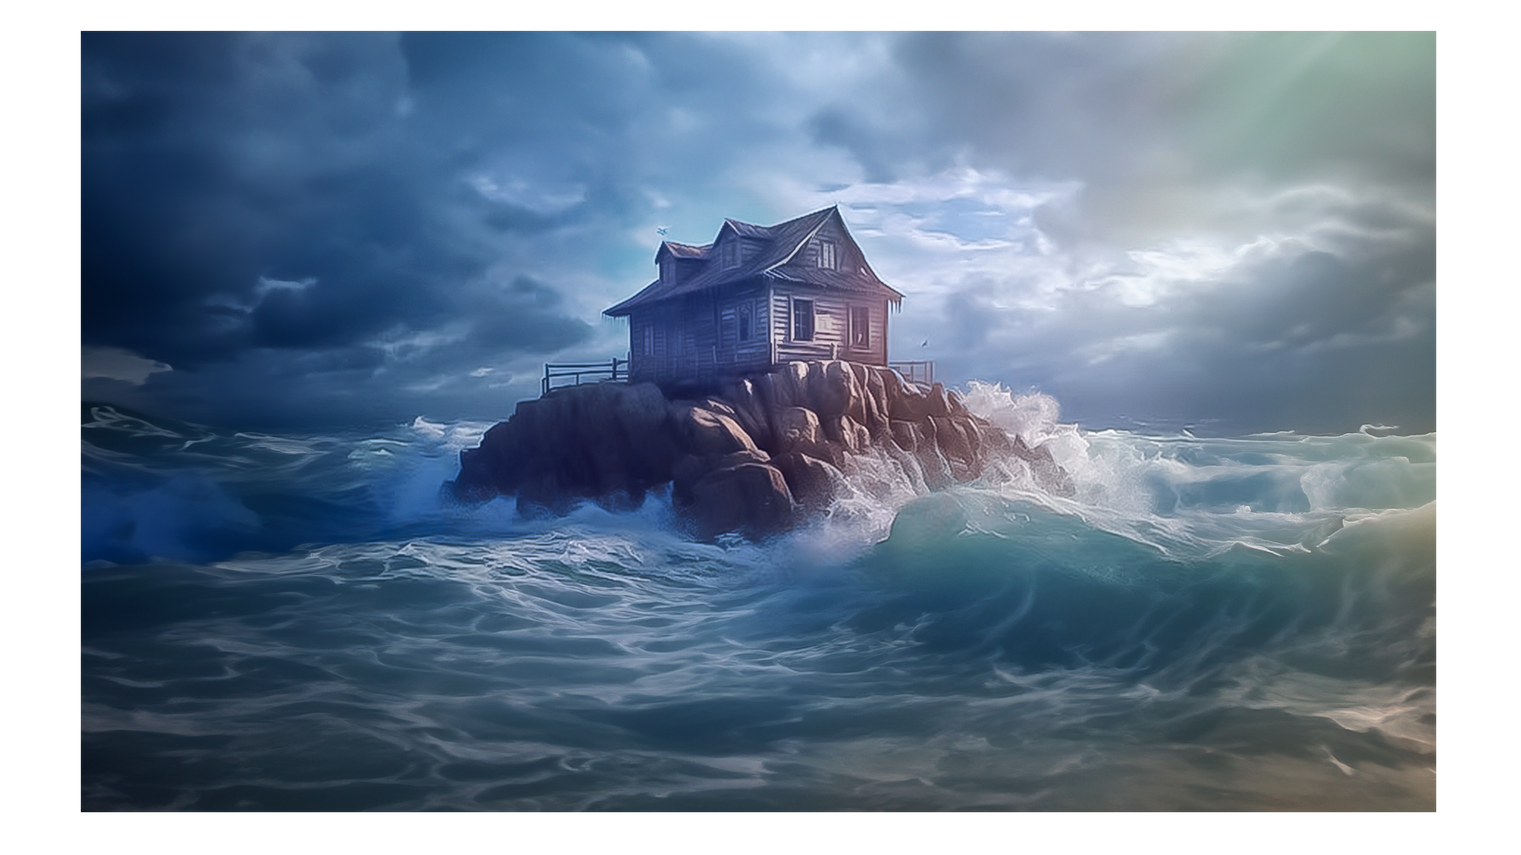

Slide 8
STAY UNITED – A CORD WOVEN TOGETHER CANNOT BE EASILY BROKEN

Slide 9
Ecclesiastes 4:9-12
9 Two are better than one, Because they have a good reward for their labor.
10 For if they fall, one will lift up his companion. But woe to him who is alone when he falls, For he has no one to help him up.

Slide 10
Ecclesiastes 4:9-12
11 Again, if two lie down together, they will keep warm; But how can one be warm alone?
12 Though one may be overpowered by another, two can withstand him. And a threefold cord is not quickly broken.

Slide 11
GET HELP – WE ARE PART OF A BODY AND A COMMUNITY

Slide 12
1 Corinthians 12:26,27
26 And if one member suffers, all the members suffer with it; or if one member is honored, all the members rejoice with it.
27 Now you are the body of Christ, and members individually.

Slide 13
BE WILLING TO CHANGE – ONLY THEN WE MOVE FROM GLORY TO GLORY

Slide 14
2 Corinthians 3:18
But we all, with unveiled face, beholding as in a mirror the glory of the Lord, are being transformed into the same image from glory to glory, just as by the Spirit of the Lord.

Slide 15
LET GO, LET GOD – THERE ARE THINGS YOU CANNOT CHANGE

Slide 16
Matthew 6:27
Which of you by worrying can add one cubit to his stature?

Slide 17
Pray through till breakthrough.

Slide 18
Stay in a place of faith.

Slide 19
Keep your joy!

Slide 20
Walk in peace.

Slide 21
FULFILL YOUR PURPOSE – THAT IS WHAT YOU WILL GIVE ACCOUNT FOR

Slide 22
2 Corinthians 5:9,10
9 Therefore we make it our aim, whether present or absent, to be well pleasing to Him.
10 For we must all appear before the judgment seat of Christ, that each one may receive the things done in the body, according to what he has done, whether good or bad.

Slide 23
REVIEW

Slide 24
BUILD ON THE ROCK – HEAR AND DO THE SAYINGS OF JESUS

Slide 25
STAY UNITED – A CORD WOVEN TOGETHER CANNOT BE EASILY BROKEN

Slide 26
GET HELP – WE ARE PART OF A BODY AND A COMMUNITY

Slide 27
BE WILLING TO CHANGE – ONLY THEN WE MOVE FROM GLORY TO GLORY

Slide 28
LET GO, LET GOD – THERE ARE THINGS YOU CANNOT CHANGE

Slide 29
FULFILL YOUR PURPOSE – THAT IS WHAT YOU WILL GIVE ACCOUNT FOR

