Slide 2
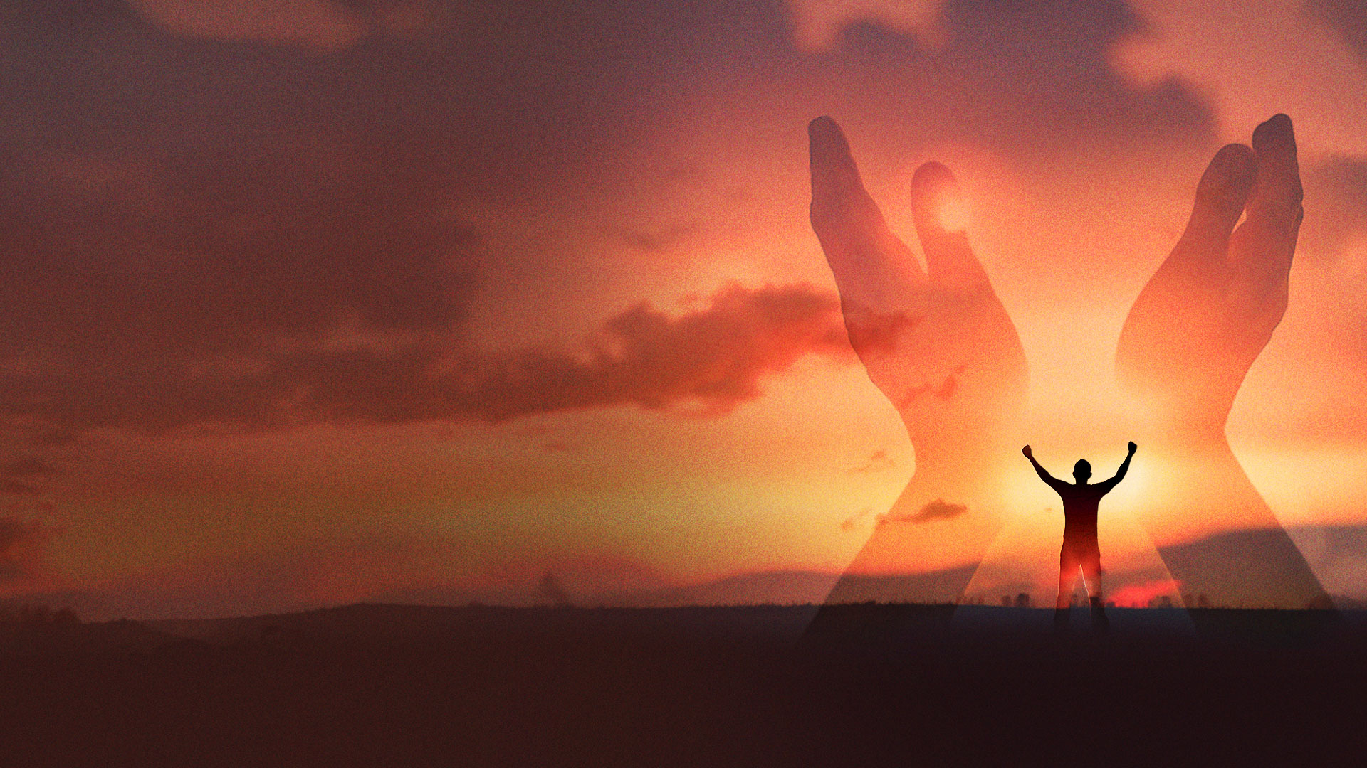
Acts 4:29-31 NKJV
29 Now, Lord, look on their threats, and grant to Your servants that with all boldness they may speak Your word,
30 by stretching out Your hand to heal, and that signs and wonders may be done through the name of Your holy Servant Jesus.”
31 And when they had prayed, the place where they were assembled together was shaken; and they were all filled with the Holy Spirit, and they spoke the word of God with boldness.

Slide 3
GREAT POWER

Slide 4
Acts 4:33 NKJV
And with great power the apostles gave witness to the resurrection of the Lord Jesus. And great grace was upon them all.

Slide 5
ANANIAS AND SAPPHIRA

Slide 6
Acts 5:11 NKJV
So great fear came upon all the church and upon all who heard these things.

Slide 7
Where there is great glory and power, there is great grace, but low tolerance for sin, so that there will be great fear (reverence) of God.

Slide 8
UNUSUAL MIRACLES

Slide 9
Act 5:12-16 NKJV
12 And through the hands of the apostles many signs and wonders were done among the people. And they were all with one accord in Solomon's Porch.
13 Yet none of the rest dared join them, but the people esteemed them highly.
14 And believers were increasingly added to the Lord, multitudes of both men and women,

Slide 10
Act 5:12-16 NKJV
15 so that they brought the sick out into the streets and laid them on beds and couches, that at least the shadow of Peter passing by might fall on some of them.
16 Also a multitude gathered from the surrounding cities to Jerusalem, bringing sick people and those who were tormented by unclean spirits, and they were all healed.

Slide 11
ANGELIC DELIVERANCES

Slide 12
Acts 5:17-20 NKJV
17 Then the high priest rose up, and all those who were with him (which is the sect of the Sadducees), and they were filled with indignation,
18 and laid their hands on the apostles and put them in the common prison.

Slide 13
Acts 5:17-20 NKJV
19 But at night an angel of the Lord opened the prison doors and brought them out, and said,
20 "Go, stand in the temple and speak to the people all the words of this life."

Slide 14
THE HOLY SPIRIT AND US

Slide 15
Acts 5:32 NKJV
And we are His witnesses to these things, and so also is the Holy Spirit whom God has given to those who obey Him."

Slide 16
THE NOBLEMAN FROM CAPERNAUM

Slide 17
John 4:46-53 NKJV
46 So Jesus came again to Cana of Galilee where He had made the water wine. And there was a certain nobleman whose son was sick at Capernaum.
47 When he heard that Jesus had come out of Judea into Galilee, he went to Him and implored Him to come down and heal his son, for he was at the point of death.

Slide 18
John 4:46-53 NKJV
48 Then Jesus said to him, "Unless you people see signs and wonders, you will by no means believe."
49 The nobleman said to Him, "Sir, come down before my child dies!"

Slide 19
John 4:46-53 NKJV
50 Jesus said to him, "Go your way; your son lives." So the man believed the word that Jesus spoke to him, and he went his way.
51 And as he was now going down, his servants met him and told him, saying, "Your son lives!"

Slide 20
John 4:46-53 NKJV
52 Then he inquired of them the hour when he got better. And they said to him, "Yesterday at the seventh hour the fever left him."
53 So the father knew that it was at the same hour in which Jesus said to him, "Your son lives." And he himself believed, and his whole household.

