Slide 2
THE COMMISSION

Slide 3
Matthew 28:19,20
19 Go therefore and make disciples of all the nations, baptizing them in the name of the Father and of the Son and of the Holy Spirit,
20 teaching them to observe all things that I have commanded you; and lo, I am with you always, even to the end of the age." Amen.

Slide 4
Matthew 24:14
And this gospel of the kingdom will be preached in all the world as a witness to all the nations
("ethnos" = races, tribes, peoples), and then the end will come.

Slide 5
CURRENT WORLD POPULATION

Slide 6
8.1 billion
5 in 6 people live in a developing economy
57% of the world’s population live in urban areas

Slide 7
INDIA

Slide 8
1.42 billion people, about 17.76% of the world's population
About 35.8% (508 million people) of India's population live in cities currently.
In the year 2000 it was 27.6%

Slide 9
A FEW HIGHLIGHTS

Slide 10
The apostle Thomas came to Kerala (Malabar region) in 52 AD.

Slide 11
Christian communities were known to be firmly established in the Malabar region by 600 AD.

Slide 12
The Portuguese explorer Vasco da Gama found a sea route to India in the 15th century AD.

Slide 13
German Lutherans and Basel mission started in 1705.

Slide 14
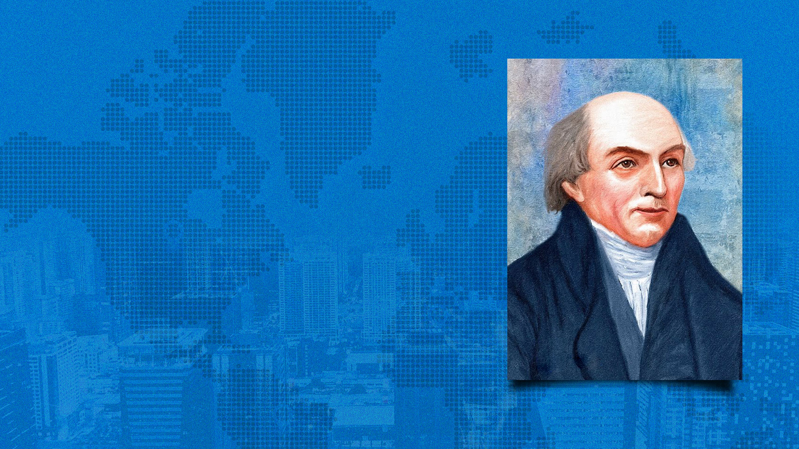
William Carey and the Baptists, starting in 1793.

Slide 15
Amy Carmichael - Irish Christian Missionary in India, starting
in 1901.

Slide 16
Dr. Ida Sophia Scudder started her work in India, 1918.

Slide 17
THE NEED

Slide 18
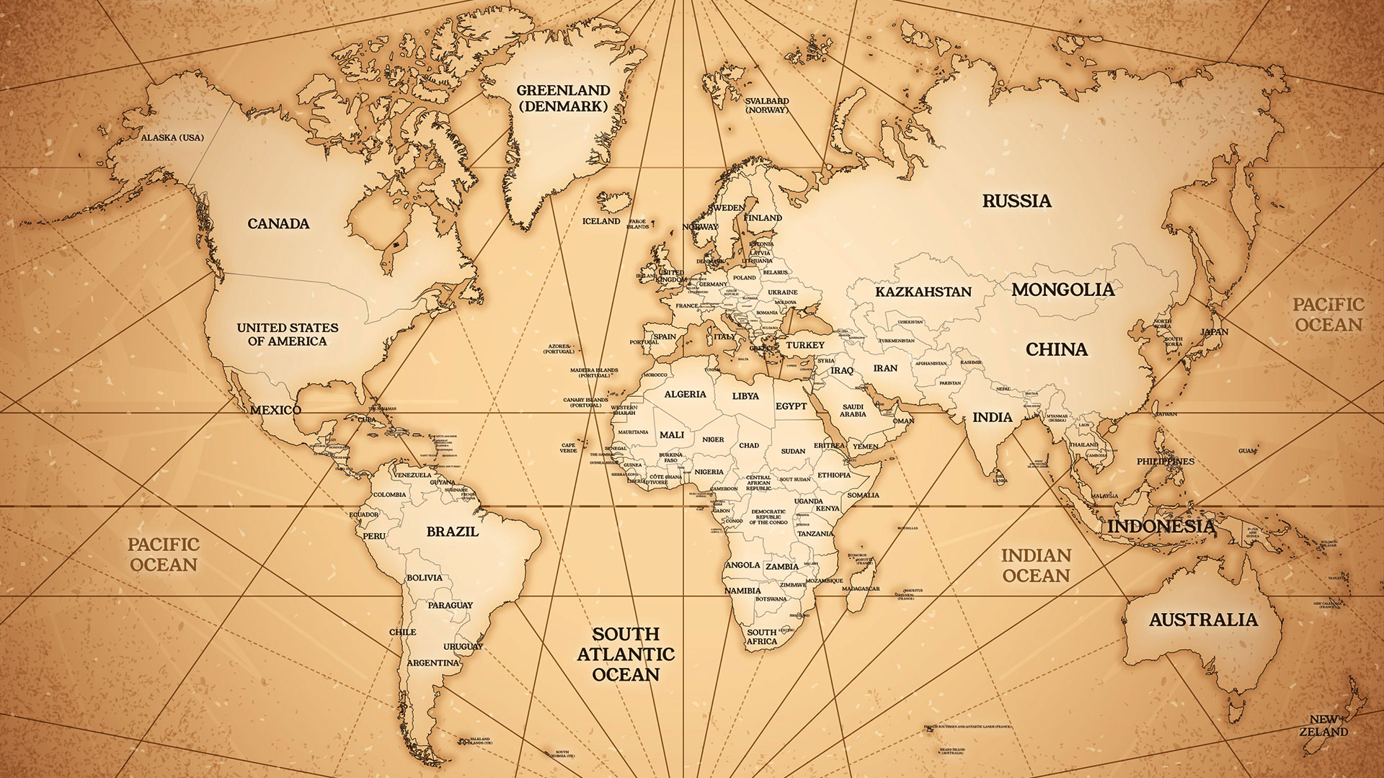

Slide 19
THE OPPORTUNITIES

Slide 20
TECH IN MISSIONS

Slide 21
BUSINESS IN MISSIONS

Slide 22
MERCY MISSIONS

Slide 23
CHURCH PLANTING IN MISSIONS

Slide 24
GET INVOLVED

Slide 25
send an email to: missions@apcwo.org
apcwo.org/employment
apcwo.org/internships

