Slide 2
REVIEW

Slide 3
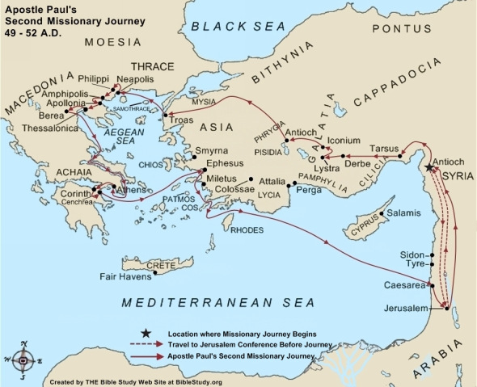

Slide 4
1 Thessalonians 5

Slide 5
TIMES AND SEASONS

Slide 6
1 But concerning the times and the seasons, brethren, you have no need that I should write to you.
2 For you yourselves know perfectly that the day of the Lord so comes as a thief in the night.
3 For when they say, "Peace and safety!" then sudden destruction comes upon them, as labor pains upon a pregnant woman. And they shall not escape.

Slide 7
WATCH AND BE SOBER

Slide 8
4 But you, brethren, are not in darkness, so that this Day should overtake you as a thief.
5 You are all sons of light and sons of the day. We are not of the night nor of darkness.
6 Therefore let us not sleep, as others do, but let us watch and be sober.
7 For those who sleep, sleep at night, and those who get drunk are drunk at night.

Slide 9
8 But let us who are of the day be sober, putting on the breastplate of faith and love, and as a helmet the hope of salvation.
9 For God did not appoint us to wrath, but to obtain salvation through our Lord Jesus Christ,
10 who died for us, that whether we wake or sleep, we should live together with Him.
11 Therefore comfort each other and edify one another, just as you also are doing.

Slide 10
FINAL INSTRUCTIONS

Slide 11
12 And we urge you, brethren, to recognize those who labor among you, and are over you in the Lord and admonish you,
13 and to esteem them very highly in love for their work's sake. Be at peace among yourselves.
14 Now we exhort you, brethren, warn those who are unruly, comfort the fainthearted, uphold the weak, be patient with all.
15 See that no one renders evil for evil to anyone, but always pursue what is good both for yourselves and for all.

Slide 12
16 Rejoice always,
17 pray without ceasing,
18 in everything give thanks; for this is the will of God in Christ Jesus for you.

Slide 13
19 Do not quench the Spirit.
20 Do not despise prophecies.
21 Test all things; hold fast what is good.
22 Abstain from every form of evil.

Slide 14
CLOSING BENEDICTION

Slide 15
23 Now may the God of peace Himself sanctify you completely; and may your whole spirit, soul, and body be preserved blameless at the coming of our Lord Jesus Christ.
24 He who calls you is faithful, who also will do it.
25 Brethren, pray for us.

Slide 16
26 Greet all the brethren with a holy kiss.
27 I charge you by the Lord that this epistle be read to all the holy brethren.
28 The grace of our Lord Jesus Christ be with you. Amen.

Slide 17
2 Thessalonians 1

Slide 18
GREETING

Slide 19
1 Paul, Silvanus, and Timothy, To the church of the Thessalonians in God our Father and the Lord Jesus Christ:
2 Grace to you and peace from God our Father and the Lord Jesus Christ.

Slide 20
THANKSGIVING

Slide 21
3 We are bound to thank God always for you, brethren, as it is fitting, because your faith grows exceedingly, and the love of every one of you all abounds toward each other,
4 so that we ourselves boast of you among the churches of God for your patience and faith in all your persecutions and tribulations that you endure,

Slide 22
WHEN HE COMES IN THAT DAY

Slide 23
5 which is manifest evidence of the righteous judgment of God, that you may be counted worthy of the kingdom of God, for which you also suffer;
6 since it is a righteous thing with God to repay with tribulation those who trouble you,
7 and to give you who are troubled rest with us when the Lord Jesus is revealed from heaven with His mighty angels,

Slide 24
8 in flaming fire taking vengeance on those who do not know God, and on those who do not obey the gospel of our Lord Jesus Christ.
9 These shall be punished with everlasting destruction from the presence of the Lord and from the glory of His power,
10 when He comes, in that Day, to be glorified in His saints and to be admired among all those who believe, because our testimony among you was believed.

Slide 25
11 Therefore we also pray always for you that our God would count you worthy of this calling, and fulfill all the good pleasure of His goodness and the work of faith with power,
12 that the name of our Lord Jesus Christ may be glorified in you, and you in Him, according to the grace of our God and the Lord Jesus Christ.

