Slide 2
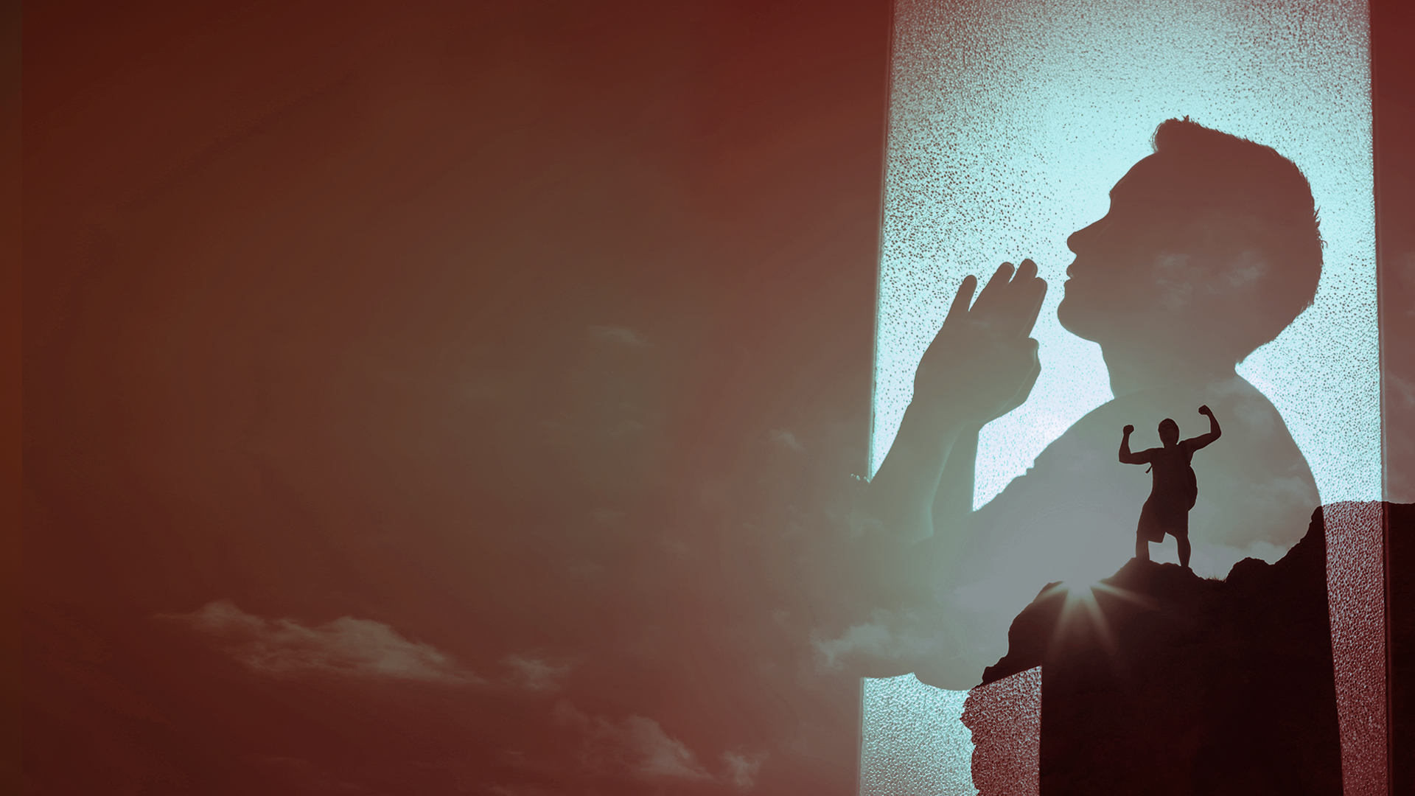
GOD ADMINISTERS HIS HEALING THROUGH MANY DIFFERENT WAYS

Slide 3
There are many ways we can receive divine healing:

Slide 4
1. Through His Word and personal faith – released through prayer, praise, declaration, and action.
2. Through the quickening of His indwelling Spirit.
3. Through the power of His life in you.
4. Through receiving the prayer of faith in Jesus’ name.

Slide 5
5. Through the prayer of agreement in faith.
6. Through the healing anointing (laying on of hands, prayer cloths, touch).
7. Through a word of command spoken over you in faith.
8. Through partaking in the Lord’s Table in faith.

Slide 6
9. Through the ministry of deliverance.
10. Through the manifestation of the gifts of the Spirit, (word of knowledge, gifts of healings, and working of miracles).
11. Through the manifestation of His healing presence.
12. Through the sovereign work of His glory.

Slide 7
13. Through releasing forgiveness to others.
14. Through receiving emotional healing and inner wholeness.
15. Through renouncing and breaking of generational curses.

Slide 8
TODAY

Slide 9
Through releasing forgiveness to others.
Through receiving emotional healing and inner wholeness.
Through renouncing and breaking of generational curses.

Slide 10
THROUGH RELEASING FORGIVENESS TO OTHERS

Slide 11
Mark 11:22-26
22 So Jesus answered and said to them, "Have faith in God.
23 For assuredly, I say to you, whoever says to this mountain, 'Be removed and be cast into the sea,' and does not doubt in his heart, but believes that those things he says will be done, he will have whatever he says.
24 Therefore I say to you, whatever things you ask when you pray, believe that you receive them, and you will have them.

Slide 12
Mark 11:22-26
25 "And whenever you stand praying, if you have anything against anyone, forgive him, that your Father in heaven may also forgive you your trespasses.
26 But if you do not forgive, neither will your Father in heaven forgive your trespasses."

Slide 13
James 5:14-16
14 Is anyone among you sick? Let him call for the elders of the church, and let them pray over him, anointing him with oil in the name of the Lord.
15 And the prayer of faith will save the sick, and the Lord will raise him up. And if he has committed sins, he will be forgiven.
16 Confess your trespasses to one another, and pray for one another, that you may be healed. The effective, fervent prayer of a righteous man avails much.

Slide 14
Job 42:7-10
7 And so it was, after the LORD had spoken these words to Job, that the LORD said to Eliphaz the Temanite, "My wrath is aroused against you and your two friends, for you have not spoken of Me what is right, as My servant Job has.

Slide 15
Job 42:7-10
8 Now therefore, take for yourselves seven bulls and seven rams, go to My servant Job, and offer up for yourselves a burnt offering; and My servant Job shall pray for you. For I will accept him, lest I deal with you according to your folly; because you have not spoken of Me what is right, as My servant Job has."
9 So Eliphaz the Temanite and Bildad the Shuhite and Zophar the Naamathite went and did as the LORD commanded them; for the LORD had accepted Job.

Slide 16
Job 42:7-10
10 And the LORD restored Job's losses when he prayed for his friends. Indeed the LORD gave Job twice as much as he had before.

Slide 17
THROUGH RECEIVING EMOTIONAL HEALING AND INNER WHOLENESS

Slide 18
Hebrews 12:14,15
14 Pursue peace with all people, and holiness, without which no one will see the Lord:
15 looking carefully lest anyone fall short of the grace of God; lest any root of bitterness springing up cause trouble, and by this many become defiled;

Slide 19
Proverbs 17:22
A merry heart does good, like medicine, But a broken spirit dries the bones.

Slide 20
Proverbs 18:14
The spirit of a man will sustain him in sickness, But who can bear a broken spirit?

Slide 21
Proverbs 18:14 (Message Bible)
A healthy spirit conquers adversity, but what can you do when the spirit is crushed?

Slide 22
Isaiah 61:1
The Spirit of the Lord GOD is upon Me, Because the LORD has anointed Me To preach good tidings to the poor; He has sent Me to heal the brokenhearted, To proclaim liberty to the captives, And the opening of the prison to those who are bound;

Slide 23
THROUGH RENOUNCING AND BREAKING OF GENERATIONAL CURSES

Slide 24
John 9:1-5
1 Now as Jesus passed by, He saw a man who was blind from birth.
2 And His disciples asked Him, saying, "Rabbi, who sinned, this man or his parents, that he was born blind?"
3 Jesus answered, "Neither this man nor his parents sinned, but that the works of God should be revealed in him.

Slide 25
John 9:1-5
4 I must work the works of Him who sent Me while it is day; the night is coming when no one can work.
5 As long as I am in the world, I am the light of the world."

Slide 26
Exodus 20:4-6
4 "You shall not make for yourself a carved image—any likeness of anything that is in heaven above, or that is in the earth beneath, or that is in the water under the earth;
5 you shall not bow down to them nor serve them. For I, the LORD your God, am a jealous God, visiting the iniquity of the fathers upon the children to the third and fourth generations of those who hate Me,

Slide 27
Exodus 20:4-6
6 but showing mercy to thousands, to those who love Me and keep My commandments.

Slide 28
Deuteronomy 7:25,26
25 You shall burn the carved images of their gods with fire; you shall not covet the silver or gold that is on them, nor take it for yourselves, lest you be snared by it; for it is an abomination to the LORD your God.
26 Nor shall you bring an abomination into your house, lest you be doomed to destruction like it. You shall utterly detest it and utterly abhor it, for it is an accursed thing.

Slide 29
1 Peter 1:18,19
18 knowing that you were not redeemed with corruptible things, like silver or gold, from your aimless conduct received by tradition from your fathers,
19 but with the precious blood of Christ, as of a lamb without blemish and without spot.

