Slide 2
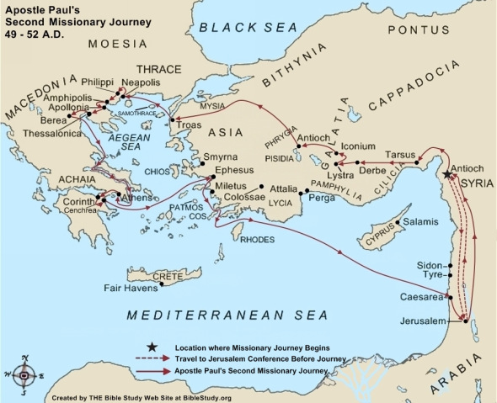

Slide 3
NOT SHAKEN BY THESE AFFLICTIONS

Slide 4
1 Thessalonians 3:1-5
1 Therefore, when we could no longer endure it, we thought it good to be left in Athens alone,
2 and sent Timothy, our brother and minister of God, and our fellow laborer in the gospel of Christ, to establish you and encourage you concerning your faith,
3 that no one should be shaken by these afflictions; for you yourselves know that we are appointed to this.

Slide 5
1 Thessalonians 3:1-5
4 For, in fact, we told you before when we were with you that we would suffer tribulation, just as it happened, and you know.
5 For this reason, when I could no longer endure it, I sent to know your faith, lest by some means the tempter had tempted you, and our labor might be in vain.

Slide 6
WE LIVE, IF YOU STAND

Slide 7
1 Thessalonians 3:6-8
6 But now that Timothy has come to us from you, and brought us good news of your faith and love, and that you always have good remembrance of us, greatly desiring to see us, as we also to see you—
7 therefore, brethren, in all our affliction and distress we were comforted concerning you by your faith.
8 For now we live, if you stand fast in the Lord.

Slide 8
PERFECT WHAT IS LACKING

Slide 9
1 Thessalonians 3:9-11
9 For what thanks can we render to God for you, for all the joy with which we rejoice for your sake before our God,
10 night and day praying exceedingly that we may see your face and perfect what is lacking in your faith?
11 Now may our God and Father Himself, and our Lord Jesus Christ, direct our way to you.

Slide 10
INCREASE AND ABOUND

Slide 11
1 Thessalonians 3:12,13
12 And may the Lord make you increase and abound in love to one another and to all, just as we do to you,
13 so that He may establish your hearts blameless in holiness before our God and Father at the coming of our Lord Jesus Christ with all His saints.

Slide 12
SANCTIFICATON AND HONOR

Slide 13
1 Thessalonians 4:1-8
1 Finally then, brethren, we urge and exhort in the Lord Jesus that you should abound more and more, just as you received from us how you ought to walk and to please God;
2 for you know what commandments we gave you through the Lord Jesus.
3 For this is the will of God, your sanctification: that you should abstain from sexual immorality;

Slide 14
1 Thessalonians 4:1-8
4 that each of you should know how to possess his own vessel in sanctification and honor,
5 not in passion of lust, like the Gentiles who do not know God;
6 that no one should take advantage of and defraud his brother in this matter, because the Lord is the avenger of all such, as we also forewarned you and testified.

Slide 15
1 Thessalonians 4:1-8
7 For God did not call us to uncleanness, but in holiness.
8 Therefore he who rejects this does not reject man, but God, who has also given us His Holy Spirit.

Slide 16
INCREASE MORE AND MORE

Slide 17
1 Thessalonians 4:9,10
9 But concerning brotherly love you have no need that I should write to you, for you yourselves are taught by God to love one another;
10 and indeed you do so toward all the brethren who are in all Macedonia. But we urge you, brethren, that you increase more and more;

Slide 18
MIND YOUR OWN BUSINESS

Slide 19
1 Thessalonians 4:11,12
11 that you also aspire to lead a quiet life, to mind your own business, and to work with your own hands, as we commanded you,
12 that you may walk properly toward those who are outside, and that you may lack nothing.

Slide 20
THE COMING OF THE LORD

Slide 21
1 Thessalonians 4:13-18
13 But I do not want you to be ignorant, brethren, concerning those who have fallen asleep, lest you sorrow as others who have no hope.
14 For if we believe that Jesus died and rose again, even so God will bring with Him those who sleep in Jesus.
15 For this we say to you by the word of the Lord, that we who are alive and remain until the coming of the Lord will by no means precede those who are asleep.

Slide 22
1 Thessalonians 4:13-18
16 For the Lord Himself will descend from heaven with a shout, with the voice of an archangel, and with the trumpet of God. And the dead in Christ will rise first.
17 Then we who are alive and remain shall be caught up together with them in the clouds to meet the Lord in the air. And thus we shall always be with the Lord.
18 Therefore comfort one another with these words.

