Slide 2
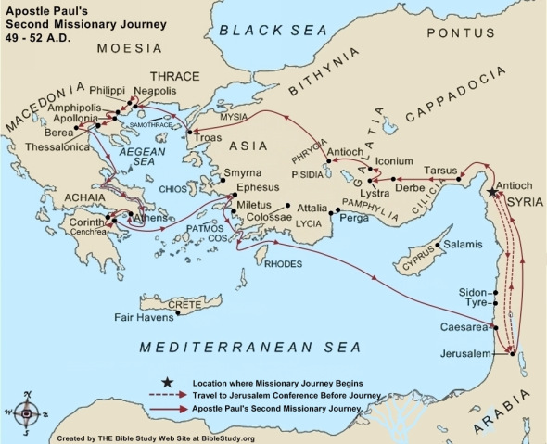

Slide 3
1 Thessalonians 1
1 Paul, Silvanus, and Timothy, To the church of the Thessalonians in God the Father and the Lord Jesus Christ: Grace to you and peace from God our Father and the Lord Jesus Christ.

Slide 4
1 Thessalonians 1
2 We give thanks to God always for you all, making mention of you in our prayers,
3 remembering without ceasing your work of faith, labor of love, and patience of hope in our Lord Jesus Christ in the sight of our God and Father,
4 knowing, beloved brethren, your election by God.

Slide 5
1 Thessalonians 1
5 For our gospel did not come to you in word only, but also in power, and in the Holy Spirit and in much assurance, as you know what kind of men we were among you for your sake.
6 And you became followers of us and of the Lord, having received the word in much affliction, with joy of the Holy Spirit,
7 so that you became examples to all in Macedonia and Achaia who believe.

Slide 6
1 Thessalonians 1
8 For from you the word of the Lord has sounded forth, not only in Macedonia and Achaia, but also in every place. Your faith toward God has gone out, so that we do not need to say anything.
9 For they themselves declare concerning us what manner of entry we had to you, and how you turned to God from idols to serve the living and true God,
10 and to wait for His Son from heaven, whom He raised from the dead, even Jesus who delivers us from the wrath to come.

Slide 7
1 Thessalonians 2
1 For you yourselves know, brethren, that our coming to you was not in vain.
2 But even after we had suffered before and were spitefully treated at Philippi, as you know, we were bold in our God to speak to you the gospel of God in much conflict.

Slide 8
1 Thessalonians 2
3 For our exhortation did not come from error or uncleanness, nor was it in deceit.
4 But as we have been approved by God to be entrusted with the gospel, even so we speak, not as pleasing men, but God who tests our hearts.
5 For neither at any time did we use flattering words, as you know, nor a cloak for covetousness—God is witness.
6 Nor did we seek glory from men, either from you or from others, when we might have made demands as apostles of Christ.

Slide 9
1 Thessalonians 2
7 But we were gentle among you, just as a nursing mother cherishes her own children.
8 So, affectionately longing for you, we were well pleased to impart to you not only the gospel of God, but also our own lives, because you had become dear to us.

Slide 10
1 Thessalonians 2
9 For you remember, brethren, our labor and toil; for laboring night and day, that we might not be a burden to any of you, we preached to you the gospel of God.
10 You are witnesses, and God also, how devoutly and justly and blamelessly we behaved ourselves among you who believe;
11 as you know how we exhorted, and comforted, and charged every one of you, as a father does his own children,
12 that you would walk worthy of God who calls you into His own kingdom and glory.

Slide 11
1 Thessalonians 2
13 For this reason we also thank God without ceasing, because when you received the word of God which you heard from us, you welcomed it not as the word of men, but as it is in truth, the word of God, which also effectively works in you who believe.

Slide 12
1 Thessalonians 2
14 For you, brethren, became imitators of the churches of God which are in Judea in Christ Jesus. For you also suffered the same things from your own countrymen, just as they did from the Judeans,
15 who killed both the Lord Jesus and their own prophets, and have persecuted us; and they do not please God and are contrary to all men,
16 forbidding us to speak to the Gentiles that they may be saved, so as always to fill up the measure of their sins; but wrath has come upon them to the uttermost.

Slide 13
1 Thessalonians 2
17 But we, brethren, having been taken away from you for a short time in presence, not in heart, endeavored more eagerly to see your face with great desire.
18 Therefore we wanted to come to you—even I, Paul, time and again—but Satan hindered us.

Slide 14
1 Thessalonians 2
19 For what is our hope, or joy, or crown of rejoicing? Is it not even you in the presence of our Lord Jesus Christ at His coming?
20 For you are our glory and joy.

