Slide 2
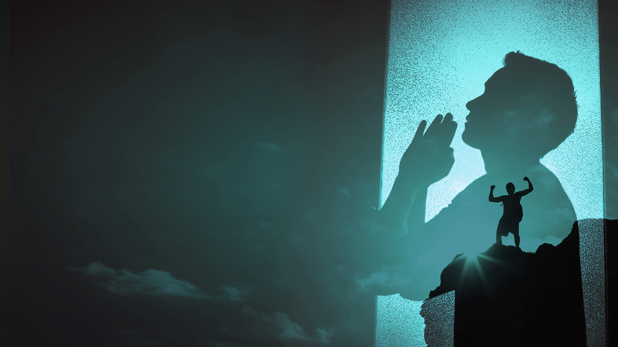
GOD ADMINISTERS HIS HEALING THROUGH MANY DIFFERENT WAYS.

Slide 3
There are many ways we can receive divine healing:

Slide 4
1. Through His Word and personal faith.
2. Through the quickening of His indwelling Spirit.
3. Through the power of His life in you.
4. Through receiving the prayer of faith in Jesus’ name.

Slide 5
5. Through the prayer of agreement in faith.
6. Through the healing anointing.
7. Through a word of command spoken over you in faith.
8. Through partaking in the Lord’s Table in faith.

Slide 6
9. Through the ministry of deliverance.
10. Through the manifestation of the gifts of the Spirit.
11. Through the manifestation of His healing presence.
12. Through the sovereign work of His glory.

Slide 7
13. Through releasing forgiveness to others.
14. Through receiving emotional healing and inner wholeness.
15. Through renouncing and breaking of generational curses.

Slide 8
THROUGH THE MANIFESTATION OF THE GIFTS OF THE SPIRIT.

Slide 9
1 Corinthians 12:4-11
4 There are diversities of gifts, but the same Spirit.
5 There are differences of ministries, but the same Lord.
6 And there are diversities of activities, but it is the same God who works all in all.
7 But the manifestation of the Spirit is given to each one for the profit of all:

Slide 10
1 Corinthians 12:4-11
8 for to one is given the word of wisdom through the Spirit, to another the word of knowledge through the same Spirit,
9 to another faith by the same Spirit, to another gifts of healings by the same Spirit,

Slide 11
1 Corinthians 12:4-11
10 to another the working of miracles, to another prophecy, to another discerning of spirits, to another different kinds of tongues, to another the interpretation of tongues.
11 But one and the same Spirit works all these things, distributing to each one individually as He wills.

Slide 12
Word of knowledge
Gifts of healings
Working of miracles

Slide 13
THROUGH THE MANIFESTATION OF HIS HEALING PRESENCE.

Slide 14
Habakkuk 3:3,4
3 God came from Teman, The Holy One from Mount Paran. Selah. His glory covered the heavens, And the earth was full of His praise.
4 His brightness was like the light; He had rays flashing from His hand, And there His power was hidden.

Slide 15
Malachi 4:2
But to you who fear My name The Sun of Righteousness shall arise With healing in His wings; And you shall go out And grow fat like stall-fed calves.

Slide 16
Luke 5:17
Now it happened on a certain day, as He was teaching, that there were Pharisees and teachers of the law sitting by, who had come out of every town of Galilee, Judea, and Jerusalem. And the power of the Lord was present to heal them.

Slide 17
THROUGH THE SOVEREIGN WORK OF HIS GLORY.

Slide 18
John 5:1-9
1 After this there was a feast of the Jews, and Jesus went up to Jerusalem.
2 Now there is in Jerusalem by the Sheep Gate a pool, which is called in Hebrew, Bethesda, having five porches.
3 In these lay a great multitude of sick people, blind, lame, paralyzed, waiting for the moving of the water.

Slide 19
John 5:1-9
4 For an angel went down at a certain time into the pool and stirred up the water; then whoever stepped in first, after the stirring of the water, was made well of whatever disease he had.
5 Now a certain man was there who had an infirmity thirty-eight years.
6 When Jesus saw him lying there, and knew that he already had been in that condition a long time, He said to him, "Do you want to be made well?"

Slide 20
John 5:1-9
7 The sick man answered Him, "Sir, I have no man to put me into the pool when the water is stirred up; but while I am coming, another steps down before me."
8 Jesus said to him, "Rise, take up your bed and walk."
9 And immediately the man was made well, took up his bed, and walked. And that day was the Sabbath.

Slide 21
John 5:19
Then Jesus answered and said to them, "Most assuredly, I say to you, the Son can do nothing of Himself, but what He sees the Father do; for whatever He does, the Son also does in like manner.

