Slide 2
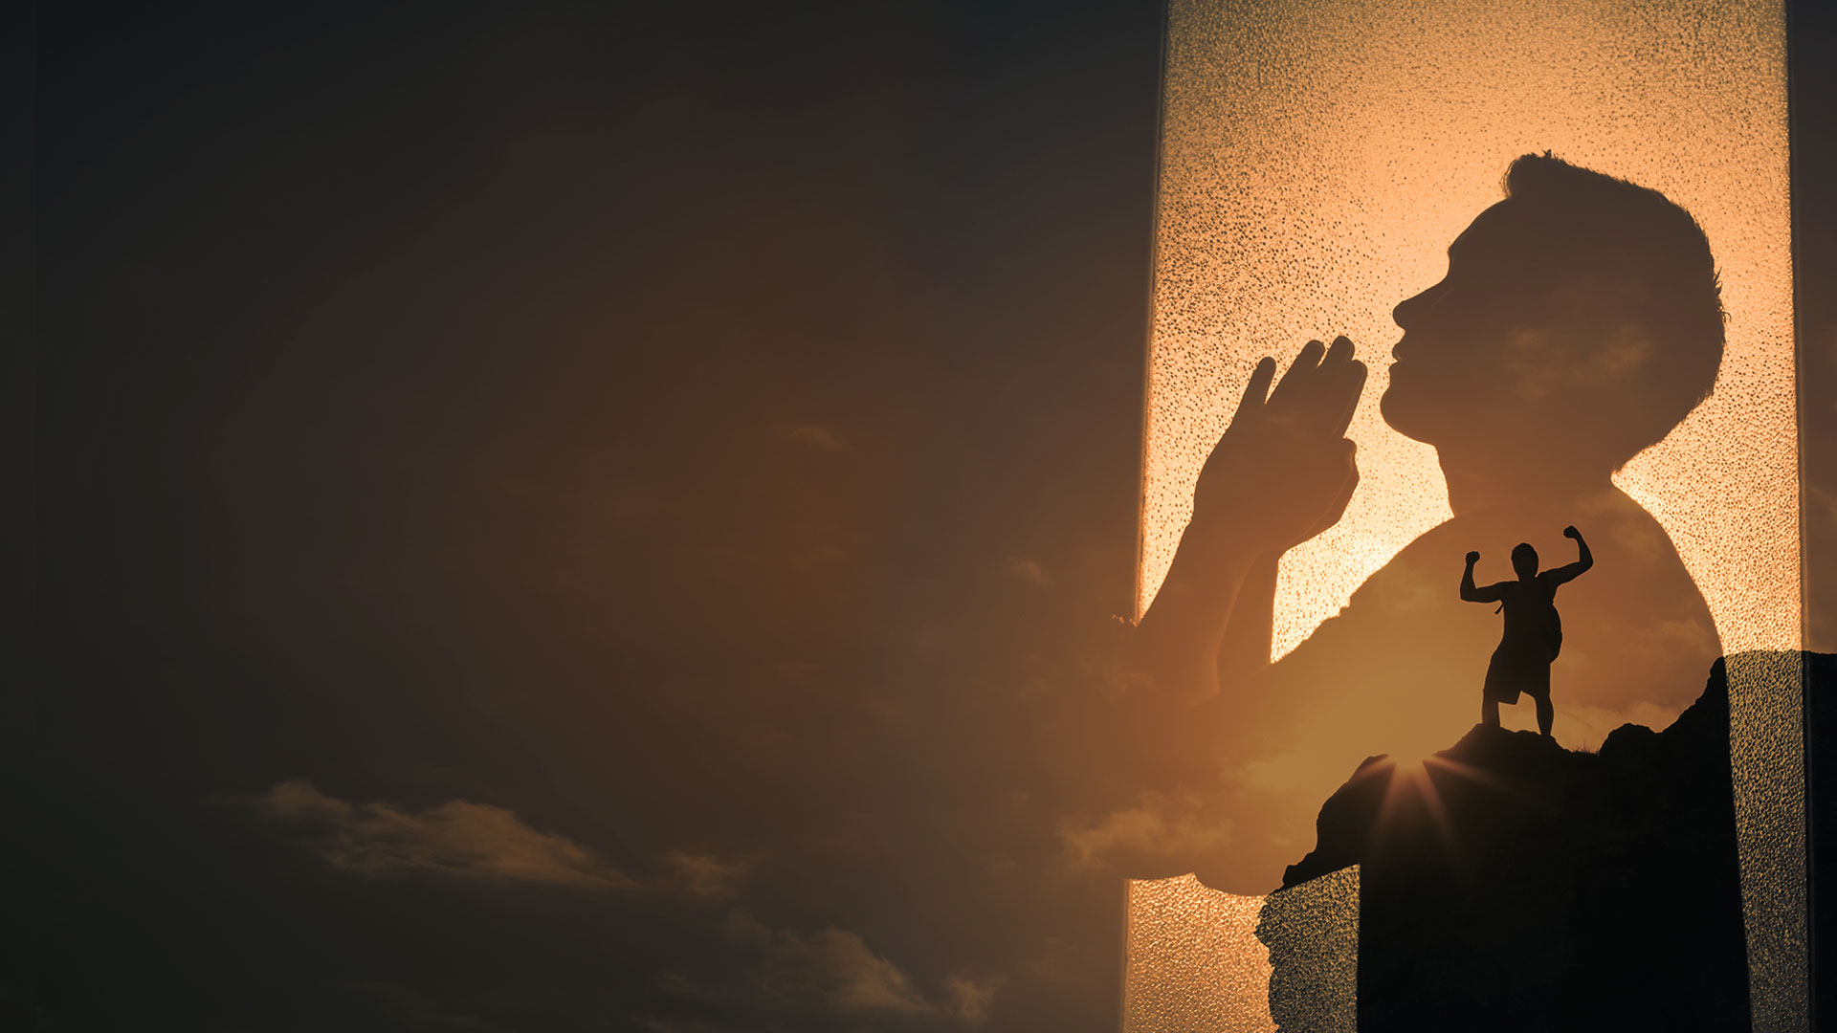
GOD ADMINISTERS HIS HEALING THROUGH MANY DIFFERENT WAYS

Slide 3
There are many ways we can receive divine healing:
1. Through His Word and personal faith.
2. Through the quickening of His indwelling Spirit.
3. Through the power of His life in you.
4. Through receiving the prayer of faith in Jesus’ name.

Slide 4
5. Through the prayer of agreement in faith.
6. Through the healing anointing.
7. Through a word of command spoken over you in faith.
8. Through partaking in the Lord’s Table in faith.

Slide 5
9. Through the ministry of deliverance.
10. Through the manifestation of the gifts of the Spirit.
11. Through the manifestation of His healing presence.
12. Through the sovereign work of His glory.

Slide 6
TODAY:

Slide 7
1. Through receiving the prayer of
faith in Jesus’ name.
2. Through the prayer of
agreement in faith.
3. Through the healing anointing
(laying on of hands, prayer
cloths and touch).

Slide 8
1. THROUGH RECEIVING THE PRAYER OF FAITH IN JESUS’ NAME.

Slide 9
Mark 6:12,13
12 So they went out and preached that people should repent.
13 And they cast out many demons, and anointed with oil many who were sick, and healed them.

Slide 10
James 5:14,15
14 Is anyone among you sick? Let him call for the elders of the church, and let them pray over him, anointing him with oil in the name of the Lord.
15 And the prayer of faith will save the sick, and the Lord will raise him up. And if he has committed sins, he will be forgiven.

Slide 11
Mark 16:17,18
17 And these signs will follow those who believe: In My name they will cast out demons; they will speak with new tongues;
18 they will take up serpents; and if they drink anything deadly, it will by no means hurt them; they will lay hands on the sick, and they will recover."

Slide 12
2. THROUGH THE PRAYER OF AGREEMENT IN FAITH.

Slide 13
Matthew 18:18-20
18 "Assuredly, I say to you, whatever you bind on earth will be bound in heaven, and whatever you loose on earth will be loosed in heaven.
19 "Again I say to you that if two of you agree on earth concerning anything that they ask, it will be done for them by My Father in heaven.
20 For where two or three are gathered together in My name, I am there in the midst of them."

Slide 14
1 John 5:14,15
14 Now this is the confidence that we have in Him, that if we ask anything according to His will, He hears us.
15 And if we know that He hears us, whatever we ask, we know that we have the petitions that we have asked of Him.

Slide 15
3. THROUGH THE HEALING ANOINTING (LAYING ON OF HANDS, PRAYER CLOTHS AND TOUCH).

Slide 16
Isaiah 10:27
It shall come to pass in that day That his burden will be taken away from your shoulder, And his yoke from your neck, And the yoke will be destroyed because of the anointing oil.

Slide 17
Luke 4:18,19
18 “The Spirit of the Lord is upon Me, Because He has anointed Me To preach the gospel to the poor; He has sent me to heal the brokenhearted, To proclaim liberty to the captives And recovery of sight to the blind, To set at liberty those who are oppressed;
19 To proclaim the acceptable year of the Lord.”

Slide 18
Luke 6:19
And the whole multitude sought to touch Him, for power went out from Him and healed them all.

Slide 19
Acts 10:38
how God anointed Jesus of Nazareth with the Holy Spirit and with power, who went about doing good and healing all who were oppressed by the devil, for God was with Him.

Slide 20
John 7:38,39
38 He who believes in Me, as the Scripture has said, out of his heart will flow rivers of living water."
39 But this He spoke concerning the Spirit, whom those believing in Him would receive; for the Holy Spirit was not yet given, because Jesus was not yet glorified.

Slide 21
Acts 19:11,12
11 Now God worked unusual miracles by the hands of Paul,
12 so that even handkerchiefs or aprons were brought from his body to the sick, and the diseases left them and the evil spirits went out of them.

