Slide 2
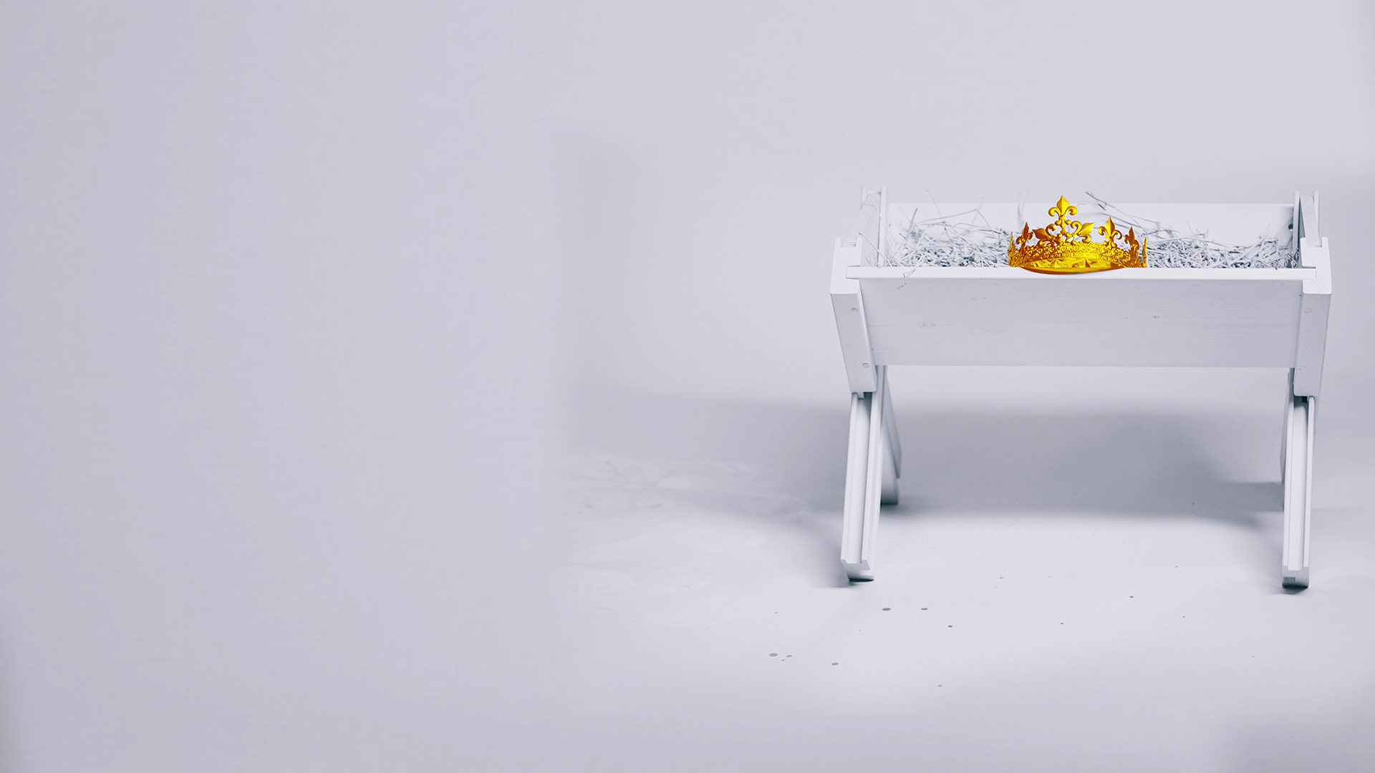
MIRACULOUS CONCEPTION

Slide 3
Isaiah 7:14
Therefore the Lord Himself will give you a sign: Behold, the virgin shall conceive and bear a Son, and shall call His name Immanuel.

Slide 4
DIVINE INCARNATION

Slide 5
John 1:1,14
1 In the beginning was the Word, and the Word was with God, and the Word was God.
14 And the Word became flesh and dwelt among us, and we beheld His glory, the glory as of the only begotten of the Father, full of grace and truth.

Slide 6
HUMBLE HABITATION

Slide 7
Philippians 2:5-7
5 Let this mind be in you which was also in Christ Jesus,
6 who, being in the form of God, did not consider it robbery to be equal with God,
7 but made Himself of no reputation, taking the form of a bondservant, and coming in the likeness of men.

Slide 8
SINLESS PERFECTION

Slide 9
Hebrews 4:15
For we do not have a High Priest who cannot sympathize with our weaknesses, but was in all points tempted as we are, yet without sin.

Slide 10
REDEEMING SACRIFICE

Slide 11
1 John 2:2
And He Himself is the propitiation for our sins, and not for ours only but also for the whole world.

Slide 12
GLORIOUS RESURRECTION

Slide 13
1 Peter 3:18,22
18 For Christ also suffered once for sins, the just for the unjust, that He might bring us to God, being put to death in the flesh but made alive by the Spirit,
22 who has gone into heaven and is at the right hand of God, angels and authorities and powers having been made subject to Him.

Slide 14
OUR SALVATION

Slide 15
1 Timothy 1:15
This is a faithful saying and worthy of all acceptance, that Christ Jesus came into the world to save sinners, of whom I am chief.

