Slide 2
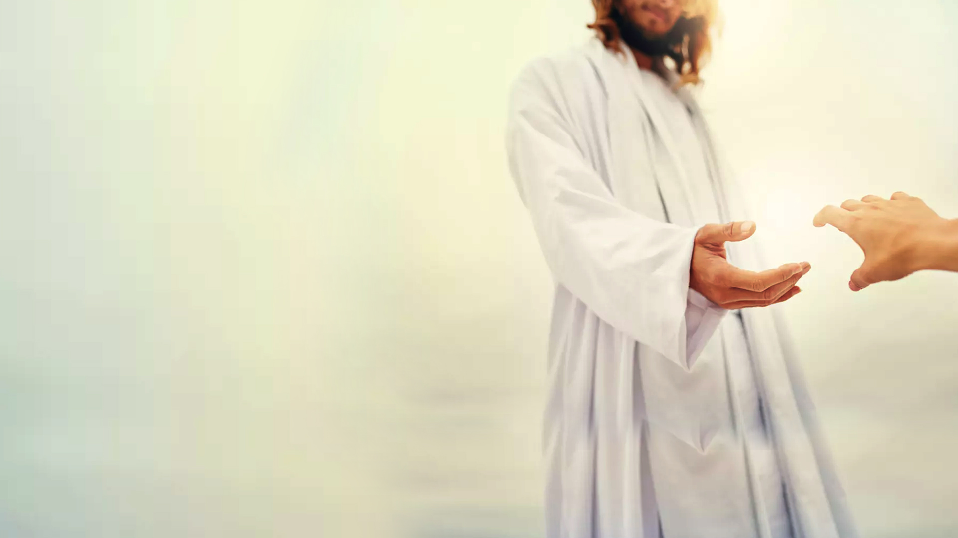
Revelation 2:1-7

Slide 3
Revelation 2:4,5 4 Nevertheless I have this against you, that you have left your first love. 5 Remember therefore from where you have fallen; repent and do the first works, or else I will come to you quickly and remove your lampstand from its place—unless you repent.

Slide 4
Three Instructions:
Remember
Repent
3) Do the first works

Slide 5
Matthew 22:37-40
37 Jesus said to him, “‘You shall love the Lord your God with all your heart, with all your soul, and with all your mind.’
38 This is the first and great commandment.

Slide 6
Matthew 22:37-40
39 And the second is like it: ‘You shall love your neighbor as yourself.’
40 On these two commandments hang all the Law and the Prophets.”

Slide 7
1. TO LOVE GOD IS TO KNOW HIM

Slide 8
1 John 4:7,8
7 Beloved, let us love one another, for love is of God; and everyone who loves is born of God and knows God.
8 He who does not love does not know God, for God is love.

Slide 9
Philippians 3:10
That I may know Him and the power of His resurrection, and the fellowship of His sufferings, being conformed to His death

Slide 10
John 15:5
“I am the vine, you are the branches. He who abides in Me, and I in him, bears much fruit; for without Me you can do nothing.

Slide 11
2. TO LOVE GOD IS TO OBEY HIM

Slide 12
John 14:15
“If you love Me, keep My commandments.

Slide 13
1 John 5:3
For this is the love of God, that we keep His commandments. And His commandments are not burdensome.

Slide 14
Keep = to guard, to fulfill (obey), to hold fast

Slide 15
3. TO LOVE GOD IS TO LOVE OTHERS

Slide 16
1 John 3:16
By this we know love, because He laid down His life for us. And we also ought to lay down our lives for the brethren.

Slide 17
1 John 4:10,11
10 In this is love, not that we loved God, but that He loved us and sent His Son to be the propitiation for our sins.
11 Beloved, if God so loved us, we also ought to love one another.

Slide 18
4. TO LOVE GOD IS TO HATE EVIL

Slide 19
Psalm 97:10
You who love the Lord, hate evil! He preserves the souls of His saints; He delivers them out of the hand of the wicked

Slide 20
Romans 12:9
Let love be without hypocrisy. Abhor what is evil. Cling to what is good.

Slide 21
1 John 2:15,16
15 Do not love the world or the things in the world. If anyone loves the world, the love of the Father is not in Him.
16 For all that is in the world – the lust of the flesh, the lust of the eyes, and the pride of life – is not of the Father but is of the world.

Slide 22
5. TO LOVE GOD IS TO TRUST HIM

Slide 23
Hebrews 11:6
But without faith it is impossible to please Him, for he who comes to God must believe that He is, and that He is a rewarder of those who diligently seek Him.

Slide 24
6. TO LOVE GOD IS TO WORSHIP HIM ONLY

Slide 25
Mark 12:29,30
29 Jesus answered him, “The first of all the commandments is: ‘Hear, O Israel, the Lord our God, the Lord is one.
30 And you shall love the Lord your God with all your heart, with all your soul, with all your mind, and with all your strength.’ This is the first commandment.

Slide 26
REVIEW

Slide 27
To love God is to
Know Him
Obey Him
Love others
Hate evil
Trust Him
Worship Him

Slide 28
Recall: Three Instructions
Remember
Repent
3) Do the first works

