Slide 2
God is interested in our thinking.

Slide 3
Psalm 139:1,2
1 O LORD, You have searched me and known me.
2 You know my sitting down and my rising up; you understand my thought afar off.

Slide 4
The impact of how we think.

Slide 5
Proverbs 23:7
For as he thinks in his heart, so is he. “Eat and drink!” he says to you, but his heart is not with you.

Slide 6
3 John 1:2
Beloved, I pray that you may prosper in all things and be in health, just as your soul prospers.

Slide 7
Where the mind goes, the man follows.

Slide 8
How do we develop and maintain a positive mindset?

Slide 9
1. DEVELOP AND MAINTAIN A BIBLE-BASED SELF-IMAGE

Slide 10
Look into the mirror of His Word.

Slide 11
Repaint your portrait according to your identity in Christ.

Slide 12
Philemon 1:6
that the sharing of your faith may become effective by the acknowledgment of every good thing which is in you in Christ Jesus.

Slide 13
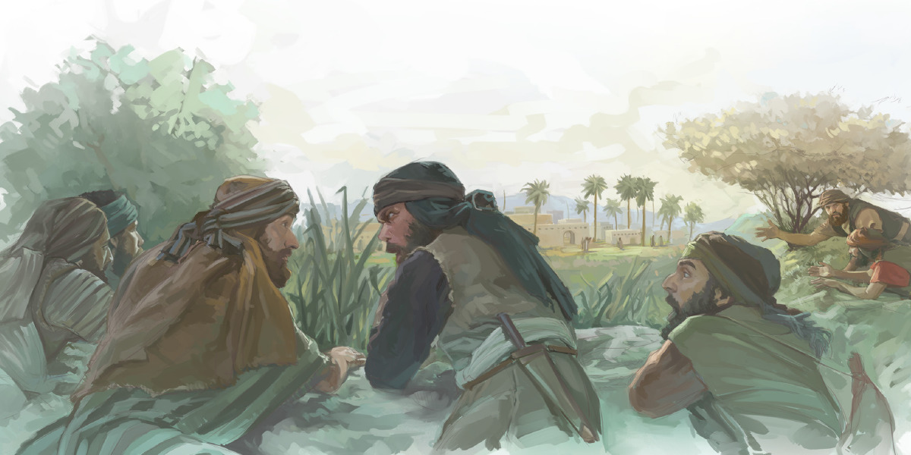

Slide 14
Negative thinking or speaking can cripple and defeat us even before the fight begins!

Slide 15
2. PRACTICE RENEWED THINKING

Slide 16
Always think aligned to God’s Word.

Slide 17
You give them something to eat.

Slide 18
To co-labor with God we must think in terms of miracles.

Slide 19
Ephesians 3:20
Now to Him who is able to do exceedingly abundantly above all that we ask or think, according to the power that works in us.

Slide 20
3. PICTURE, PRAY AND PROCLAIM THE PROMISES OF GOD FULFILLED

Slide 21
Abraham count the stars!

Slide 22
Genesis 15:5
Then He brought him outside and said, “Look now toward heaven, and count the stars if you are able to number them.” And He said to him, “So shall your descendants be.”

Slide 23
We need to visualize the promises of God becoming a reality in our lives.

Slide 24
Romans 4:17
(As it is written, “I have made you a father of many nations”) in the presence of Him whom he believed—God, who gives life to the dead and calls those things which do not exist as though they did God calls things that do not exist as though they did.

Slide 25
Hebrews 11:12
Therefore from one man, and him as good as dead, were born as many as the stars of the sky in multitude—innumerable as the sand which is by the seashore.

Slide 26
4. BE STRONG MENTALLY – DON’T QUIT

Slide 27
Tired of fighting – focus on Jesus.

Slide 28
Discouraged along the way – look at the destination

Slide 29
Greatly distressed
- Strengthen yourself in God.

Slide 30
Strengthen yourself in God by waiting, resting, quieting, calming yourself in His presence and listening to God.

Slide 31
5. KEEP HOPE ALIVE AT ALL TIMES

Slide 32
Hebrews 6:19
This hope we have as an anchor of the soul, both sure and steadfast, and which enters the Presence behind the veil.

Slide 33
Hebrews 11:1
Now faith is the substance of things hoped for, the evidence of things not seen.

Slide 34
Romans 4:18
who, contrary to hope, in hope believed, so that he became the father of many nations, according to what was spoken, "SO SHALL YOUR DESCENDANTS BE."

Slide 35
My cup overflows.

Slide 36
6. STAY SINGLE-MINDED

Slide 37
Psalm 119:113
I hate the double-minded, but I love Your law.

Slide 38
James 1:8
He is a double-minded man, unstable in all his ways.

