Slide 2
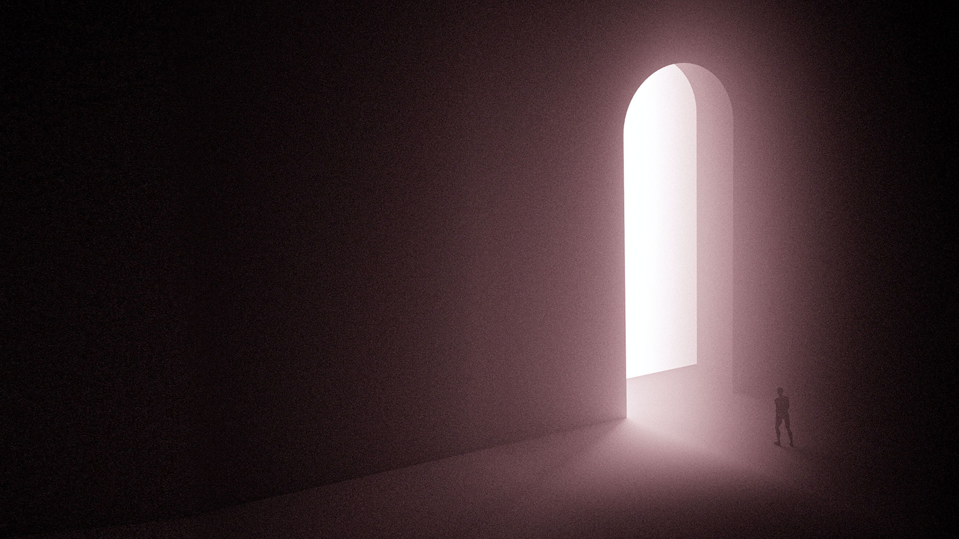
Matthew 16:13-19
13 When Jesus came into the region of Caesarea Philippi, He asked His disciples, saying, "Who do men say that I, the Son of Man, am?"
14 So they said, "Some say John the Baptist, some Elijah, and others Jeremiah or one of the prophets."
15 He said to them, "But who do you say that I am?"

Slide 3
Matthew 16:13-19
16 Simon Peter answered and said, "You are the Christ, the Son of the living God."
17 Jesus answered and said to him, "Blessed are you, Simon Bar-Jonah, for flesh and blood has not revealed this to you, but My Father who is in heaven.

Slide 4
Matthew 16:13-19
18 And I also say to you that you are Peter, and on this rock I will build My church, and the gates of Hades shall not prevail against it.
19 And I will give you the keys of the kingdom of heaven, and whatever you bind on earth will be bound in heaven, and whatever you loose on earth will be loosed in heaven."

Slide 5
The two “I will”s of Jesus in this passage:
1. I will build My church
2. I will give you the keys of the
kingdom of heaven

Slide 6
1. I WILL BUILD MY CHURCH

Slide 7
JESUS IS BUILDING HIS CHURCH

Slide 8
THIS IS A CHURCH THAT OVERTHROWS THE POWERS OF HELL

Slide 9
2. I WILL GIVE YOU THE KEYS OF
THE KINGDOM OF HEAVEN

Slide 10
THE AUTHORITY OF HEAVEN IS VESTED IN THE CHURCH - IN EVERY BELIEVER

Slide 11
WE MUST EXERCISE OUR AUTHORITY OVER THE WORKS OF DARKNESS

Slide 12
YOU/WE ARE THE CHURCH

