Slide 2
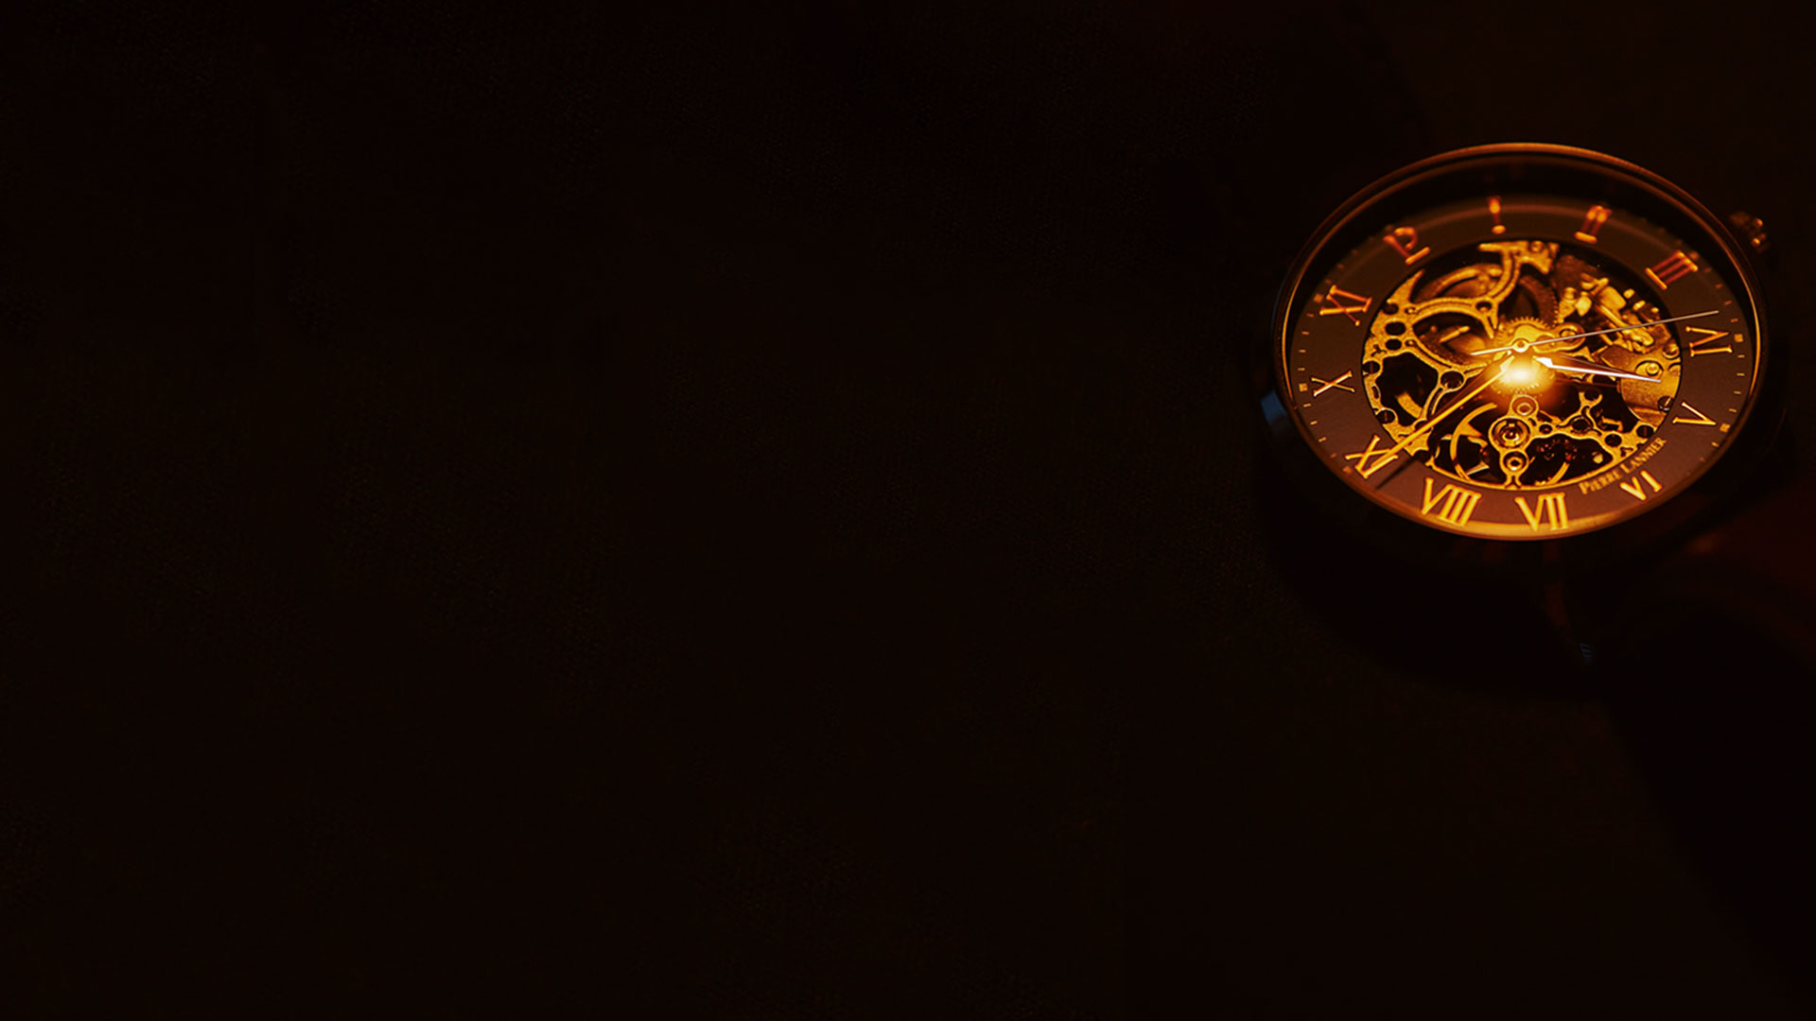
Ephesians 4:11-13
11 And He Himself gave some to be apostles, some prophets, some evangelists, and some pastors and teachers,
12 for the equipping of the saints for the work of ministry, for the edifying of the body of Christ,
13 till we all come to the unity of the faith and of the knowledge of the Son of God, to a perfect man, to the measure of the stature of the fullness of Christ;

Slide 3
Ephesians 5:25-27
25 Husbands, love your wives, just as Christ also loved the church and gave Himself for her,
26 that He might sanctify and cleanse her with the washing of water by the word,
27 that He might present her to Himself a glorious church, not having spot or wrinkle or any such thing, but that she should be holy and without blemish.

Slide 4
A BRIEF HISTORY OF THE CHURCH

Slide 5
The First Four Hundred Years
(A.D. 30 – A.D. 400)

Slide 6
The Dark Ages
(A.D. 401 - A.D. 1500)

Slide 7
Revival, Restoration and Glory
(1500 - Present)

Slide 8
WHAT IS GOD DOING IN THE
CHURCH TODAY?

Slide 9
The five - fold ministries are working
to equip the saints and build up the
Body of Christ so that we all come to:

Slide 10
A. THE UNITY OF THE FAITH

Slide 11
B. KNOWING JESUS ACCURATELY

Slide 12
C. MATURITY TO CHRISTLIKENESS

Slide 13
D. BEING A GLORIOUS CHURCH

Slide 14
WE GET TO BE A PART OF WHAT
GOD IS DOING!

Slide 15
A. The Church is coming to a place
of unity of the faith.

Slide 16
B. The Church will come to know
Jesus accurately.

Slide 17
C. The Church, the believers, will come to
a place of maturity by becoming Christlike.

Slide 18
D. The Church will come to a place
of being a glorious Church.

Slide 19
Haggai 2:9
'The glory of this latter temple shall be greater than the former, ’ says the LORD of hosts. 'And in this place I will give peace, ’ says the LORD of hosts."

Slide 20
WHAT IS THE CHURCH?

Slide 21
The Church is the blood bought and blood washed, redeemed saints of God, who have been made kings and priests unto God!

Slide 22
The Church is Christ’s Body on the Earth.
We are His hands and His feet.
We go where He sends us and do what He tells us!

Slide 23
The Church is the salt of the earth. We release the God flavors into our world.
We dispense His life and virtue and preserve righteousness and truth.

Slide 24
The Church is the light of the world.
We release the God colors into the earth.
We emanate His expressions of wisdom, power, glory, and beauty, dispelling darkness and advancing the Kingdom of light.

Slide 25
The Church is the house of God. We are the dwelling place of God on the earth.
God dwells in us, moves among us and is seen amongst us.

Slide 26
The Church is the pillar of truth.
We uphold truth and are standard bearers for justice, fairness, righteousness, peace, and equity for all.

Slide 27
The Church is the branch on the true Vine.
We express the life of the Vine so that His fruit can be seen in and through us.

Slide 28
The Church is the family of God. As sons and daughters, the Father cares for us and we care for each other. As His family we love, welcome, and embrace others as they come into the family of God through personal faith in Jesus Christ.

Slide 29
The Church is a nation of holy people, a peculiar people, a people set apart to Him, to walk in Kingdom culture and values and to declare the praises of the One who brought us out of darkness into His marvelous light.

Slide 30
The Church is the emissary of Christ. We are ambassadors of Christ, reaching out to a hurting world, announcing the good news of the Kingdom of God, and inviting people to be reconciled to God.

Slide 31
The Church are the anointed ones. Sowers sowing seed. Soldiers in conflict. Laborers in the vineyard. Bondservants of Christ. Earthen vessels filled with heavenly treasure. Messengers of good news. Called, appointed and anointed by the Spirit of God, doing His will and releasing His Kingdom on earth as it is in heaven.

Slide 32
The Church is the Bride of Christ. We are set on Him. Our hearts and affections are devoted to Him and we set ourselves apart as a bride for her groom, waiting for that great union in the sky and to be seated at the marriage supper of the Lamb of God!

Slide 33
The Church is the work Christ is building, to whom He has given the keys of the Kingdom. As those authorized in Jesus’ name, we bind on earth what heaven has bound and release on earth, what heaven has released.

Slide 34
The Church is the unstoppable move of the Holy Spirit of God through nameless, faceless, men and women, Jews and Gentiles, people from every, race, tongue, tribe, and nation.

Slide 35
This is the Church’s finest hour!

Slide 36
This is the Church’s brightest day!

Slide 37
This is the Church’s greatest moment!

Slide 38
This is the Church’s final fray!

Slide 39
And all the powers of hell cannot stop this advancing Church.

Slide 40
This is Christ’s Church!

