Slide 2
KINSMAN REDEEMER

Slide 3
THE STORY OF THE BOOK OF RUTH

Slide 4
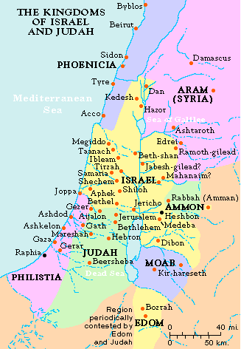
MOAB

Slide 5
MOAB
Deuteronomy 23:3
An Ammonite or Moabite shall not enter the assembly of the LORD; even to the tenth generation none of his descendants shall enter the assembly of the LORD forever,

Slide 6
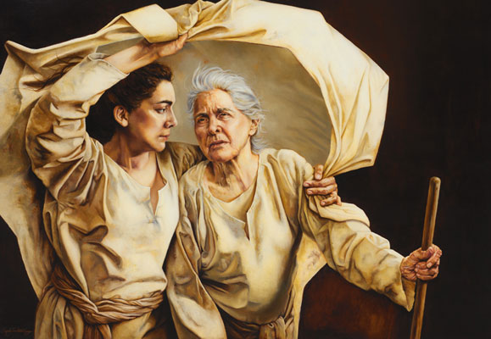
RUTH, THE MOABITE
‘Whither thou goest’, Painting: Sandy Freckleton Gagan

Slide 7
RUTH, THE MOABITE
Ruth 1:16-17
16 But Ruth said: "Entreat me not to leave you, Or to turn back from following after you; For wherever you go, I will go; And wherever you lodge, I will lodge; Your people shall be my people, And your God, my God.
17 Where you die, I will die, And there will I be buried. The LORD do so to me, and more also, If anything but death parts you and me."

Slide 8
RUTH, THE MOABITE
Isaiah 56:6-7
6 "Also the sons of the foreigner Who join themselves to the LORD, to serve Him, And to love the name of the LORD, to be His servants—Everyone who keeps from defiling the Sabbath, And holds fast My covenant—
7 Even them I will bring to My holy mountain, And make them joyful in My house of prayer. Their burnt offerings and their sacrifices Will be accepted on My altar; For My house shall be called a house of prayer for all nations."

Slide 9
THE CURSE IS REMOVED
WHEN A PERSON TURNS
TO THE LIVING GOD

Slide 10
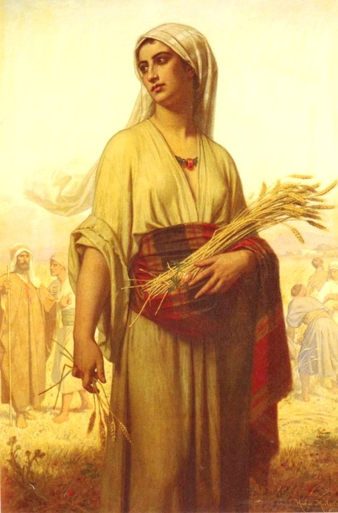
‘Ruth in the Fields’,
Painting: Merle Hugues, 1876

Slide 11
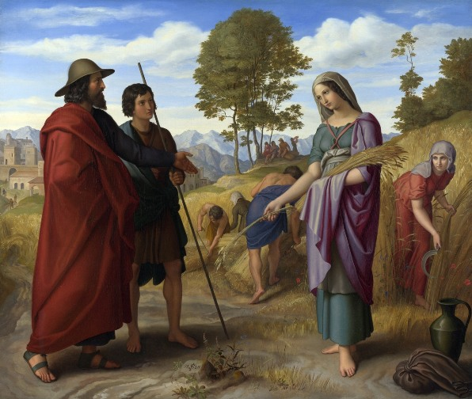
‘Ruth in Boaz’ Field’,
Painting: Julius Schnorr von Carolsfeld, 1828

Slide 12
THE APPEAL TO BOAZ
Ruth 3:9
And he said, "Who are you?" So she answered, "I am Ruth, your maidservant. Take your maidservant under your wing, for you are a close relative."

Slide 13
REDEMPTION
Ruth 4:17
Also the neighbor women gave him a name, saying, "There is a son born to Naomi." And they called his name Obed. He is the father of Jesse, the father of David.

Slide 14
HEBREW ‘GAW-AL’
Psalm 78:35
Then they remembered that God was their rock, And the Most High God their Redeemer (gaw-al).

Slide 15
HEBREW ‘GAW-AL’
Psalm 103:4
Who redeems (gaw-al) your life from destruction, Who crowns you with lovingkindness and tender mercies

Slide 16
HEBREW ‘GAW-AL’
Isaiah 43:1
But now, thus says the LORD, who created you, O Jacob, And He who formed you, O Israel: "Fear not, for I have redeemed (gaw-al) you; I have called you by your name; You are Mine.

Slide 17
JESUS OUR KINSMAN REDEEMER

Slide 18
JESUS OUR KINSMAN REDEEMER
Hebrews 2:14-16
14 Inasmuch then as the children have partaken of flesh and blood, He Himself likewise shared in the same, that through death He might destroy him who had the power of death, that is, the devil,
15 and release those who through fear of death were all their lifetime subject to bondage.
16 For indeed He does not give aid to angels, but He does give aid to the seed of Abraham.

