Slide 2
1 John 5:1,4
1 Whoever believes that Jesus is the Christ is born of God,...

Slide 3
1 John 5:1,4
4 For whatever is born of God overcomes the world. And this is the victory that has overcome the world—our faith.

Slide 4
I AM BORN OF GOD
AND I OVERCOME THIS WORLD
AND ALL THAT IS IN IT.
I OVERCOME BY FAITH.

Slide 5
1 John 4:4
You are of God, little children, and have overcome them, because He who is in you is greater than he who is in the world.

Slide 6
JESUS WHO IS IN ME
IS GREATER THAN ANYTHING OR ANY POWER THAT I FACE IN THIS WORLD

Slide 7
ANXIETY
feeling of worry, apprehension,
nervousness, uneasiness or fear

Slide 8
ANXIETY DISORDER
characterized by excessive or prolonged nervousness, fear, apprehension,
and worry that disrupts daily life

Slide 9
Practical Biblical instructions
that will help us overcome
feelings of anxiety and worry

Slide 10
IMPORTANT NOTE
Get professional help if you need it.
Do not discontinue professional help until directed to do so.

Slide 11
PERFECT PEACE –
GOD'S ANTIDOTE TO ANXIETY
Our God is JEHOVAH SHALOM,
God who gives us peace,
perfect peace (Judges 6:24).

Slide 12
PERFECT PEACE –
GOD'S ANTIDOTE TO ANXIETY
Isaiah 26:3
You will keep him in perfect peace, Whose mind is stayed on You, Because he trusts in You.

Slide 13
PERFECT PEACE –
GOD'S ANTIDOTE TO ANXIETY
John 14:27
Peace I leave with you, My peace I give to you; not as the world gives do I give to you. Let not your heart be troubled, neither let it be afraid.

Slide 14
PERFECT PEACE –
GOD'S ANTIDOTE TO ANXIETY
John 16:33
These things I have spoken to you, that in Me you may have peace. In the world you will have tribulation; but be of good cheer, I have overcome the world.

Slide 15
PERFECT PEACE –
GOD'S ANTIDOTE TO ANXIETY
WE MUST LEARN
HOW TO
LIVE IN PERFECT PEACE
EVEN IN THE MIDDLE
OF A PERFECT STORM

Slide 16
WHAT ANXIETY (WORRY) DOES?
1, WORRY PRODUCES NOTHING GOOD

Slide 17
WHAT ANXIETY (WORRY) DOES?
1, WORRY PRODUCES NOTHING GOOD
Matthew 6:25-27 (TPT)
25 “This is why I tell you to never be worried about your life, for all that you need will be provided, such as food, water, clothing—everything your body needs. Isn’t there more to your life than a meal? Isn’t your body more than clothing?

Slide 18
WHAT ANXIETY (WORRY) DOES?
1, WORRY PRODUCES NOTHING GOOD
Matthew 6:25-27 (TPT)
26 “Look at all the birds—do you think they worry about their existence? They don’t plant or reap or store up food, yet your heavenly Father provides them each with food. Aren’t you much more valuable to your Father than they?

Slide 19
WHAT ANXIETY (WORRY) DOES?
1, WORRY PRODUCES NOTHING GOOD
Matthew 6:25-27 (TPT)
27 So, which one of you by worrying could add anything to your life?

Slide 20
WHAT ANXIETY (WORRY) DOES?
2, WORRY IS A SILENT KILLER

Slide 21
TROUBLING THOUGHTS - PRIMARY DISRUPTORS TO PERFECT PEACE
WHEN OUR MIND IS OVERPOWERED BY TROUBLING THOUGHTS,
WE TEND TO LOSE OUR PEACE

Slide 22
TROUBLING THOUGHTS - PRIMARY DISRUPTORS TO PERFECT PEACE
2 Corinthians 10:5 (TPT)
We can demolish every deceptive fantasy that opposes God and break through every arrogant attitude that is raised up in defiance of the true knowledge of God. We capture, like prisoners of war, every thought and insist that it bow in obedience to the Anointed One.

Slide 23
TROUBLING THOUGHTS - PRIMARY DISRUPTORS TO PERFECT PEACE
WORRYING
IS REALLY US BEING TRAPPED IN A
"WHAT IF......"
THINKING PATTERN

Slide 24
CONQUERING AND CALMING YOUR MIND
1, PRAY, LET GO, LET GOD

Slide 25
CONQUERING AND CALMING YOUR MIND
1, PRAY, LET GO, LET GOD
1 Peter 5:6-7 (TPT)
6 If you bow low in God’s awesome presence, he will eventually exalt you as you leave the timing in his hands.

Slide 26
CONQUERING AND CALMING YOUR MIND
1, PRAY, LET GO, LET GOD
1 Peter 5:6-7 (TPT)
7 Pour out all your worries and stress upon him and leave them there, for he always tenderly cares for you.

Slide 27
CONQUERING AND CALMING YOUR MIND
1, PRAY, LET GO, LET GOD
Psalm 37:7-8 (TPT)
7 Quiet your heart in his presence and pray; keep hope alive as you long for God to come through for you. And don’t think for a moment that the wicked in their prosperity are better off than you.

Slide 28
CONQUERING AND CALMING YOUR MIND
1, PRAY, LET GO, LET GOD
Psalm 37:7-8 (TPT)
8 Stay away from anger and revenge. Keep envy far from you, for it only leads you into lies.

Slide 29
CONQUERING AND CALMING YOUR MIND
1, PRAY, LET GO, LET GOD
Psalm 131:1-2
1 LORD, my heart is not haughty, Nor my eyes lofty. Neither do I concern myself with great matters, Nor with things too profound for me

Slide 30
CONQUERING AND CALMING YOUR MIND
1, PRAY, LET GO, LET GOD
Psalm 131:1-2
2 Surely I have calmed and quieted my soul, Like a weaned child with his mother; Like a weaned child is my soul within me.

Slide 31
CONQUERING AND CALMING YOUR MIND
1, PRAY, LET GO, LET GOD
Philippians 4:6-7 (TPT)
6 Don’t be pulled in different directions or worried about a thing. Be saturated in prayer throughout each day, offering your faith-filled requests before God with overflowing gratitude. Tell him every detail of your life,

Slide 32
CONQUERING AND CALMING YOUR MIND
1, PRAY, LET GO, LET GOD
Philippians 4:6-7 (TPT)
7 then God’s wonderful peace that transcends human understanding, will make the answers known to you through Jesus Christ.

Slide 33
CONQUERING AND CALMING YOUR MIND
2, FOCUS ON GOD AND HIS PROMISES

Slide 34
CONQUERING AND CALMING YOUR MIND
2, FOCUS ON GOD AND HIS PROMISES
Philippians 4:8 (TPT)
So keep your thoughts continually fixed on all that is authentic and real, honorable and admirable, beautiful and respectful, pure and holy, merciful and kind….

Slide 35
CONQUERING AND CALMING YOUR MIND
2, FOCUS ON GOD AND HIS PROMISES
Philippians 4:8 (TPT)
…And fasten your thoughts on every glorious work of God, praising him always.

Slide 36
CONQUERING AND CALMING YOUR MIND
2, FOCUS ON GOD AND HIS PROMISES
Isaiah 26:3
You will keep him in perfect peace, Whose mind is stayed on You, Because he trusts in You.

Slide 37
CONQUERING AND CALMING YOUR MIND
2, FOCUS ON GOD AND HIS PROMISES
Promises about children
Isaiah 44:3-4, Isaiah 54:13

Slide 38
CONQUERING AND CALMING YOUR MIND
2, FOCUS ON GOD AND HIS PROMISES
Promises about sleep
Psalm 4:8, Psalm 127:2, Proverbs 3:24

Slide 39
CONQUERING AND CALMING YOUR MIND
2, FOCUS ON GOD AND HIS PROMISES
Matthew 6:31-33 (TPT)
31 “So then, forsake your worries! Why would you say, ‘What will we eat?’ or ‘What will we drink?’ or ‘What will we wear?’

Slide 40
CONQUERING AND CALMING YOUR MIND
2, FOCUS ON GOD AND HIS PROMISES
Matthew 6:31-33 (TPT)
32 For that is what the unbelievers chase after. Doesn’t your heavenly Father already know the things your bodies require?

Slide 41
CONQUERING AND CALMING YOUR MIND
2, FOCUS ON GOD AND HIS PROMISES
Matthew 6:31-33 (TPT)
33 “So above all, constantly chase after the realm of God’s kingdom and the righteousness that proceeds from him. Then all these less important things will be given to you abundantly.

Slide 42
CONQUERING AND CALMING YOUR MIND
3, DECLARE HIS WORD ALOUD

Slide 43
CONQUERING AND CALMING YOUR MIND
3, DECLARE HIS WORD ALOUD
'hagah' = meditate, mutter,
utter, speak, low speaking

Slide 44
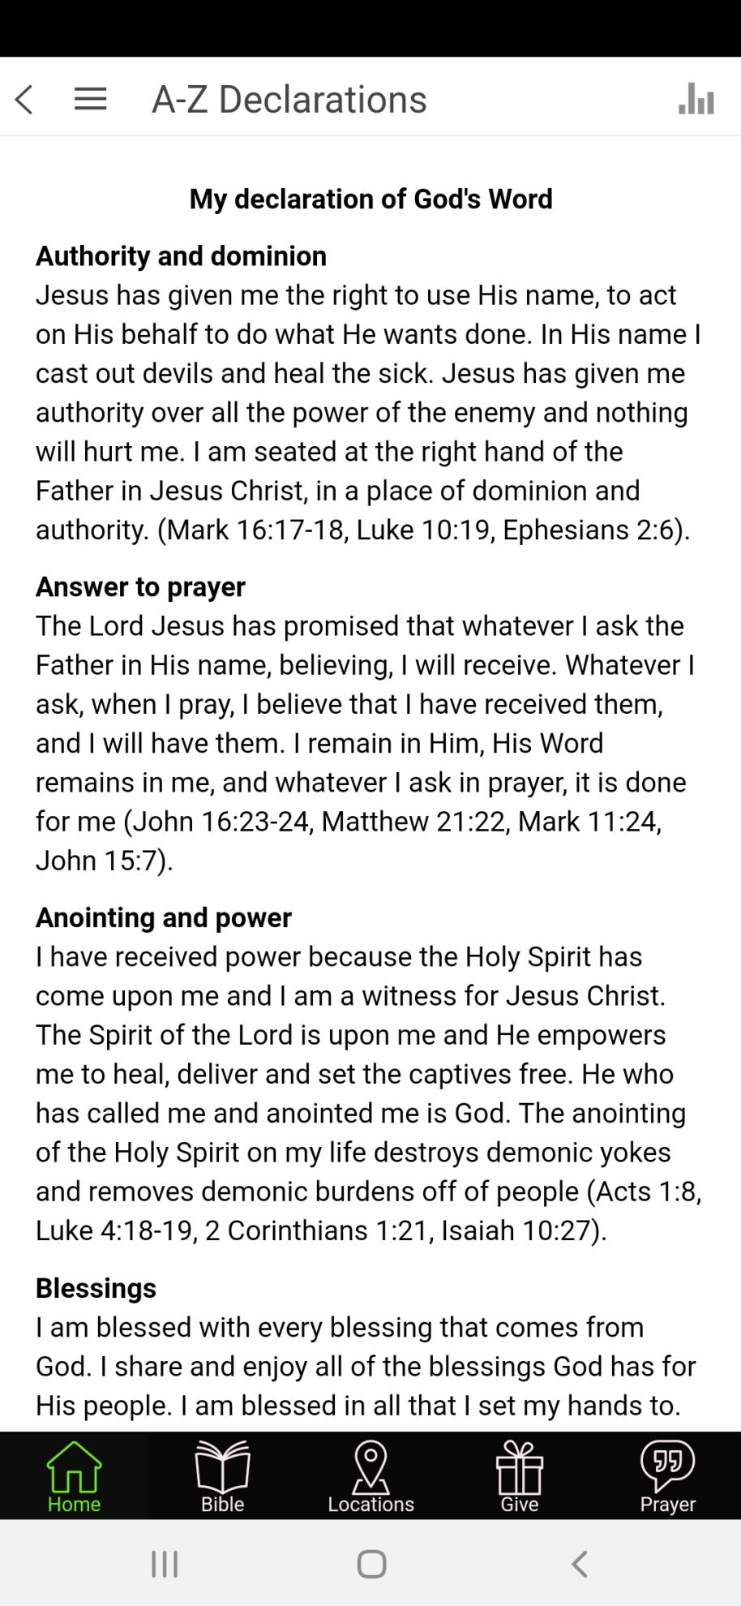

Slide 45
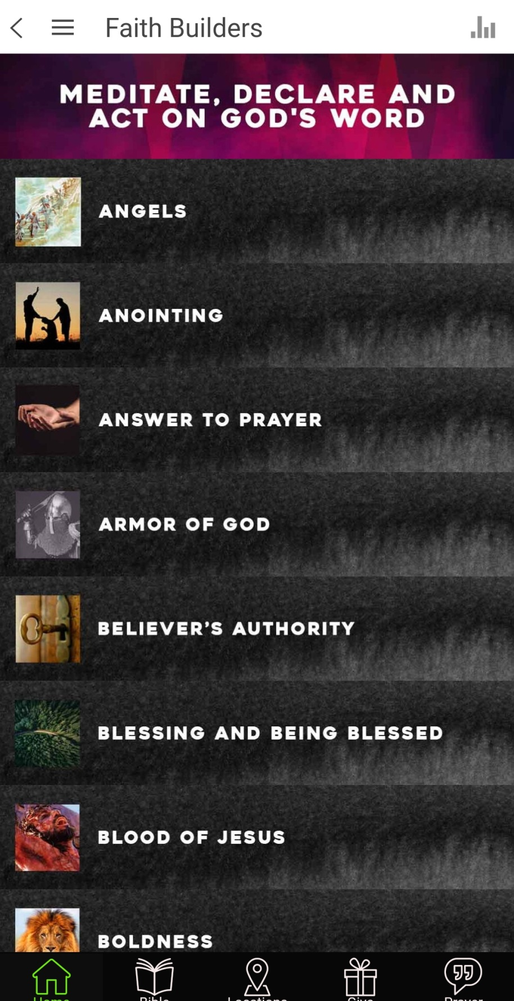

Slide 46
CONQUERING AND CALMING YOUR MIND
4, TAKE ONE DAY AT A TIME

Slide 47
CONQUERING AND CALMING YOUR MIND
4, TAKE ONE DAY AT A TIME
Matthew 6:34 (TPT)
Refuse to worry about tomorrow, but deal with each challenge that comes your way, one day at a time. Tomorrow will take care of itself.

Slide 48
CONQUERING AND CALMING YOUR MIND
5, SHARE YOUR BURDEN

Slide 49
CONQUERING AND CALMING YOUR MIND
5, SHARE YOUR BURDEN
A) Talk to someone who will listen
Galatians 6:2
Bear one another's burdens, and so fulfill the law of Christ.

Slide 50
CONQUERING AND CALMING YOUR MIND
5, SHARE YOUR BURDEN
B) Delegate, de-clutter, relinquish

Slide 51
CONQUERING AND CALMING YOUR MIND
1, Pray, Let Go, Let God
2, Focus On God And His Promises
3, Declare His Word Aloud
4, Take One Day At A Time
5, Share your burden

Slide 52
Isaiah 26:3
You will keep him in perfect peace, Whose mind is stayed on You, Because he trusts in You.

