Slide 2
Introduction
Corinth

Slide 3
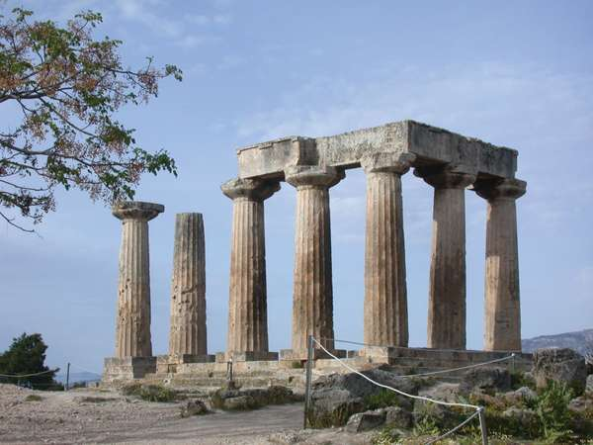
Introduction
Temple of Apollo
Acropolis

Slide 4
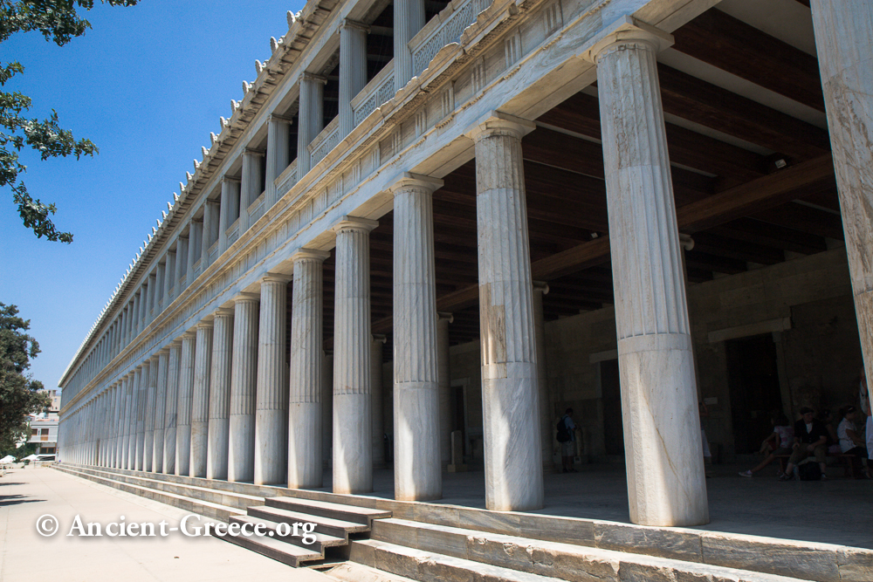
Introduction
Agora (marketplace)

Slide 5
Introduction
Paul’s Second Missionary Journey
A.D. 49 - A.D. 52
Acts 15:36 – Acts 18:22

Slide 6
Introduction
Enter Apollos
Acts 18:24-28
24 Now a certain Jew named Apollos, born at Alexandria, an eloquent man and mighty in the Scriptures, came to Ephesus.
25 This man had been instructed in the way of the Lord; and being fervent in spirit, he spoke and taught accurately the things of the Lord, though he knew only the baptism of John

Slide 7
Introduction
Enter Apollos
Acts 18:24-28
26 So he began to speak boldly in the synagogue. When Aquila and Priscilla heard him, they took him aside and explained to him the way of God more accurately.

Slide 8
Introduction
Enter Apollos
Acts 18:24-28
27 And when he desired to cross to Achaia, the brethren wrote, exhorting the disciples to receive him; and when he arrived, he greatly helped those who had believed through grace;
28 for he vigorously refuted the Jews publicly, showing from the Scriptures that Jesus is the Christ.

Slide 9
Introduction
Paul's Third Missionary Journey
A.D. 53 - A.D. 58
Acts 18:23 – Acts 21:15

Slide 10
Introduction
The church in Corinth
Established about A.D. 51
1 Corinthians written about A.D. 58

Slide 11
1 Corinthians 1
Salutation
1 Corinthians 1:1-3

Slide 12
1 Corinthians 1
verse 1
….called to be an apostle of Jesus Christ through the will of God,…
When we fulfill our calling,
we are fulfilling the will of God

Slide 13
1 Corinthians 1
verse 2
…. church of God which is at Corinth…
The church of God is
to influence the city

Slide 14
1 Corinthians 1
verse 2
…. sanctified in Christ Jesus, called to be saints …
sanctified = set apart, consecrated to God
saints = people who are sacred, set apart, holy and consecrated

Slide 15
1 Corinthians 1
verse 2
…. with all who in every place call on the name of Jesus Christ our Lord…
This epistle is for us today

Slide 16
1 Corinthians 1
verse 3
Grace to you and peace from God our Father and the Lord Jesus Christ.
Grace refers to favor, empowering, virtues and gifts that come from God.
Peace refers to total well-being.

Slide 17
1 Corinthians 1
Recognizing What God Has Done
1 Corinthians 1:4-9

Slide 18
1 Corinthians 1
Recognizing What God Has Done
Vs 4:
I thank my God always concerning you…
See the good things and give thanks, even as you address the challenges, issues and difficulties.

Slide 19
1 Corinthians 1
Recognizing What God Has Done
Vs 4:
…. for the grace of God which was given to you by Christ Jesus

Slide 20
1 Corinthians 1
Recognizing What God Has Done
Vs 5:
that you were enriched in everything by Him in all utterance and all knowledge,
"As a believer, I have been enriched in everything by Jesus Christ because of the grace of God given to me".

Slide 21
1 Corinthians 1
Recognizing What God Has Done
Vs 6:
even as the testimony of Christ was confirmed in you,

Slide 22
1 Corinthians 1
Recognizing What God Has Done
Vs 7:
so that you come short in no gift, eagerly waiting for the revelation of our Lord Jesus Christ,
The expression of the gifts of the Spirit are not to be equated
to spiritual maturity.

Slide 23
1 Corinthians 1
Recognizing What God Has Done
Vs 8:
who will also confirm you to the end, that you may be blameless in the day of our Lord Jesus Christ.

Slide 24
1 Corinthians 1
Recognizing What God Has Done
Vs 9:
God is faithful, by whom you were called into the fellowship of His Son, Jesus Christ our Lord.

Slide 25
1 Corinthians 1
A Call To Unity
1 Corinthians 1:10-17

Slide 26
1 Corinthians 1
A Call To Unity
Vs 10:
Now I plead with you, brethren, by the name of our Lord Jesus Christ, that you all speak the same thing, and that there be no divisions among you, but that you be perfectly joined together in the same mind and in the same judgment.

Slide 27
1 Corinthians 1
A Call To Unity
Vs 10:
speak the same thing
no divisions
be perfectly joined together
same mind
same judgment

Slide 28
1 Corinthians 1
A Call To Unity
Vs 11-17:
What was causing divisions and quarrels among the Corinthian believers?
People, taking sides with various leaders

Slide 29
1 Corinthians 1
A Call To Unity
Vs 11-17:
While each leader, church and ministry has their own distinctive according to the grace given to them, as believers, we receive through them, but our identity is not from them

Slide 30
1 Corinthians 1
A Call To Unity
Vs 17:
For Christ did not send me to baptize, but to preach the gospel, not with wisdom of words, lest the cross of Christ should be made of no effect.

Slide 31
1 Corinthians 1
A Call To Unity
Vs 17:
The power of the Gospel is inherent in the message of the cross of Christ and does not depend in any measure on human eloquence.

Slide 32
1 Corinthians 1
The Message Of The Cross
1 Corinthians 1:18-25

Slide 33
1 Corinthians 1
The Message Of The Cross
vs 18:
….the message of the cross... is the power of God…
God's power is delivered and administered into people's lives as we bring the message of
the cross of Christ to them.

Slide 34
1 Corinthians 1
The Message Of The Cross
vs 21:
…the world through wisdom did not know God..
Spiritual things are understood not with the natural mind, but with the help of the Holy Spirit

Slide 35
1 Corinthians 1
The Message Of The Cross
vs 21:
…it pleased God through the foolishness of the message preached to save those who believe…

Slide 36
1 Corinthians 1
The Message Of The Cross
vs 22-24:
22 For Jews request a sign, and Greeks seek after wisdom;
23 but we preach Christ crucified, to the Jews a stumbling block and to the Greeks foolishness,
24 but to those who are called, both Jews and Greeks, Christ the power of God and the wisdom of God.

Slide 37
1 Corinthians 1
The Message Of The Cross
vs 22-24:
To both audiences, Jews (spiritual) and Greeks (intellectual), we have just one message, the message of the cross of Christ.

Slide 38
1 Corinthians 1
The Message Of The Cross
vs 25:
Because the foolishness of God is wiser than men, and the weakness of God is stronger than men.

Slide 39
1 Corinthians 1
Understanding God's Calling
1 Corinthians 1:26-31

Slide 40
1 Corinthians 1
Understanding God's Calling
God will work in each of our lives
displaying His wisdom and power
and He will be glorified in each of us!

Slide 41
1 Corinthians 1
Understanding God's Calling
vs 30
God has brought us to be in Christ Jesus.
God has made Christ to be for us wisdom, righteousness, sanctification and redemption.

