Slide 1
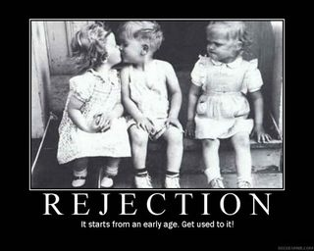

Slide 2
Rejection – Cause & Cure
A. Definition
Opposite = acceptance
‘Rejection’ = the feeling of being unwanted, excluded, worthless, not really belonging, somehow on the outside looking in, but never knowing how to get on the inside.

Slide 3
Rejection – Cause & Cure
Isaiah 54:4-6…
…a wife deserted & distressed in spirit
…a wife married young, only to be rejected.
Proverbs 18:14…
‘A man’s spirit sustains him in sickness, but a crushed spirit, who can bear?”

Slide 4
Rejection – Cause & Cure
B. Result of Rejection:
Inability to receive and pass on love
I John 4:19 - we love him, because he first loved us.
Rejection passed down from one generation to the next

Slide 5
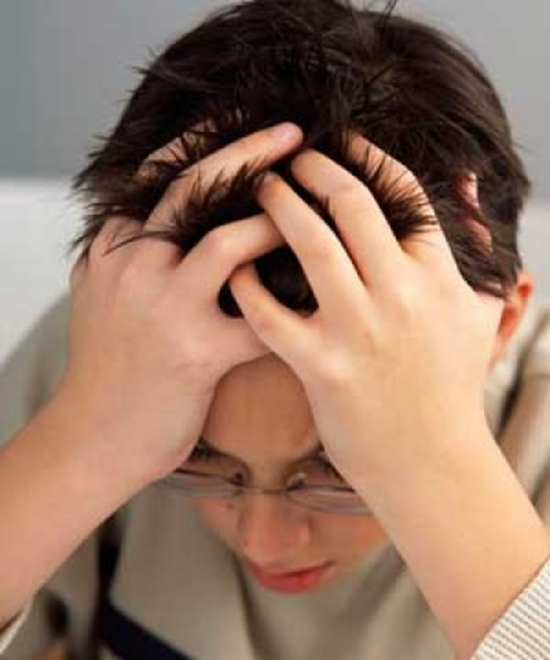
Rejection – Cause & Cure
C. Wrong ways of Handling Rejection
(1) Depression

Slide 6
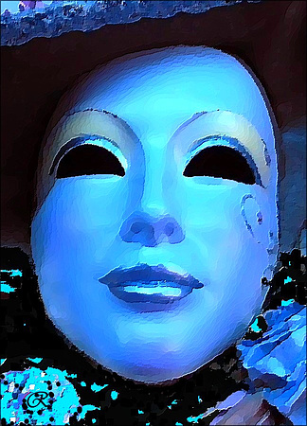
Rejection – Cause & Cure
C. Wrong ways of Handling Rejection
(2) Masking

Slide 7
Rejection – Cause & Cure
C. Wrong ways of Handling Rejection
(3) Revenge

Slide 8
Rejection – Cause & Cure
D. Remedy - Isaiah 53 : 4 - 6
‘Surely he took up our infirmities and carried our sorrows, yet we considered him stricken by God, smitten by him & afflicted. But he was pierced for our transgression, he was crushed for our iniquities, and the punishment that brought us peace was upon him and by his wounds we are healed. We all like sheep have gone astray, each of us have turned to his own way, and the Lord has laid on him the iniquity of us all.”

Slide 9
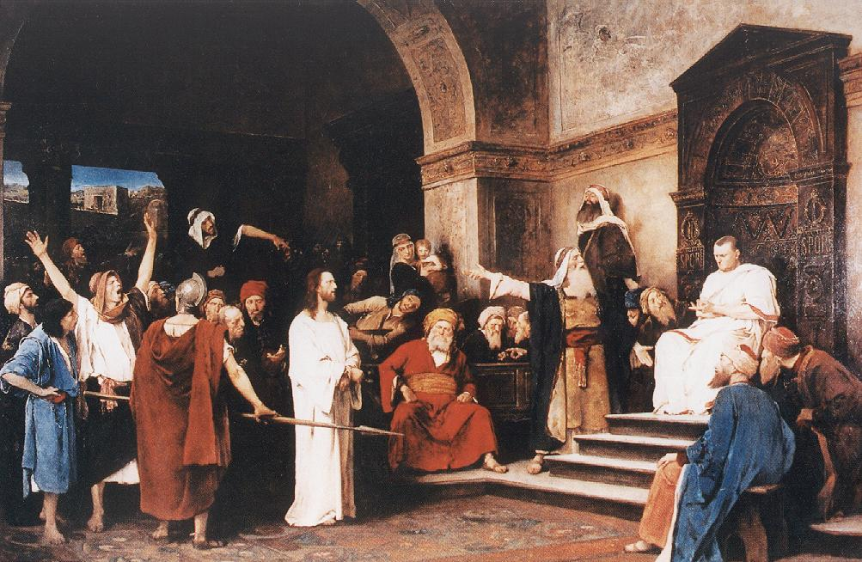

Slide 10
Rejection – Cause & Cure
Cross = Divine Exchange
Jesus … So that we might …
… was punished … be forgiven
… was wounded … be healed
… was made sin … be made righteous
… took our curses … be blessed
… died our death … have eternal life
… was rejected … be accepted

Slide 11
Rejection – Cause & Cure
E. How to apply God’s Remedy
1. Repent
2. Forgive
3. Exchange
4. Belong
Would you like to be prayed for?

