Slide 1
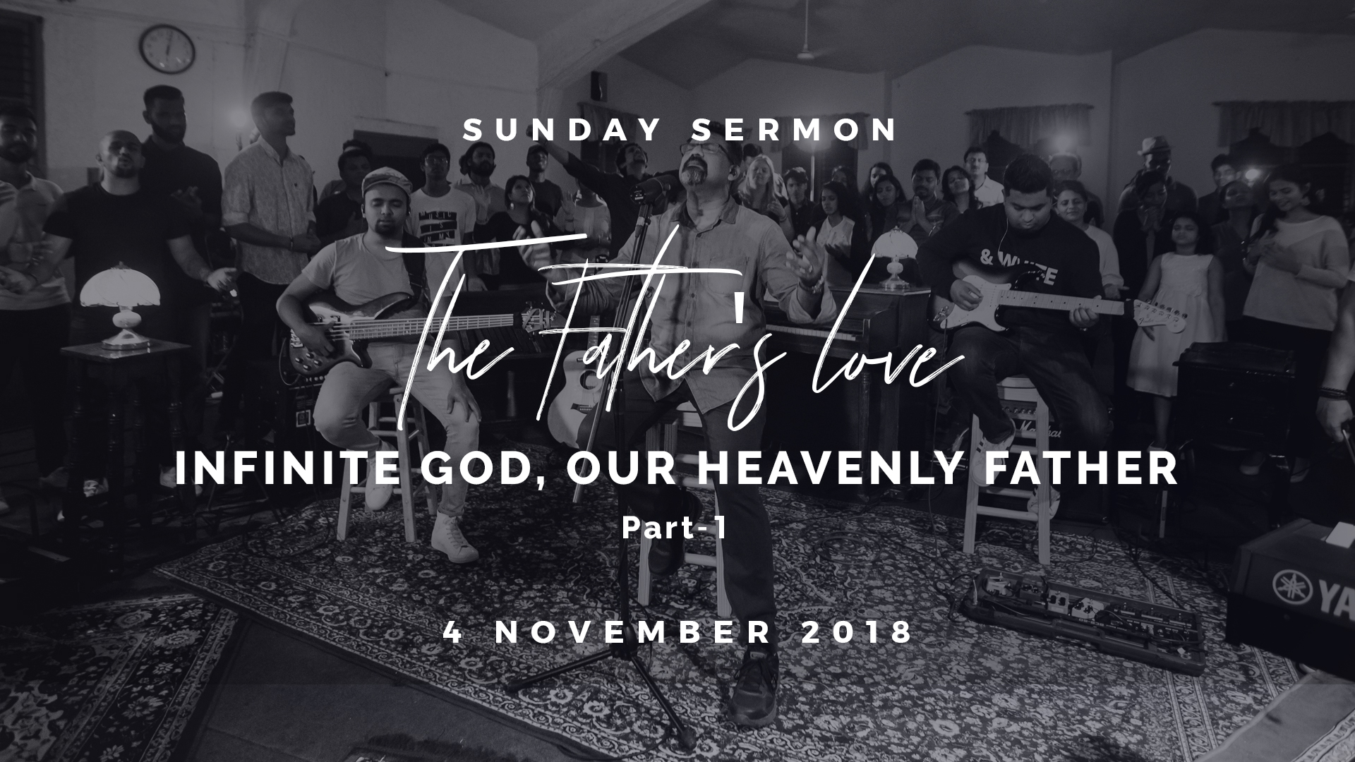

Slide 2
Your revelation of God
affects your relationship with God.
Your relationship with God
also affects your relationship with others.

Slide 3
Our Father in Heaven
Matthew 6:9
..Our Father in heaven,...
1 John 4:8
....God is Love.....

Slide 4
God is Relational
John 17:24
"Father, I desire that they also whom You gave Me may be with Me where I am, that they may behold My glory which You have given Me; for You loved Me before the foundation of the world.

Slide 5
God is Relational
Mark 12:29-31
29 Jesus answered him, "The first of all the commandments is: 'HEAR, O ISRAEL, THE LORD OUR GOD, THE LORD IS ONE.
30 AND YOU SHALL LOVE THE LORD YOUR GOD WITH ALL YOUR HEART, WITH ALL YOUR SOUL, WITH ALL YOUR MIND, AND WITH ALL YOUR STRENGTH.' This is the first commandment.

Slide 6
God is Relational
Mark 12:29-31
31 And the second, like it, is this: 'YOU SHALL LOVE YOUR NEIGHBOR AS YOURSELF.' There is no other commandment greater than these."

Slide 7
God Has Made Us The Focus of His Unlimited, Unconditional Love
Ephesians 1:4-5 (Message Bible)
4 Long before he laid down earth's foundations, he had us in mind, had settled on us as the focus of his love, to be made whole and holy by his love.
5 Long, long ago he decided to adopt us into his family through Jesus Christ. (What pleasure he took in planning this!)

Slide 8
God Has Made Us The Focus of His Unlimited, Unconditional Love
There was love even before Creation,
and there was Creation because of love.

Slide 9
Restoring Our Capacity To Be Loved
Our capacity to love
and be loved
is broken

Slide 10
Wrong Postures

Slide 11
Wrong Postures (A) The Prodigal
Luke 15:19
"...I am no longer worthy to be called your son. Make me like one of your hired servants." '

Slide 12
Wrong Postures (A) The Prodigal
Luke 7:47
Therefore I say to you, her sins, which are many, are forgiven, for she loved much. But to whom little is forgiven, the same loves little."

Slide 13
Wrong Postures (B) The Slave

Slide 14
Wrong Postures (B) The Slave
Romans 8:15 (Contemporary English Version)
God's Spirit doesn't make us slaves who are afraid of him. Instead, we become his children and call him our Father.

Slide 15
Wrong Postures (B) The Slave
Romans 8:15 (Good News Bible)
For the Spirit that God has given you does not make you slaves and cause you to be afraid; instead, the Spirit makes you God's children, and by the Spirit's power we cry out to God, "Father! my Father!"

Slide 16
Wrong Postures (C) The Orphan

Slide 17
Wrong Postures (C) The Orphan
Galatians 4:4-5
4 But when the fullness of the time had come, God sent forth His Son, born of a woman, born under the law,
5 to redeem those who were under the law, that we might receive the adoption as sons.

Slide 18
Wrong Postures (D) The Outcast

Slide 19
Wrong Postures (D) The Outcast
Ephesians 2:12-13,18
12 that at that time you were without Christ, being aliens from the commonwealth of Israel and strangers from the covenants of promise, having no hope and without God in the world.
13 But now in Christ Jesus you who once were far off have been brought near by the blood of Christ.
18 For through Him we both have access by one Spirit to the Father.

Slide 20
Wrong Postures (E) The Proud Elder Brother

Slide 21
Wrong Postures (E) The Proud Elder Brother
Luke 15:29-30
29 So he answered and said to his father, 'Lo, these many years I have been serving you; I never transgressed your commandment at any time; and yet you never gave me a young goat, that I might make merry with my friends.
30 But as soon as this son of yours came, who has devoured your livelihood with harlots, you killed the fatted calf for him.'

Slide 22
Wrong Postures (F) The Wounded

Slide 23
Wrong Postures (F) The Wounded
Jeremiah 31:3
The LORD has appeared of old to me, saying: "Yes, I have loved you with an everlasting love; Therefore with lovingkindness I have drawn you.

Slide 24
Wrong Postures (G) The Self Critical

Slide 25
Wrong Postures (G) The Self Critical
Ephesians 2:4-5
4 But God, who is rich in mercy, because of His great love with which He loved us,
5 even when we were dead in trespasses, made us alive together with Christ (by grace you have been saved),

Slide 26
What Is Stopping You From
Receiving God's Love?
A) The Prodigal
B) The Slave
C) The Orphan
D) The Outcast
E) The Proud Elder Brother
F) The Wounded
G) The Self Critical

Slide 27
What Is Stopping You From
Receiving God's Love?
1 John 3:1 (Message Bible)
"What marvelous love the Father has extended to us! Just look at it--we're called children of God! That's who we really are..."

Slide 28
What Is Stopping You From
Receiving God's Love?
YOU are a son or daughter of God,
someone who is the FOCUS
of His unlimited and unconditional love

