Slide 2
Immanuel
God with us

Slide 3
Micah 5:2
"But you, Bethlehem Ephrathah, Though you are little among the thousands of Judah, Yet out of you shall come forth to Me The One to be Ruler in Israel, Whose goings forth are from of old, From everlasting."

Slide 4
Philippians 2:6-11 (Contemporary English Version)
6 Christ was truly God. But he did not try to remain equal with God.
7 Instead he gave up everything and became a slave, when he became like one of us.
8 Christ was humble. He obeyed God and even died on a cross.

Slide 5
Philippians 2:6-11 (Contemporary English Version)
9 Then God gave Christ the highest place and honored his name above all others.
10 So at the name of Jesus everyone will bow down, those in heaven, on earth, and under the earth.
11 And to the glory of God the Father everyone will openly agree, "Jesus Christ is Lord!"

Slide 6
Why would God need to incarnate?
Why Would God need to come
as a human person to the earth?

Slide 7
Why come as a
feeble human being?

Slide 8
Why a gruesome Cross?

Slide 9
What about
before and after?

Slide 10
What about other
groups of people?

Slide 11
Would God need to
incarnate multiple times?

Slide 12
Before the beginning,
God...

Slide 13
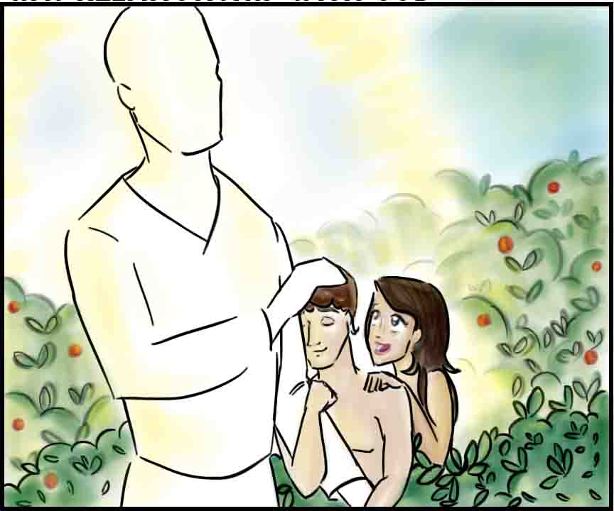
In the beginning,
God...

Slide 14
Sin and its consequences

Slide 15
Sin and its consequences

Slide 16
Sin and its consequences
..our attempts to reach God..futile

Slide 17
Why the Incarnation?
#1, He had to become a Man to REVEAL God

Slide 18
Why the Incarnation?
#2, He had to become a Man to DEMONSTRATE

Slide 19
Why the Incarnation?
#3, He had to become a Man to REPRESENT

Slide 20
Hebrews 2:14-18
14 Inasmuch then as the children have partaken of flesh and blood, He Himself likewise shared in the same, that through death He might destroy him who had the power of death, that is, the devil,

Slide 21
Hebrews 2:14-18
17 Therefore, in all things He had to be made like His brethren, that He might be a merciful and faithful High Priest in things pertaining to God, to make propitiation for the sins of the people.
18 For in that He Himself has suffered, being tempted, He is able to aid those who are tempted.

Slide 22
Why the Incarnation?
#4, He had to become a Man to be the Perfect SUBSTITUTE

Slide 23
"The essence of sin is we human beings substituting ourselves for God, while the essence of salvation is God substituting himself for us. We...put ourselves where only God deserves to be; God...puts himself where we deserve to be." - John Stott

Slide 24
Romans 5:18-19
18 Therefore, as through one man's offense judgment came to all men, resulting in condemnation, even so through one Man's righteous act the free gift came to all men, resulting in justification of life.
19 For as by one man's disobedience many were made sinners, so also by one Man's obedience many will be made righteous.

Slide 25
Why the Incarnation?
He had to become a Man -
to REVEAL God
to DEMONSTRATE
to REPRESENT
to be the perfect SUBSTITUTE

Slide 26
Why come as a
feeble human being?

Slide 27
Why a gruesome Cross?
A) God is holy, God is love, God is just
B) Forgiveness is not cheap
C) True love is always substitutionary

Slide 28
What about before and after?

Slide 29
What about other groups of people?
1 John 2:2 (BBE)
He is the offering for our sins; and not for ours only, but for all the world.

Slide 30
Would God need to
incarnate multiple times?
Hebrews 10:12, 14 (BBE)
12 But when Jesus had made one offering for sins for ever, he took his place at the right hand of God;
14 Because by one offering he has made complete for ever those who are made holy.

Slide 31
The Reason for the Incarnation?
He had to become a Man -
to REVEAL God
to DEMONSTRATE
to REPRESENT
to be the perfect SUBSTITUTE

Slide 32
Our Response
Repent, Believe, Follow
Acts 10:43
To him all the prophets give witness, that through his name everyone who has faith in him will have forgiveness of sins.

