Slide 2
Paul’s First Missionary Journey
(A.D. 44 - A.D. 46; Acts 13:1 - Acts 14:28)

Slide 3
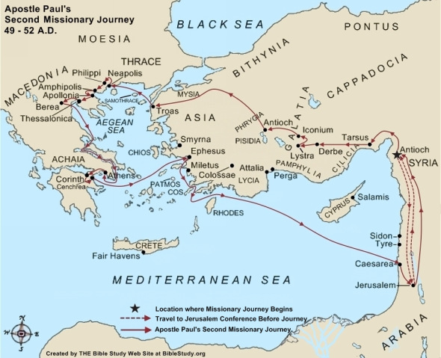

Slide 5
Paul's second missionary journey
(A.D. 49 - A.D. 52; Acts 15:36 – Acts 18:22)
Timothy about 17 years of age, A.D. 49

Slide 6
During Paul's Third Missionary Journey
(A.D. 53 - A.D. 58; Acts 18:23 – Acts 21:15)
he came to the city of Ephesus, where he spent about 3 years

Slide 7
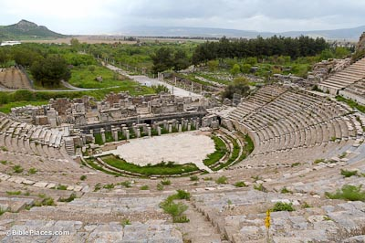
The Theatre (Acts 19:28-29)

Slide 8
Paul, A Prisoner in Caesarea (A.D. 58- A.D. 60)
Paul's Journey To Rome
And Roman Imprisonment
(A.D. 60 - A.D. 63; Acts 27:1 - Acts 28:31)

Slide 9
Paul's Final Years (A.D. 63- A.D. 67)
Paul wrote 1 Timothy, Titus (and Hebrews) during this time, most likely from Macedonia (A.D. 67)

Slide 10
Timothy served alongside Paul for about 18 years (A.D. 49 to A.D. 67).
Timothy at this point may have been about 34 years old and was put in charge of the church in Ephesus.

Slide 11
1 Timothy 1:1
an apostle
An apostle is a "sent one", and in terms of function is one who goes ahead as a pioneer to advance the Kingdom
by the commandment of God
Your calling is a "command"

Slide 12
1 Timothy 1:1-2
God ...and the Lord Jesus Christ
God our Savior, our Father..Jesus Christ our hope, our Lord

Slide 13
1 Timothy 1:3-4
Protect believers from false teaching
Sound teaching will bring "godly edification" in faith - the building up of the faith of the believers.

Slide 14
Acts 20:28-32
28 Therefore take heed to yourselves and to all the flock, among which the Holy Spirit has made you overseers, to shepherd the church of God which He purchased with His own blood.
29 For I know this, that after my departure savage wolves will come in among you, not sparing the flock.
30 Also from among yourselves men will rise up, speaking perverse things, to draw away the disciples after themselves.

Slide 15
Acts 20:28-32
31 Therefore watch, and remember that for three years I did not cease to warn everyone night and day with tears.
32 "So now, brethren, I commend you to God and to the word of His grace, which is able to build you up and give you an inheritance among all those who are sanctified.

Slide 16
1 Timothy 1:5-7
love must flow out of a pure heart, a good conscience, sincere faith
pure heart : pure in motives, no selfish interest, no personal agendas
good conscience : or a clear conscience is one where you live by what is right before God and man
sincere faith : genuine, real faith. Not faith that is put on as a pretense before people.

Slide 17
1 Timothy 1:8-11
Anything that says these sins are OK is "contrary to sound doctrine" and is contrary to the glorious Gospel.
vs 10: ".. the sexually immoral, men who practice homosexuality,..." (ESV, English Standard Version)

Slide 18
1 Timothy 1:12-17
vs 12: God looks for faithfulness.
vs 14: God is lavish in His grace and kindness towards us.
vs 15:...Christ Jesus came into the world to save sinners, of whom I am chief.

Slide 19
1 Timothy 1:12-17
vs 16-17: What God did in me is an example of His abundant grace and patience

Slide 20
1 Timothy 1:18-20
vs 18 : make use of the prophecies spoken over your life. Use them to fight the good fight. Use them in spiritual warfare against the enemy.

Slide 21
1 Timothy 1:18-20
vs 19: once again a reminder to hold on to faith with a good conscience. A good conscience is simply living right before God and man.
If I do away with a good conscience - do things that my conscience says are wrong - I will make shipwreck of my faith - destroy my own faith.

Slide 22
1 Timothy 1:18-20
vs 20 : apostolic judgment

Slide 23
Key Takeaway : 1 Timothy 1:5,19
We must live and must love out of a pure heart, a good conscience, sincere faith.
If I do away with a good conscience - do things that my conscience says are wrong - I will make shipwreck of my faith - destroy my own faith.

