Slide 2
EPHESIANS

Slide 3
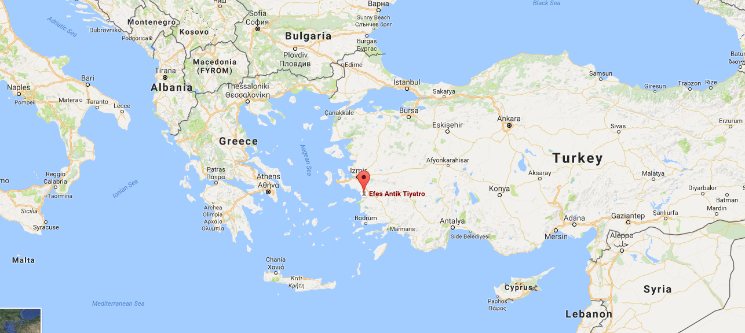
EPHESUS

Slide 4
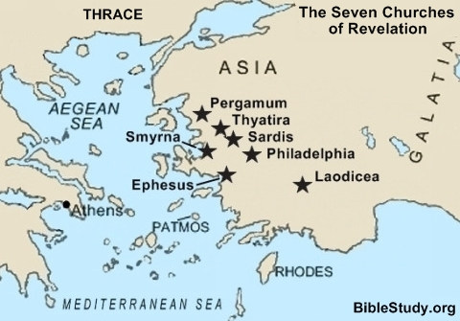
PAULS MINISTRY AT EPHESUS

Slide 5
PAULS MINISTRY AT EPHESUS
Paul's third missionary journey
(A.D. 53 - A.D. 58)
Paul spent about 3 years in Ephesus
Acts 19:1-41, Acts 20:1

Slide 6
PAULS MINISTRY AT EPHESUS
Acts 20:17-38

Slide 7
Paul in Roman imprisonment (A.D. 60 - A.D. 63)
Paul wrote Colossians, Philemon, Ephesians, Philippians (called the 'prison epistles').

Slide 8
Timothy appointed to pastor the church at Ephesus (A.D. 64).
Paul wrote 1 Timothy, most likely from Macedonia to encourage Timothy at Ephesus (A.D. 67).

Slide 9
Once Paul returned to Rome, he was imprisoned. Paul wrote his last epistle,
2 Timothy (A.D. 68).
Revelation chapter 2
The Lord Jesus speaks to the church at Ephesus (A.D. 90)

Slide 10
EPHESIANS 1

