Slide 3
Sex and Sexuality

Slide 4
Sex and Sexuality
God Designed Sex
Hebrews 13:4 (MSG)
Honor marriage, and guard the sacredness of sexual intimacy between wife and husband. God draws a firm line against casual and illicit sex.

Slide 5
Sex and Sexuality
God Designed Sex For Procreation And Enjoyment
1 Corinthians 7:1-6 (MSG)
1 Now, getting down to the questions you asked in your letter to me. First, Is it a good thing to have sexual relations?
2 Certainly--but only within a certain context. It's good for a man to have a wife, and for a woman to have a husband. Sexual drives are strong, but marriage is strong enough to contain them and provide for a balanced and fulfilling sexual life in a world of sexual disorder.

Slide 6
Sex and Sexuality
God Designed Sex For Procreation And Enjoyment
1 Corinthians 7:1-6 (MSG)
3 The marriage bed must be a place of mutuality--the husband seeking to satisfy his wife, the wife seeking to satisfy her husband.
4 Marriage is not a place to "stand up for your rights." Marriage is a decision to serve the other, whether in bed or out.

Slide 7
Sex and Sexuality
God Designed Sex For Procreation And Enjoyment
1 Corinthians 7:1-6 (MSG)
5 Abstaining from sex is permissible for a period of time if you both agree to it, and if it's for the purposes of prayer and fasting--but only for such times. Then come back together again. Satan has an ingenious way of tempting us when we least expect it.
6 I'm not, understand, commanding these periods of abstinence--only providing my best counsel if you should choose them.

Slide 8
Sex and Sexuality
God Designed Sex For Procreation And Enjoyment
Proverbs 5:15-19
15 Drink water from your own cistern, And running water from your own well.
16 Should your fountains be dispersed abroad, Streams of water in the streets?
17 Let them be only your own, And not for strangers with you.
18 Let your fountain be blessed, And rejoice with the wife of your youth.

Slide 9
Sex and Sexuality
God Designed Sex For Procreation And Enjoyment
Proverbs 5:15-19
19 As a loving deer and a graceful doe, Let her breasts satisfy you at all times; And always be enraptured with her love.

Slide 10
Sex and Sexuality
Sex Is An Expression Of Commitment, Intimacy, Pleasure
1 Corinthians 6:16-20 (MSG)
16 There's more to sex than mere skin on skin. Sex is as much spiritual mystery as physical fact. As written in Scripture, "The two become one."
17 Since we want to become spiritually one with the Master, we must not pursue the kind of sex that avoids commitment and intimacy, leaving us more lonely than ever--the kind of sex that can never "become one."

Slide 11
Sex and Sexuality
Sex Is An Expression Of Commitment, Intimacy, Pleasure
1 Corinthians 6:16-20 (MSG)
18 There is a sense in which sexual sins are different from all others. In sexual sin we violate the sacredness of our own bodies, these bodies that were made for God-given and God-modeled love, for "becoming one" with another.

Slide 12
Sex and Sexuality
Sex Is An Expression Of Commitment, Intimacy, Pleasure
1 Corinthians 6:16-20 (MSG)
19 Or didn't you realize that your body is a sacred place, the place of the Holy Spirit? Don't you see that you can't live however you please, squandering what God paid such a high price for? The physical part of you is not some piece of property belonging to the spiritual part of you.
20 God owns the whole works. So let people see God in and through your body.

Slide 13
For The First Night And After
The Act of Marriage : The Beauty of Sexual Love
Tim and Beverly LaHaye

Slide 14
Sex and Sexuality
Managing Personal Sexuality
Direct all your sexual affections
toward your spouse alone.

Slide 15
Sex and Sexuality
Managing Personal Sexuality
Refuse the deceiving thought that you need to find sexual fulfillment through other means.
Refuse sexual fantasies, pornography, or anything that is dishonorable before God.

Slide 16
Sex and Sexuality
Managing Personal Sexuality
Pray over and consecrate your sexual affections before God and dedicate them for your spouse. This is honoring God and your spouse with your body.

Slide 17
Enjoying Sex When You Are Forty And Beyond
The Act of Marriage after 40 : Making Love for Life
Tim and Beverly LaHaye
with Mike Yorkey

Slide 18
"Affection, warmth, and sensuality do not have to deteriorate with age and can actually increase in the midlife years. Sex in later life is sex for its own sake since our childbearing years are in our rearview mirrors. We make love for pleasure, release, communication, and intimacy."

Slide 19
Becoming A Team

Slide 20
Becoming A Team
The Power of Two
Ecclesiastes 4:9-12 (GNB)
9 Two are better off than one, because together they can work more effectively.
10 If one of them falls down, the other can help him up. But if someone is alone and falls, it's just too bad, because there is no one to help him.
11 If it is cold, two can sleep together and stay warm, but how can you keep warm by yourself ?

Slide 21
Becoming A Team
The Power of Two
Ecclesiastes 4:9-12 (GNB)
12 Two people can resist an attack that would defeat one person alone. A rope made of three cords is hard to break.

Slide 22
Becoming A Team
Hindrances To Becoming A Good Team
Self-preservation
Selfishness
Competition
Pride
Blaming instead of taking responsibility
Problem focused instead of finding solutions

Slide 23
Becoming A Team
What Makes A Good Husband-Wife Team?
When the husband and wife understand each other and respect their differences
When the husband and wife understand each other's roles and support each other

Slide 24
Becoming A Team
What Makes A Good Husband-Wife Team?
When the husband and wife are able to share interests and pursue common goals
When both work at being good team players instead of individual stars

Slide 25
Becoming A Team
What Makes A Good Husband-Wife Team?
When they sharing each other's strengths and hence experience enhanced strength.
When they support each other to overcome weaknesses

Slide 26
Becoming A Team
Becoming A Kingdom Team
One For A Purpose

Slide 27
Resolving Conflicts

Slide 28
Resolving Conflicts
Conflicts Happen Because We Are Different!

Slide 29
Resolving Conflicts
Men And Women Are Different
Anatomically, physiologically
Problem solving

Slide 30
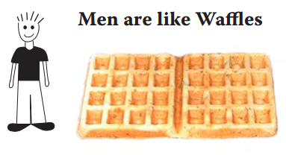
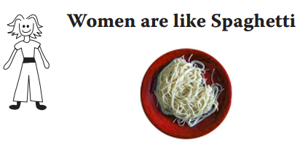
Resolving Conflicts
Men And Women Are Different
Thinking

Slide 31
Resolving Conflicts
Men And Women Are Different
Memory
Sensitivity

Slide 32
Resolving Conflicts
Men And Women Are Different
Personal differences

Slide 33
Resolving Conflicts
Offended, Hurt And Angry

Slide 34
Resolving Conflicts
Offended, Hurt And Angry
Anger must be controlled

Slide 35
Resolving Conflicts
Offended, Hurt And Angry
Press The PAUSE Button

Slide 36
Resolving Conflicts
Offended, Hurt And Angry
Avoid
Avoidance

Slide 37
Resolving Conflicts
Offended, Hurt And Angry
Get Help From A Counselor Or Intermediary

Slide 38
Resolving Conflicts
Seven Steps To Resolving Conflicts
#1, Pray and prepare your heart

Slide 39
Resolving Conflicts
Seven Steps To Resolving Conflicts
#2, Receive God’s Empowering To Love And Forgive

Slide 40
Resolving Conflicts
Seven Steps To Resolving Conflicts
#3, Receive God’s Wisdom To Address The Situation

Slide 41
Resolving Conflicts
Seven Steps To Resolving Conflicts
#4, Lovingly Discuss And Address The Matter

Slide 42
Resolving Conflicts
Seven Steps To Resolving Conflicts
#5, Resolve The Matter In Peace

Slide 43
Resolving Conflicts
Seven Steps To Resolving Conflicts
#6, Give And Receive
Forgiveness

Slide 44
Resolving Conflicts
Seven Steps To Resolving Conflicts
#7, Release Blessing

Slide 45
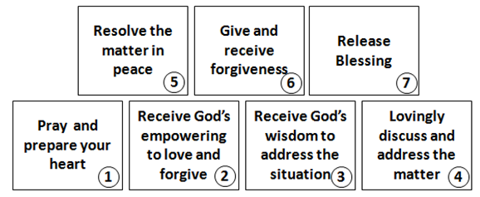
Resolving Conflicts
Keep Strife Out Of Your Life

