Slide 1
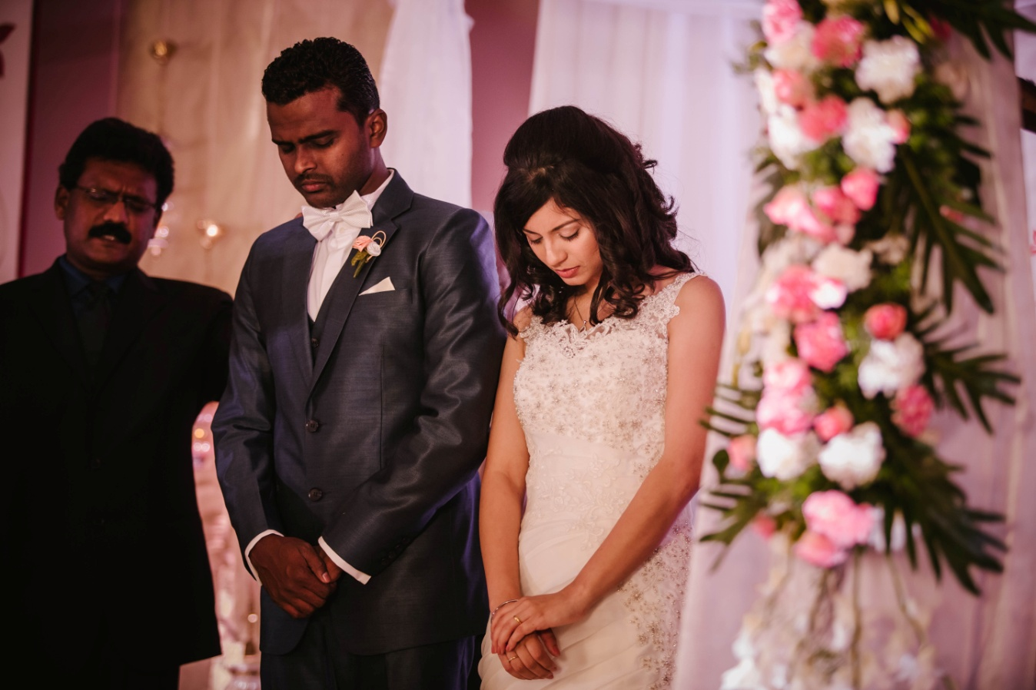
Marriage & Family
Part 1

Slide 2
Series overview
Understanding Marriage
Preparing For Marriage
Making The Choice
Understanding Roles: Husband And Wife
Attitudes And Temperament
Communication In Marriage
Managing Your Home
Sex And Sexuality

Slide 3
Series overview
Becoming A Team
Resolving Conflicts
Overcoming Life's Challenges
Pressing Forward By Releasing The Past
Boundaries
Parenting Primer
Nurturing Children

Slide 4
Series overview
The Family Altar And Intercession
The Family, The Church, And The Kingdom
When Children Become Your Friends
Enjoying The Rest Of The Journey

Slide 5
Series overview
Sunday August 23 till Sunday October 25
Invite friends!

Slide 6
1, Understanding Marriage
God – The Designer of Marriage

Slide 7
1, Understanding Marriage
Genesis 2:18-25 (MSG)
18 GOD said, "It's not good for the Man to be alone; I'll make him a helper, a companion."
19 So GOD formed from the dirt of the ground all the animals of the field and all the birds of the air. He brought them to the Man to see what he would name them. Whatever the Man called each living creature, that was its name.

Slide 8
1, Understanding Marriage
Genesis 2:18-25 (MSG)
20 The Man named the cattle, named the birds of the air, named the wild animals; but he didn't find a suitable companion.
21 GOD put the Man into a deep sleep. As he slept he removed one of his ribs and replaced it with flesh.
22 GOD then used the rib that he had taken from the Man to make Woman and presented her to the Man.

Slide 9
1, Understanding Marriage
Genesis 2:18-25 (MSG)
23 The Man said, "Finally! Bone of my bone, flesh of my flesh! Name her Woman for she was made from Man."
24 Therefore a man leaves his father and mother and embraces his wife. They become one flesh.
25 The two of them, the Man and his Wife, were naked, but they felt no shame.

Slide 10
1, Understanding Marriage
Adam being alone, by himself
was one thing God saw as “not good”.
Man needed a companion.

Slide 11
1, Understanding Marriage
Genesis 2:24-25 gives us the
Biblical definition of marriage:
Marriage is a man and a woman leaving all other earthly relationships, embracing (cleaving, pursuing) each other and becoming one person, before God.

Slide 12
1, Understanding Marriage
God designed this
intimate union
between a man and woman
called marriage.

Slide 13
1, Understanding Marriage
Matthew 19:3-6 (GNB)
3 Some Pharisees came to him and tried to trap him by asking, "Does our Law allow a man to divorce his wife for whatever reason he wishes?"
4 Jesus answered, "Haven't you read the scripture that says that in the beginning the Creator made people male and female?

Slide 14
1, Understanding Marriage
Matthew 19:3-6 (GNB)
5 And God said, 'For this reason a man will leave his father and mother and unite with his wife, and the two will become one.'
6 So they are no longer two, but one. No human being must separate, then, what God has joined together."

Slide 15
1, Understanding Marriage
Since God designed marriage –
the best Person who can instruct us
on building a strong marriage is God Himself.

Slide 16
1, Understanding Marriage
Marriage – A 'Good Thing'
Marriage was designed by God. Whatever God designs is good! It was designed to bless us. Marriage was designed to benefit us. It was designed to enrich our individual lives.

Slide 17
1, Understanding Marriage
Marriage – A 'Good Thing'
Proverbs 18:22
He who finds a wife finds a good thing, And obtains favor from the LORD.

Slide 18
1, Understanding Marriage
Both the husband and wife must maintain a Biblical confession about their marriage:
“Our marriage was designed by God and it is a good thing. It was designed to bless, benefit and enrich our lives. We need to learn how to do this right and then we will experience God's intended blessing through marriage.”

Slide 19
1, Understanding Marriage
Marriage - An Institution To Be Honored
Hebrews 13:4 (MSG)
Honor marriage, and guard the sacredness of sexual intimacy between wife and husband. God draws a firm line against casual and illicit sex.

Slide 20
1, Understanding Marriage
Marriage – A Solemn Covenant (Promise)
Malachi 2:13-14 (MSG)
13 And here's a second offense: You fill the place of worship with your whining and sniveling because you don't get what you want from GOD.

Slide 21
1, Understanding Marriage
Marriage – A Solemn Covenant (Promise)
Malachi 2:13-14 (MSG)
14 Do you know why? Simple. Because GOD was there as a witness when you spoke your marriage vows to your young bride, and now you've broken those vows, broken the faith-bond with your vowed companion, your covenant wife.

Slide 22
1, Understanding Marriage
Marriage – is Between One Man And One Woman Only
Genesis 2:24-25 (MSG)
24 Therefore a man leaves his father and mother and embraces his wife. They become one flesh.
25 The two of them, the Man and his Wife, were naked, but they felt no shame.

Slide 23
1, Understanding Marriage
Marriage – is Between One Man And One Woman Only
Marriage is meant for one man and one woman. There is what we can consider an "inner circle" and "inner sanctum" that is meant only for the man and the woman bonded together by God. There is no room for anything or anyone else in the inner circle.

Slide 24
1, Understanding Marriage
Marriage – A Union of Two
Genesis 2:24 (MSG)
24 Therefore a man leaves his father and mother and embraces his wife. They become one flesh.
To be made "one flesh" means
to be made "one properly united person".

Slide 25
1, Understanding Marriage
Marriage – A Union of Two
Ephesians 5:31-32 (GNB)
31 As the scripture says, "For this reason a man will leave his father and mother and unite with his wife, and the two will become one."
32 There is a deep secret truth revealed in this scripture, which I understand as applying to Christ and the church.

Slide 26
1, Understanding Marriage
Marriage – A Union of Two
In marriage
a man and woman are made one
at the moment of their marriage
in God's presence.
Then in everyday life they live this out.

Slide 27
1, Understanding Marriage
Marriage – A Union of Two
Becoming one in every day life,
involves an ongoing process
of discovering and growing
into a place of oneness with each other.

Slide 28
1, Understanding Marriage
Marriage – A Union of Two
Key words that describe “becoming one”:
Relationship Companionship
Agreement Complementing
Unity Intimacy (closeness)

Slide 29
1, Understanding Marriage
Marriage – A Union of Two
“Becoming one” was designed by God
and therefore is achieved through Him alone.

Slide 30
1, Understanding Marriage
Marriage - A Journey of Love 'Till Death Do Us Part'
Matthew 19:6
6 So then, they are no longer two but one flesh. Therefore what God has joined together, let not man separate."

Slide 31
1, Understanding Marriage
Marriage - A Journey of Love 'Till Death Do Us Part'
“With this ring, I, (Groom), take you (Bride) to be my wife, to have and to hold from this day forward; for better, for worse, for richer, for poorer, in sickness and in health, to love and to cherish till death us do part, according to God’s holy Word.”

Slide 32
2, Preparing for Marriage
Marriage is a union of two individuals.
It is the coming together of two different "worlds".
This union of two individuals, can either become a beautiful synergy or a massive collision.

Slide 33
2, Preparing for Marriage
#1, Becoming The Best 'You'
John 14:2-3
2 In My Father's house are many mansions; if it were not so, I would have told you. I go to prepare a place for you.
3 And if I go and prepare a place for you, I will come again and receive you to Myself; that where I am, there you may be also.

Slide 34
2, Preparing for Marriage
#1, Becoming The Best 'You'
The best gift you can bring to your spouse, your marriage and your future family, is yourself.
Nothing can substitute that or match up to it.

Slide 35
2, Preparing for Marriage
#2, Your Emotional Health
Proverbs 17:22 (MSG)
22 A cheerful disposition is good for your health; gloom and doom leave you bone-tired.
Having and maintaining positive emotions, attitudes and behaviors is important not only for yourself, but also for those around you.

Slide 36
2, Preparing for Marriage
#2, Your Emotional Health
Marriage is not a cure
to the emotional problems you have.
In fact, marriage will only expose and aggravate emotional weaknesses. These in turn will be detrimental to the marriage relationship.

Slide 37
2, Preparing for Marriage
#2, Your Emotional Health
Some negative or unhealthy emotions, attitudes and behaviors:
1. Outbursts of anger
2. Depressive and emotionally vacillating as opposed to being cheerful, thankful and joyful at all times

Slide 38
2, Preparing for Marriage
#2, Your Emotional Health
Some negative or unhealthy emotions, attitudes and behaviors:
3. Unable to handle stressful situations
4. Critical and judgmental
5. Negativity and pessimism
6. Guilt and shame

Slide 39
2, Preparing for Marriage
#2, Your Emotional Health
Some negative or unhealthy emotions, attitudes and behaviors:
7. Insecurity, inadequacy, lack of self-Esteem or self-worth
8. Emotionally dependent on parents or other individual(s)

Slide 40
2, Preparing for Marriage
#2, Your Emotional Health
Some negative or unhealthy emotions, attitudes and behaviors:
9. Self-centeredness and unhealthy independence
10. Jealousy
11. Pride

Slide 41
2, Preparing for Marriage
#2, Your Emotional Health
Some negative or unhealthy emotions, attitudes and behaviors:
12. Controlling, demanding, authoritative
13. Manipulative and cunning
14. Unforgiving and calculative
15. Selfish and stingy 16. Deceptive or secretive

Slide 42
2, Preparing for Marriage
#2, Your Emotional Health
Negative emotions, attitudes and behaviors need to be addressed, and as individuals we need to develop Christ-like attitudes, a Spirit-Controlled temperament, and Word-governed behavior.

Slide 43
2, Preparing for Marriage
#3, Personal Management
Proverbs 25:28
Whoever has no rule over his own spirit Is like a city broken down, without walls.

Slide 44
2, Preparing for Marriage
#3, Personal Management
1. Career
2. Finances
3. Time management
4. Household skills

Slide 45
2, Preparing for Marriage
#4, Relationship Skills
Philippians 2:3-5 (GNB)
3 Don't do anything from selfish ambition or from a cheap desire to boast, but be humble toward one another, always considering others better than yourselves.
4 And look out for one another's interests, not just for your own. 5 The attitude you should have is the one that Christ Jesus had:

Slide 46
2, Preparing for Marriage
#4, Relationship Skills
1. Communication
2. Roles in marriage
3. In-law relationships

Slide 47
2, Preparing for Marriage
#5, Overcoming Past Abuse, Trauma and Negative Experiences
Isaiah 43:18-19 (MSG)
18 But the LORD says, "Do not cling to events of the past or dwell on what happened long ago.
19 Watch for the new thing I am going to do. It is happening already---you can see it now! I will make a road through the wilderness and give you streams of water there.

Slide 48
2, Preparing for Marriage
#5, Overcoming Past Abuse, Trauma and Negative Experiences
1. Abuse
2. Addictions (smoking/alcohol/drugs/gambling, etc.)
3. Negative Home Environments and Experiences

Slide 49
2, Preparing for Marriage
#6, Sexual Purity
Hebrews 13:4 (MSG)
4 Honor marriage, and guard the sacredness of sexual intimacy between wife and husband. God draws a firm line against casual and illicit sex.

Slide 50
2, Preparing for Marriage
#6, Sexual Purity
1. Break free of all sexual addictions
2. Sexual intimacy
3. Pregnancy and childbirth
4. Infertility

Slide 51
2, Preparing for Marriage
#7, Christian Maturity, Calling & Ministry
Ephesians 4:12-13 (GNB)
12 He did this to prepare all God's people for the work of Christian service, in order to build up the body of Christ.
13 And so we shall all come together to that oneness in our faith and in our knowledge of the Son of God; we shall become mature people, reaching to the very height of Christ's full stature.

Slide 52
2, Preparing for Marriage
#7, Christian Maturity, Calling & Ministry
1. Spiritual growth
2. Christian Calling

