Slide 1
Rachel & Leah

Slide 2
All of the
Old Testament
is all about
Christ Jesus
the Messiah
who was to come

Slide 3
Gen 29
31 When the Lord saw that Leah was not loved, he enabled her to conceive, but Rachel remained childless. 32 Leah became pregnant and gave birth to a son. She named him Reuben, for she said, “It is because the Lord has seen my misery. Surely my husband will love me now.”
33 She conceived again, and when she gave birth to a son she said, “Because the Lord heard that I am not loved, he gave me this one too.” So she named him Simeon.
34 Again she conceived, and when she gave birth to a son she said, “Now at last my husband will become attached to me, because I have borne him three sons.” So he was named Levi.

Slide 4
35 She conceived again, and when she gave birth to a son she said, “This time I will praise
the Lord.” So she named him Judah. Then she stopped having children.
Gen 30
1 When Rachel saw that she was not bearing Jacob any children, she became jealous of her sister. So she said to Jacob, “Give me children, or I’ll die!”
2 Jacob became angry with her and said, “Am I in the place of God, who has kept you from having children?”
3 Then she said, “Here is Bilhah, my servant. Sleep with her so that she can bear children for me and I too can build a family through her.”

Slide 5
Verse 22 :Then God remembered Rachel; he listened to her and enabled her to conceive. 23 She became pregnant and gave birth to a son and said, “God has taken away my disgrace.” 24 She named him Joseph, and said, “May the Lord add to me another son."

Slide 6
Two Objections!

Slide 7
Jesus is how
the grace of God
covers
the flaws of men

Slide 8
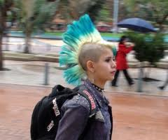
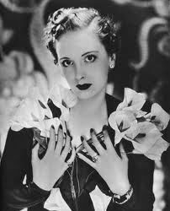
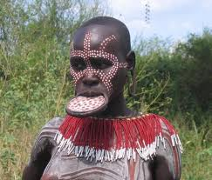
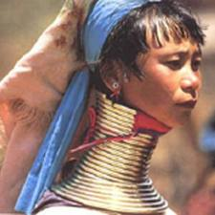

Slide 9
Who is a better judge of true beauty?
Transient humans
or a
Transcendental God?

Slide 10
1) Both Rachel and Leah mostly used God just as a means to some other end

Slide 11
“When the LORD saw that Leah was not loved, he enabled her to conceive, but Rachel remained childless.”
Genesis 29:31

Slide 12
God is drawing these two women to Himself, using the very things they were using Him for!

Slide 13
"Surely my husband will love me now."

Slide 14
"The Lord heard I am unloved."

Slide 15
"At last my husband will now become attached to me."

Slide 16
"This time I will praise the Lord."

Slide 17
14 During wheat harvest, Reuben went out into the fields and found some mandrake plants, which he brought to his mother Leah. Rachel said to Leah, “Please give me some of your son’s mandrakes.”
15 But she said to her, “Wasn’t it enough that you took away my husband? Will you take my son’s mandrakes too?”
“Very well,” Rachel said, “he can sleep with you tonight in return for your son’s mandrakes.”
16 So when Jacob came in from the fields that evening, Leah went out to meet him. “You must sleep with me,” she said. “I have hired you with my son’s mandrakes.” So he slept with her that night

Slide 18
Verse 22 Then God remembered Rachel; he listened to her and enabled her to conceive. 23 She became pregnant and gave birth to a son and said, “God has taken away my disgrace.” 24 She named him Joseph, and said, “May the Lord add to me another son

Slide 19
Ugly Leah was quicker to turn to God.
Beautiful Rachel took longer to turn to God.
But the sad truth is neither really came to God as the ultimate end.

Slide 20
2) Leah experienced Jesus more intimately than Rachel or Jacob

Slide 21
Ugly, unloved, rejected, depressed and lonely — Leah carried in her womb the one who showed us the greatest love in all the universe -- Christ Jesus

Slide 22
The ugliness of Leah pointed to the ugliness of Jesus on the cross

Slide 23
The loneliness of Leah pointed to the loneliness of Jesus on the cross

Slide 24
The rejection of Leah pointed to the rejection of Jesus on the cross

Slide 25
Jesus is closest to us when we are saddest
Jesus is closest to us at our lonely worst
Jesus is closest to us at our unloved worst

Slide 26
We don't need to fear or despise sad and lonely moments.
Like Leah, that's probably when we grow closest to Jesus

Slide 27
WHO WOULD YOU RATHER BE?
Rachel or Leah?

