Slide 2
Isaiah 58:1-14

Slide 3
Part 1 : Preparation
1, Having right MOTIVES
2, Maintaining right RELATIONSHIPS
3, Showing COMPASSION to the needy
4, A life that HONORS God in every way

Slide 4
Part 2 : Positioning
For whom, Why and How

Slide 5
Isaiah 58:8
Then your light shall break forth like the morning, Your healing shall spring forth speedily, And your righteousness shall go before you; The glory of the LORD shall be your rear guard.

Slide 6
Isaiah 58:9
Then you shall call, and the LORD will answer; You shall cry, and He will say, 'Here I am.'

Slide 7
Isaiah 58:10
....Then your light shall dawn in the darkness, And your darkness shall be as the noonday.

Slide 8
Isaiah 58:11
The LORD will guide you continually, And satisfy your soul in drought, And strengthen your bones; You shall be like a watered garden, And like a spring of water, whose waters do not fail.

Slide 9
Isaiah 58:12
Those from among you Shall build the old waste places; You shall raise up the foundations of many generations; And you shall be called the Repairer of the Breach, The Restorer of Streets to Dwell In.

Slide 10
Isaiah 58:14
Then you shall delight yourself in the LORD; And I will cause you to ride on the high hills of the earth, And feed you with the heritage of Jacob your father. The mouth of the LORD has spoken."

Slide 11
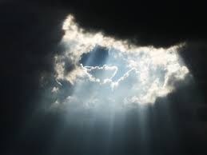
#1, Then your light
Shall break forth
like the morning (58:8)

Slide 12
#2, Your healing
shall spring forth speedily (58:8)

Slide 13
#3, And your righteousness
shall go before you (58:8)

Slide 14
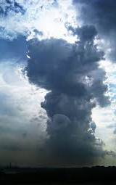
#4, The glory of the LORD
shall be
your rear guard (58:8)

Slide 15
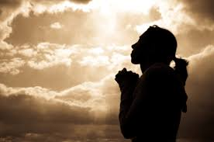
#5, Then you shall call,
and the LORD will answer;
You shall cry,
and He will say, 'Here I am.' (58:9)

Slide 16
#6, Then your light
shall dawn in the darkness,
And your darkness
shall be as the noonday (58:10)

Slide 17
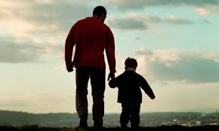
#7, The LORD will guide you
continually (58:11)

Slide 18
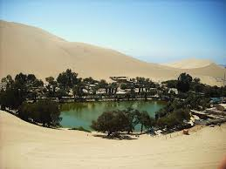
#8, And satisfy your soul
in drought (58:11)

Slide 19
#9, And strengthen
your bones (58:11)

Slide 20
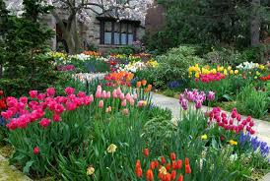
#10, You shall be
like a watered garden (58:11)

Slide 21
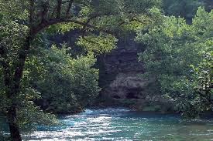
#11, And like a spring of water,
whose waters do not fail (58:11)

Slide 22
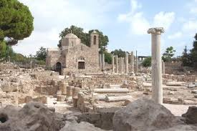
#12, Those from among you
Shall build the old waste places (58:12)

Slide 23
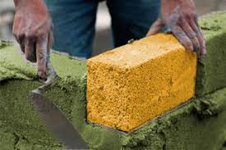
#13, You shall raise up
the foundations
of many generations (58:12)

Slide 24
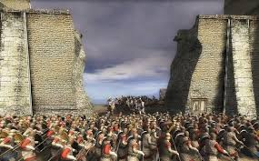
#14, And you shall be called
the Repairer of the Breach (58:12)

Slide 25
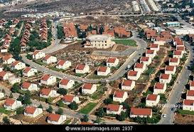
#15, The Restorer
of Streets to Dwell In (58:12)

Slide 26
#16, Then you shall delight yourself
in the LORD (58:14)

Slide 27
#17, And I will cause you to ride
on the high hills of the earth (58:14)

Slide 28
#18, And feed you
with the heritage
of Jacob your father (58:14)

Slide 29
The Chosen Fast
Let’s do this for ourselves and for others
Take time to Fast & Pray, one or more meals over the next 2 weeks. Pray the promises of ISAIAH 58 for yourself, others in need and for APC as a local church community.

