Slide 2
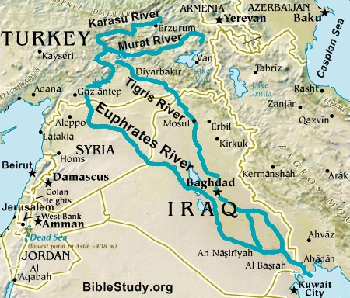
Abraham And The Land Promised To His Descendants

Slide 3
Abraham And The Land Promised To His Descendants
Genesis 12:1-4
1 Now the LORD had said to Abram: "Get out of your country, From your family And from your father's house, To a land that I will show you.
2 I will make you a great nation; I will bless you And make your name great; And you shall be a blessing

Slide 4
Abraham And The Land Promised To His Descendants
Genesis 12:1-4
3 I will bless those who bless you, And I will curse him who curses you; And in you all the families of the earth shall be blessed."
4 So Abram departed as the LORD had spoken to him, and Lot went with him. And Abram was seventy-five years old when he departed from Haran.

Slide 5
The Nation of Israel - Timeline
ca 2000 BC | Covenant with Abraham
ca 1940 BC | Abraham 'offers' Isaac at Mount Moriah
ca 1460 BC | The Exodus from Egypt. The Law was given to the Israelites through Moses at Mount Sinai.
ca 1040 BC | King David conquered Jerusalem (also called Zion)

Slide 6
The Nation of Israel - Timeline
ca 960 BC | Divided kingdom : North and South
727 BC | The Assyrians start conquest. Start of the first exile. The scattering of the Jewish people began.
722 BC | The Assyrians conquered the northern kingdom of Israel. The survivors of the ten tribes of Israel were taken into exile.

Slide 7
The Nation of Israel - Timeline
ca 586 BC | Nebuchadnezzar conquered Judah. The First Temple in Jerusalem was destroyed.
539 BC | Cyrus the Persian conquered Babylon. King Cyrus made a proclamation to rebuild the Temple in Jerusalem.
520-515 BC | Zerubbabel built the Second Temple in Jerusalem.
ca 450 BC | Nehemiah rebuilt the wall around Jerusalem.

Slide 8
The Nation of Israel - Timeline
333 BC | Alexander the Great conquered Persia.
168 BC | The Seleucid empire had succeeded Alexander (312-63 BC). Antiochus IV (175-164 BC), was the 8th ruler of the Seleucid empire. He was violently bitter against the Jews.

Slide 9
The Nation of Israel - Timeline
63 BC | The Romans occupied Israel.
37-4 BC | Herod the Great, king of Judea . The Second Temple renovations were started in 18 BC and would take 46 years, being completed after his death.
ca 6 BC | Jesus was born in Bethlehem
70 AD | The Romans under Titus captured Jerusalem. The Romans destroyed the Second Temple.

Slide 10
The Nation of Israel - Timeline
135 | The Romans conquered Israel. The Temple Mount was ploughed with salt and Jews were banished from Jerusalem on pain of death.
622 | Islam was established by Mohammed in Mecca.
638 | Caliph Omar conquered Jerusalem.
691 | Construction of the Dome of the Rock and Al-Aqsa mosque. Moslem presence established on the Temple Mount in Jerusalem.

Slide 11
The Nation of Israel - Timeline
1517 | Start of 400-year occupation of Palestine and Jerusalem by the Ottoman Turks (Turkish Empire)
1888 | Start of the First Aliyah ("ascent" migration of Jews from the diaspora to the Land of Israel).
1904 | Start of the Second Aliyah. A second wave of Jews, mainly from Russia and Poland, migrated to Palestine. They were driven by persecutions.
1909 | The first kibbutz (settlement) was established in Galilee.

Slide 12
The Nation of Israel - Timeline
1914-1918 | World War I
1917 | Battle of Jerusalem occurred during the British Empire's "Jerusalem Operations" against the Ottoman Empire. General Edmund Allenby takes Jerusalem.

Slide 13
The Nation of Israel - Timeline
1939-1945 | World War II – Holocaust. Six million Jews perished in the Nazi concentration camps.
1947 | Partition Plan for Palestine.
1948 | The State of Israel was declared. Israel was proclaimed a State on 14 May 1948.
1949 | Egyptian army defeated .Jordan, Syria and Lebanon signed armistice agreements. Jerusalem divided-Israel controlled the west, the new city. Jordan occupied the Old City and the east.

Slide 14
The Nation of Israel - Timeline
The Re-gathering and the Birth of a nation
foretold and fulfilled
Isaiah 11:12
He will set up a banner for the nations, And will assemble the outcasts of Israel, And gather together the dispersed of Judah From the four corners of the earth.

Slide 15
The Nation of Israel - Timeline
The Re-gathering and the Birth of a nation
foretold and fulfilled
Ezekiel 37:21
"Then say to them, 'Thus says the Lord GOD: "Surely I will take the children of Israel from among the nations, wherever they have gone, and will gather them from every side and bring them into their own land;

Slide 16
The Nation of Israel - Timeline
The Re-gathering and the Birth of a nation
foretold and fulfilled
Isaiah 66:8
Who has heard such a thing? Who has seen such things? Shall the earth be made to give birth in one day? Or shall a nation be born at once? For as soon as Zion was in labor, She gave birth to her children.

Slide 17
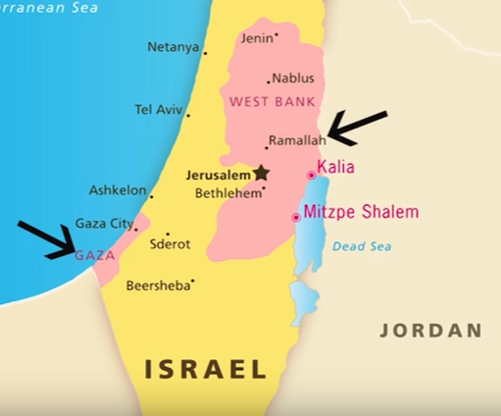
Israel and Its Neighbors

Slide 18
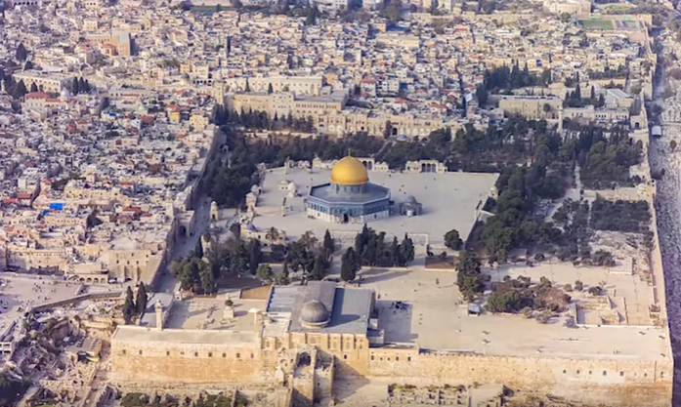
The Temple Mount
Dome of the Rock
Al-Aqsa Mosque

Slide 19
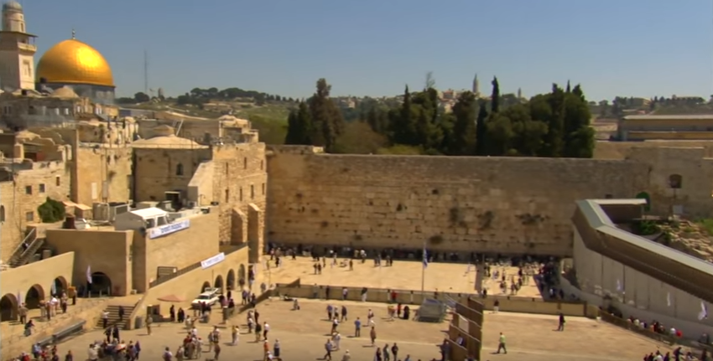
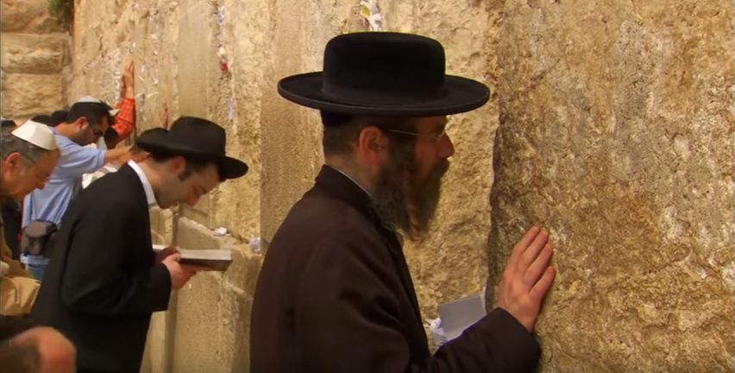
The Western Wall
The Temple Mount

Slide 20
The Temple Mount
Video

Slide 21
The Temple Mount
Both the
Old Testament and the New Testament
affirm that a new Temple
will once again occupy this platform
as part of God's end-time program
for the nation of Israel.

Slide 22
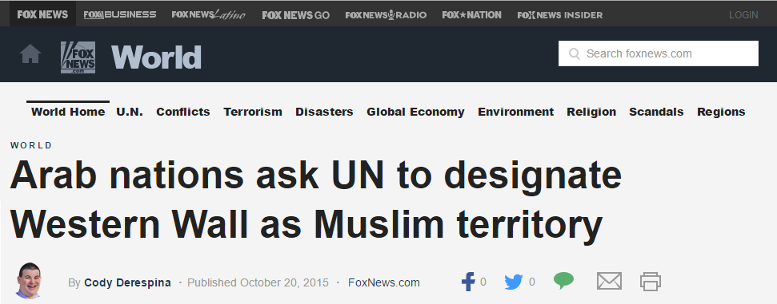
The Temple Mount

Slide 23
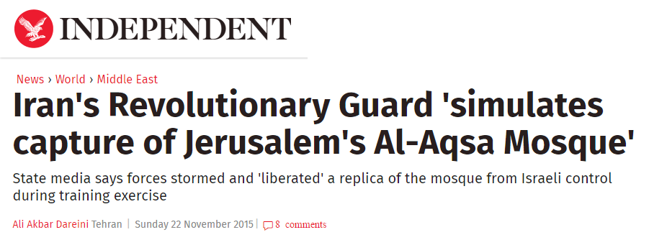
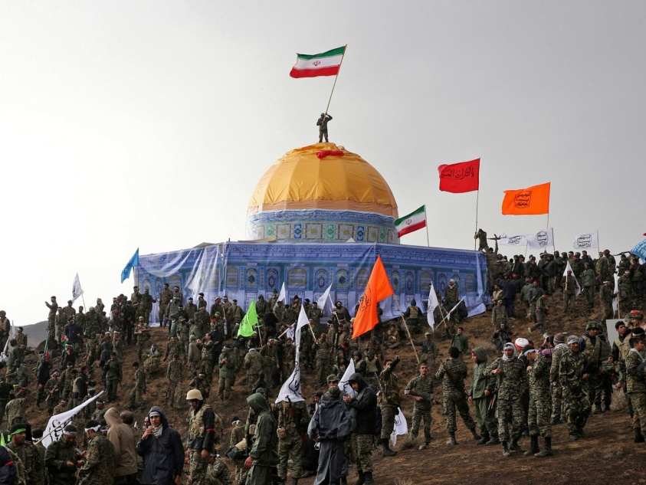
The Temple Mount

Slide 24
The Jewish Settlements
Jeremiah 31:38-40
38 "Behold, the days are coming, says the LORD, that the city shall be built for the LORD—from the Tower of Hananel to the Corner Gate.
39 The surveyor's line shall again extend straight forward over the hill Gareb; then it shall turn toward Goath.
40 And the whole valley of the dead bodies and of the ashes, and all the fields as far as the Brook Kidron, to the corner of the Horse Gate toward the east, shall be holy to the LORD. It shall not be plucked up or thrown down anymore forever."

Slide 25
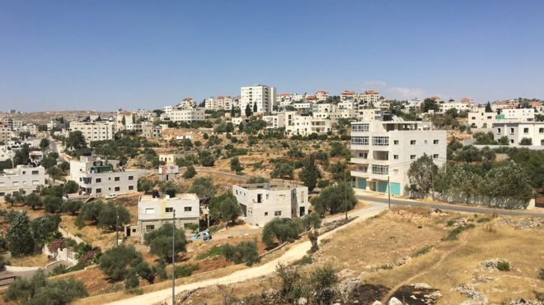
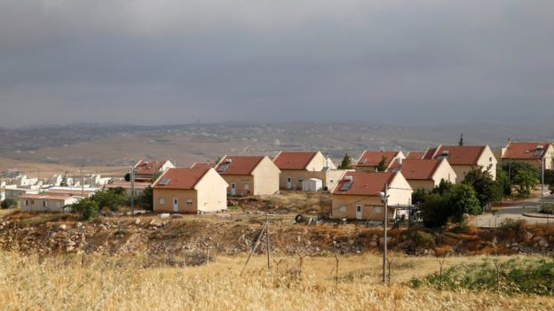
The Jewish Settlements

Slide 26
Jerusalem
The Place of David’s Capital By Divine Appointment
The Place That Became the Home of the Levites
The Place That Became the Home of the High Priests
The Place Where the Feasts Were Observed
The Place Toward Which God’s People Prayed
The Place God’s People Have Always Loved

Slide 27
Jerusalem
The Place That Was Home to Melchizedek, the Ancient King and Priest
The Place That Became Home to the Ark of the Covenant
The Place That David Purchased and Built An Altar to God
The Place Where the Temple Was Built
The Place From Which the Word Would Go Forth
The Place Where the Holy Spirit Was Outpoured

Slide 28
Jerusalem
Jerusalem will be the Future Capital of Messiah’s Eternal Kingdom

Slide 29
The Kingdom, Israel and The Church

Slide 30
The Future of Israel Foretold In The Bible
Jerusalem will become a world trouble spot and all nations will turn against Israel
Zechariah 12:2-3
2 "Behold, I will make Jerusalem a cup of drunkenness to all the surrounding peoples, when they lay siege against Judah and Jerusalem.

Slide 31
The Future of Israel Foretold In The Bible
Jerusalem will become a world trouble spot and all nations will turn against Israel
Zechariah 12:2-3
3 And it shall happen in that day that I will make Jerusalem a very heavy stone for all peoples; all who would heave it away will surely be cut in pieces, though all nations of the earth are gathered against it.

Slide 32
The Future of Israel Foretold In The Bible
A peace treaty and 3½ years of false peace
A coming world leader (the 'Antichrist') will enforce a peace plan or treaty (‘covenant’) upon Israel
The Temple will be rebuilt on the Temple Mount at some point
(Daniel 7:23-26, Daniel 9:27, Matthew 24:15-16, 2 Thessalonians 2:3-4)

Slide 33
The Future of Israel Foretold In The Bible
The Great Tribulation
Two-thirds of the people in Israel will be 'cut off and die' during this time.
144,000 Jews sealed and marked for protection during the great tribulation.
(Matthew 24:21-22, Zechariah 13:8-9, Jeremiah 30:7, Daniel 12:1, Revelation 7:3-8)

Slide 34
The Future of Israel Foretold In The Bible
The Battle of Armageddon and the Second Coming
God's end-time judgment on the nations will be for dividing up His land.
The armies of the world will gather in and around the nation of Israel.
The Lord Jesus Himself will return to save Israel and will descends on Mount of Olives.

Slide 35
The Future of Israel Foretold In The Bible
During the Millennium
The Messiah will reign from Jerusalem
Jerusalem will be the center of worship during the Millennium
The Millennial Temple

