Slide 2
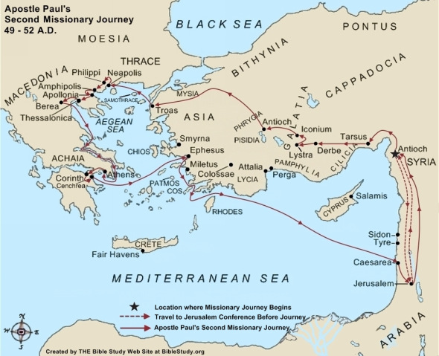

Slide 3
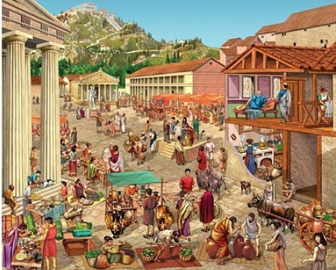
Greek Agora,
or Marketplace

Slide 4
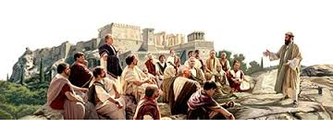
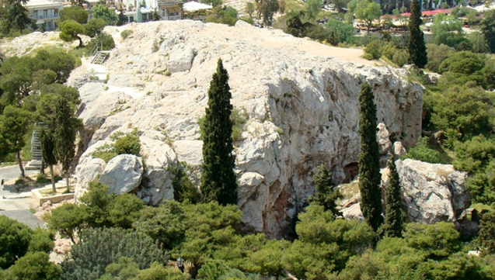
Paul at ‘Areopagus’ or Mars Hill

Slide 5
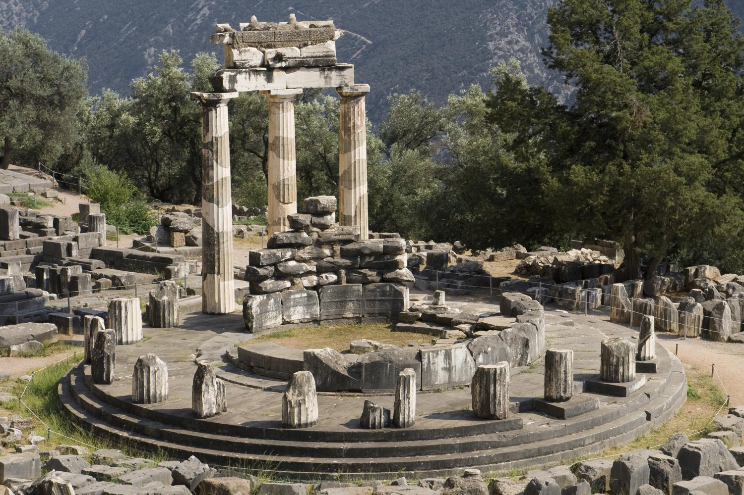
“You are very religious” (Acts 17:22)
Recognize where people are in their spiritual quest.
Altars

Slide 6
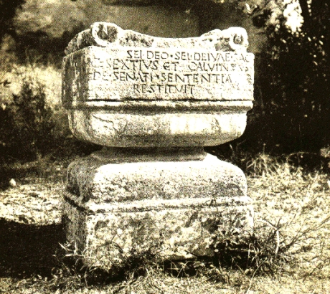
“To an unknown god” (Acts 17:23)
Use something they relate to and understand, as a starting point.
Altar to the unknown god

Slide 7
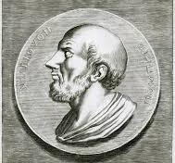
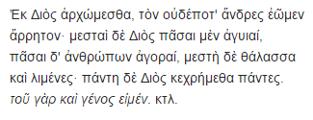
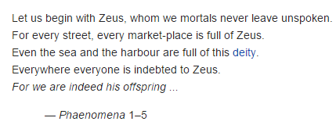
Aratus
(310 BC – 240 BC)
a Greek poet.
"some of your own poets have said, ‘For we are also His offspring.‘ " (Acts 17:28)
Let them know that you have made an effort to know and understand what they believe.

Slide 8
Share the message of Jesus Christ.

Slide 9
Preach Christ and His work on the Cross
(1 Corinthians 1:20-24)

Slide 10
Understand, reason, but remember that reasoning alone cannot do it all.
We must depend on the work of the Spirit, signs, wonders and miracles
(1 Corinthians 2:3-4)

Slide 11
Do not get into meaningless arguments and debates (2 Timothy 2:23-26)
Don’t lose the relationship just to win an argument.

Slide 12
Hindus, Muslims, Atheists and Agnostics
REASONS (4-part series October 2014)
apcwo.org/sermons

Slide 13
Points of emphasis when speaking with a Hindu
The existence of sin and evil

Slide 14
Points of emphasis when speaking with a Hindu
Forgiveness contrasted with Karma and reincarnation

Slide 15
Points of emphasis when speaking with a Hindu
Christ contrasted with many avatars

Slide 16
Points of emphasis when speaking with a Hindu
A loving God seeking personal relationship with man contrasted with "enlightenment", "liberation", etc. achieved by self effort.

Slide 17
Points of emphasis when speaking with a Hindu
Christ power to transform an individual life versus engaging in self-actualization, self-realization, self-discipline.

Slide 18
Points of emphasis when speaking to a Muslim
1, Whether Christ is Lord (DIETY)
2, Whether He died on the cross (DEATH)
3, whether He rose from the dead (RESURRECTION)
Addressed in the October 2014 sermon series: REASONS

Slide 19
Points of emphasis when speaking to a Muslim
The Nature of God
Sin
Forgiveness
Fatherhood of God
Christian Life

Slide 20
Strategy #1: Invite and Pray
Strategy #2: Connect and Impact
Strategy #3: Understand and Reason

