Slide 2
John 4:1-43

Slide 3
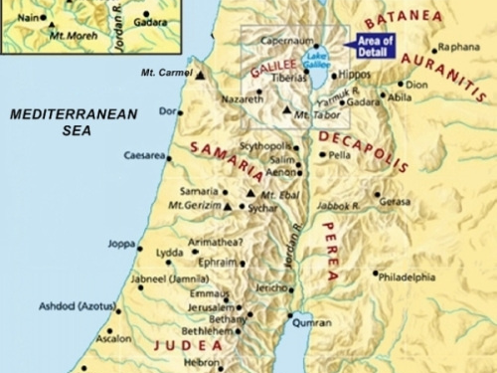

Slide 4
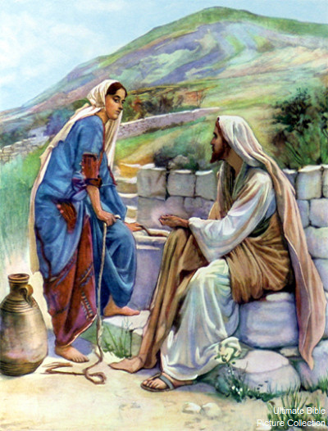

Slide 5
CONNECT
Engage with people based on things they can relate to.
Lay aside inhibitions.
Talk about spiritual things.

Slide 6
IMPACT
Ask God to release His supernatural power through you

Slide 7
John 14:12
"Most assuredly, I say to you, he who believes in Me, the works that I do he will do also; and greater works than these he will do, because I go to My Father.

Slide 8
Mark 16:15-20
15 And He said to them, "Go into all the world and preach the gospel to every creature.
16 He who believes and is baptized will be saved; but he who does not believe will be condemned.
17 And these signs will follow those who believe: In My name they will cast out demons; they will speak with new tongues;

Slide 9
Mark 16:15-20
18 they will take up serpents; and if they drink anything deadly, it will by no means hurt them; they will lay hands on the sick, and they will recover."
19 So then, after the Lord had spoken to them, He was received up into heaven, and sat down at the right hand of God.
20 And they went out and preached everywhere, the Lord working with them and confirming the word through the accompanying signs. Amen.

Slide 10
We never know how one life
we connect and impact –
can affect many others
who will be brought to faith.

Slide 11
Strategy #2 : Connect and Impact
Connect with people
based on things they can relate to.
Impact their lives
with the supernatural power of God.

Slide 12
How to disciple a new believer
TEACH
God's Truth
TRAIN
in spiritual Disciplines
CONNECT
with Christian Fellowship
EQUIP
to Serve

Slide 13
How to disciple a new believer
TEACH
God's Truth
TRAIN
in spiritual Disciplines
CONNECT
with Christian Fellowship
EQUIP
to Serve
FOUNDATIONS
apcwo.org/foundations
Water baptism & Lord's Table

Slide 14
How to disciple a new believer
TEACH
God's Truth
TRAIN
in spiritual Disciplines
CONNECT
with Christian Fellowship
EQUIP
to Serve
Personal time in prayer
Personal reading of God's Word
Godly living

Slide 15
How to disciple a new believer
TEACH
God's Truth
TRAIN
in spiritual Disciplines
CONNECT
with Christian Fellowship
EQUIP
to Serve
Life Groups
Local Church

Slide 16
How to disciple a new believer
TEACH
God's Truth
TRAIN
in spiritual Disciplines
CONNECT
with Christian Fellowship
EQUIP
to Serve
Sharing Jesus
Holy Spirit baptism
Serving in Local church
Missions

