Slide 2
Colossians 4:12,13
12 Epaphras, who is one of you, a bondservant of Christ, greets you, always laboring fervently for you in prayers, that you may stand perfect and complete in all the will of God.
13 For I bear him witness that he has a great zeal for you, and those who are in Laodicea, and those in Hierapolis.

Slide 3
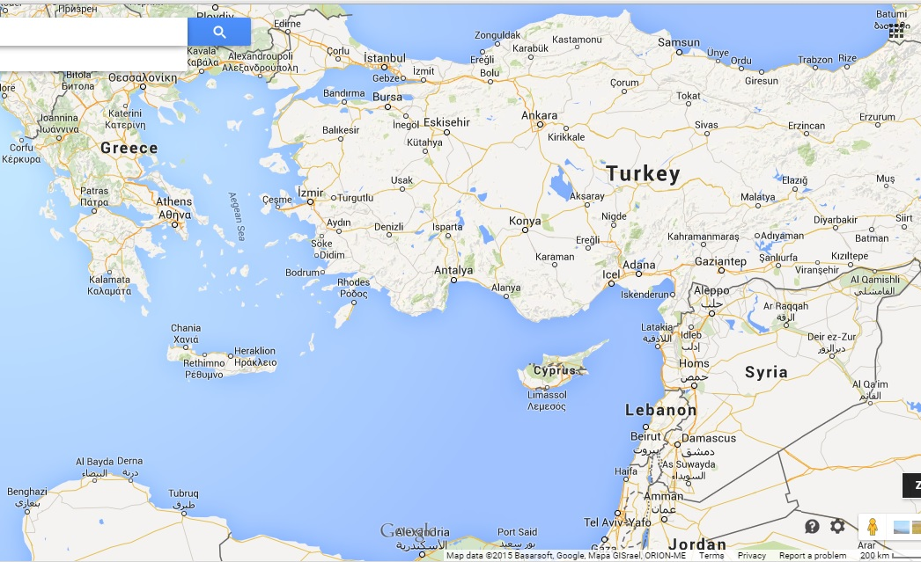
Ephesus

Slide 4
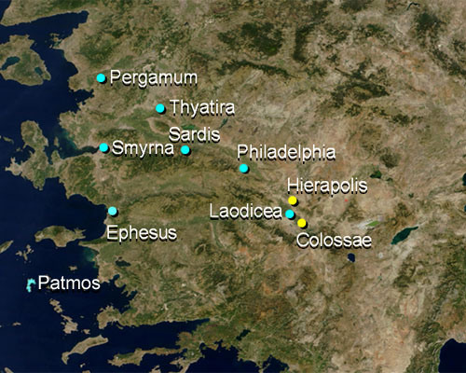
Turkey
Western Coast

Slide 5
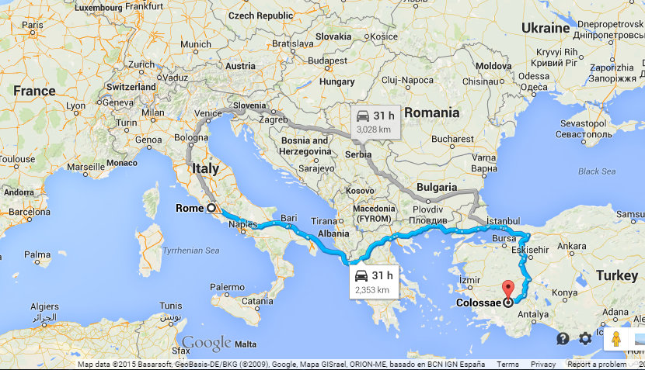

Slide 6
Prayer ministry has no limit of
time, distance or location!

Slide 7
Colossians 4:12,13
12 Epaphras, who is one of you, a bondservant of Christ, greets you, always laboring fervently for you in prayers, that you may stand perfect and complete in all the will of God.
13 For I bear him witness that he has a great zeal for you, and those who are in Laodicea, and those in Hierapolis.

Slide 8
1 Corinthians 7:10-16 (Message Bible)
10 And if you are married, stay married. This is the Master's command, not mine.
11 If a wife should leave her husband, she must either remain single or else come back and make things right with him. And a husband has no right to get rid of his wife.

Slide 9
1 Corinthians 7:10-16 (Message Bible)
12 For the rest of you who are in mixed marriages--Christian married to nonChristian--we have no explicit command from the Master. So this is what you must do. If you are a man with a wife who is not a believer but who still wants to live with you, hold on to her.
13 If you are a woman with a husband who is not a believer but he wants to live with you, hold on to him.

Slide 10
1 Corinthians 7:10-16 (Message Bible)
14 The unbelieving husband shares to an extent in the holiness of his wife, and the unbelieving wife is likewise touched by the holiness of her husband. Otherwise, your children would be left out; as it is, they also are included in the spiritual purposes of God.
15 On the other hand, if the unbelieving spouse walks out, you've got to let him or her go. You don't have to hold on desperately. God has called us to make the best of it, as peacefully as we can.

Slide 11
1 Corinthians 7:10-16 (Message Bible)
16 You never know, wife: The way you handle this might bring your husband not only back to you but to God. You never know, husband: The way you handle this might bring your wife not only back to you but to God.

Slide 12
As a believer
you have spiritual influence in your home
over your spouse and children,
even if they are unsaved
at the moment.

Slide 13
1 Corinthians 7:14 (Message Bible)
14 The unbelieving husband shares to an extent in the holiness of his wife, and the unbelieving wife is likewise touched by the holiness of her husband. Otherwise, your children would be left out; as it is, they also are included in the spiritual purposes of God.

Slide 14
What you can pray for your spouse and children
1. Pray for their salvation
2. Pray for God's rule and reign to be established in their lives ("thy Kingdom come, they will be done")

Slide 15
What you can pray for your spouse and children
3. Pray for God's purposes to
be fulfilled in their lives
(that they will serve the purposes
of God in their generation ).

Slide 16
What you can pray for your spouse and children
4. Speak God's Word and declare their prophetic destiny - in line with God's calling and gifting over their lives.

Slide 17
What you can pray for your spouse and children
5. Take authority over any work of darkness influencing their lives.
Resist the works of the enemy.

Slide 18
Some promises you can pray and speak over your children
Isaiah 44:3,4
God pours His blessing on my offspring and His Spirit upon my Children.

Slide 19
Some promises you can pray and speak over your children
Isaiah 54:13
All my children are taught by the Lord
and they have His peace

Slide 20
Some promises you can pray and speak over your children
Isaiah 59:21
God's Word and God's Spirit pass on to my children and their children

Slide 21
Some promises you can pray and speak over your children
Psalm 112:2
My children will be mighty upon the earth.

Slide 22
Some promises you can pray and speak over your children
Psalm 128:3
Husbands : my wife is like a fruitful vine and my children like olive plants

Slide 23
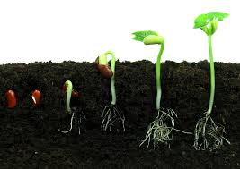
Prayer is like sowing seeds. You sow in faith. Results will come in due time.

Slide 24
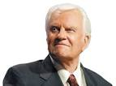
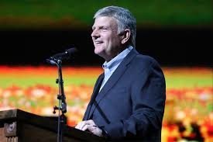
The story of Franklin Graham

Slide 25
Promises you can use to pray over your home
Psalm 23
The Lord is our Shepherd, we will not be in want...

Slide 26
Promises you can use to pray over your home
Psalm 112, Philippians 4:19
Wealth and riches are in my home.
All our needs are met.

Slide 27
Promises you can use to pray over your home
Psalm 118:15
Voice of rejoicing and salvation (well-being) in my home

Slide 28
Promises you can use to pray over your home
Proverbs 3:33
God's blessing is on my home

Slide 29
Promises you can use to pray over your home
Proverbs 12:7
the house of the righteous will stand

Slide 30
Elijah (1 Kings 18)
the sound of abundance of rain!

Slide 31
God reveals His will
and then invites us to pray
till we see it done here on earth.

Slide 32
James 5:16-20
16 Confess your trespasses to one another, and pray for one another, that you may be healed. The effective, fervent prayer of a righteous man avails much.
17 Elijah was a man with a nature like ours, and he prayed earnestly that it would not rain; and it did not rain on the land for three years and six months.

Slide 33
James 5:16-20
18 And he prayed again, and the heaven gave rain, and the earth produced its fruit.
19 Brethren, if anyone among you wanders from the truth, and someone turns him back,
20 let him know that he who turns a sinner from the error of his way will save a soul from death and cover a multitude of sins.

Slide 34
Through the ministry of prayer,
as we pray for one another,
we are able to administer healing
and also see wandering souls
brought back from error!

