Slide 1
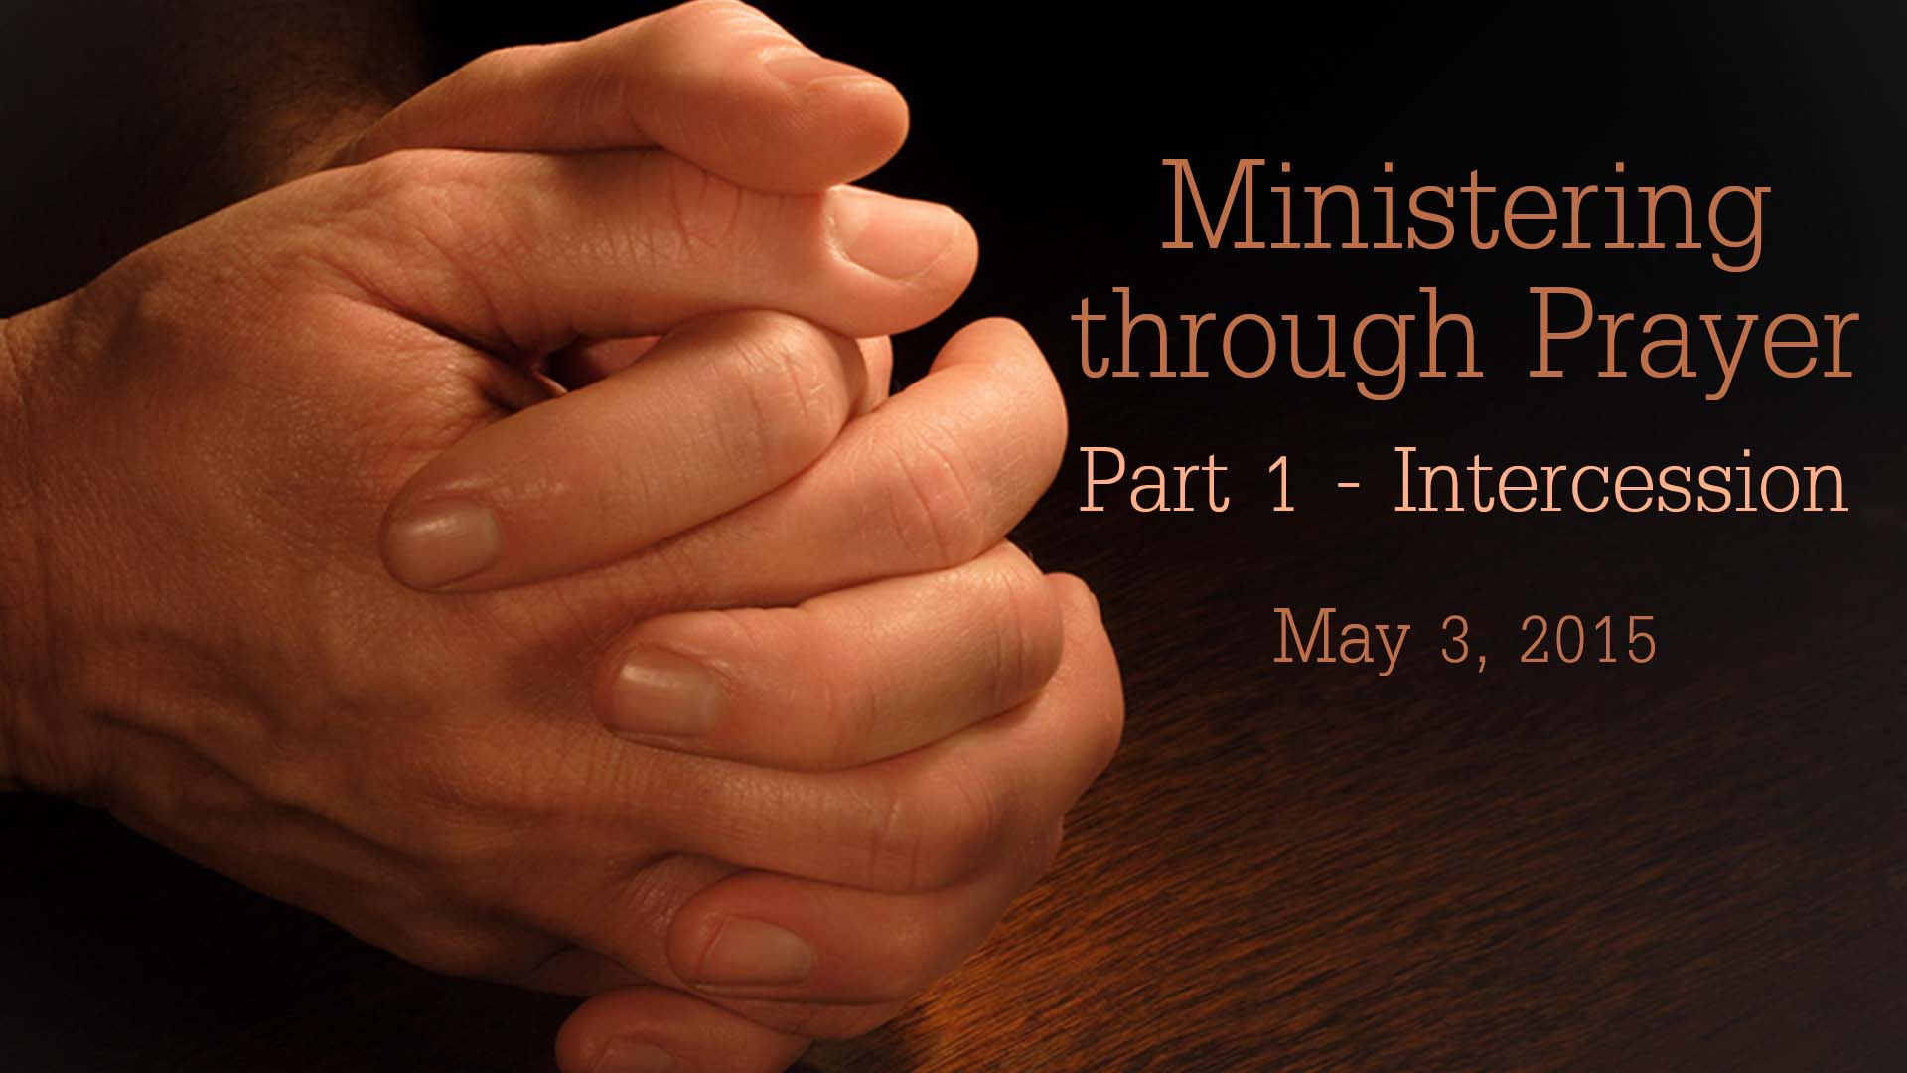

Slide 2
Paul’s Third Missionary Journey
Spent 3 years at Ephesus
During which time he trained 8 young leaders including Titus and Timothy
He also met Philemon and Epaphras, both from Colossae.

Slide 3
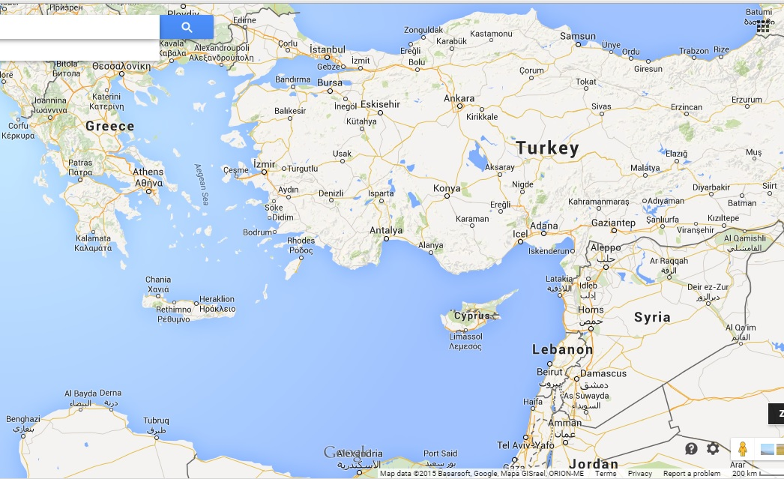
Ephesus

Slide 4
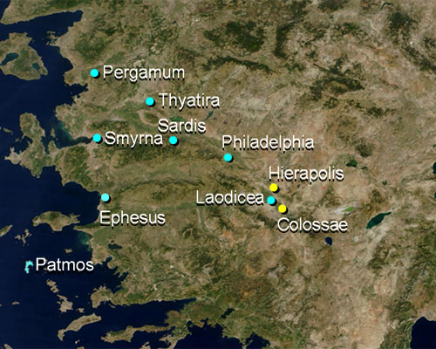

Slide 5
Colossians 4:12,13
12 Epaphras, who is one of you, a bondservant of Christ, greets you, always laboring fervently for you in prayers, that you may stand perfect and complete in all the will of God.
13 For I bear him witness that he has a great zeal for you, and those who are in Laodicea, and those in Hierapolis.

Slide 6
Matthew 6:5,6
5 "And when you pray, you shall not be like the hypocrites. For they love to pray standing in the synagogues and on the corners of the streets, that they may be seen by men. Assuredly, I say to you, they have their reward.
6 But you, when you pray, go into your room, and when you have shut your door, pray to your Father who is in the secret place; and your Father who sees in secret will reward you openly.

Slide 7
Revelation 5:8
8 Now when He had taken the scroll, the four living creatures and the twenty-four elders fell down before the Lamb, each having a harp, and golden bowls full of incense, which are the prayers of the saints.

Slide 8
Revelation 8:3,4
3 Then another angel, having a golden censer, came and stood at the altar. He was given much incense, that he should offer it with the prayers of all the saints upon the golden altar which was before the throne.
4 And the smoke of the incense, with the prayers of the saints, ascended before God from the angel's hand.

Slide 9
Ephesians 6:18-20
18 praying always with all prayer and supplication in the Spirit, being watchful to this end with all perseverance and supplication for all the saints—
19 and for me, that utterance may be given to me, that I may open my mouth boldly to make known the mystery of the gospel,
20 for which I am an ambassador in chains; that in it I may speak boldly, as I ought to speak.

Slide 10
Romans 15:30-32
30 Now I beg you, brethren, through the Lord Jesus Christ, and through the love of the Spirit, that you strive together with me in prayers to God for me,
31 that I may be delivered from those in Judea who do not believe, and that my service for Jerusalem may be acceptable to the saints,
32 that I may come to you with joy by the will of God, and may be refreshed together with you.

Slide 11
Philippians 1:19-21
19 For I know that this will turn out for my deliverance through your prayer and the supply of the Spirit of Jesus Christ,
20 according to my earnest expectation and hope that in nothing I shall be ashamed, but with all boldness, as always, so now also Christ will be magnified in my body, whether by life or by death.
21 For to me, to live is Christ, and to die is gain.

Slide 12
Acts 12:1-17
1 Now about that time Herod the king stretched out his hand to harass some from the church.
2 Then he killed James the brother of John with the sword.
3 And because he saw that it pleased the Jews, he proceeded further to seize Peter also. Now it was during the Days of Unleavened Bread.

Slide 13
Acts 12:1-17
4 So when he had arrested him, he put him in prison, and delivered him to four squads of soldiers to keep him, intending to bring him before the people after Passover.
5 Peter was therefore kept in prison, but constant prayer was offered to God for him by the church.
6 And when Herod was about to bring him out, that night Peter was sleeping, bound with two chains between two soldiers; and the guards before the door were keeping the prison.

Slide 14
Acts 12:1-17
7 Now behold, an angel of the Lord stood by him, and a light shone in the prison; and he struck Peter on the side and raised him up, saying, "Arise quickly!" And his chains fell off his hands.
8 Then the angel said to him, "Gird yourself and tie on your sandals"; and so he did. And he said to him, "Put on your garment and follow me."
9 So he went out and followed him, and did not know that what was done by the angel was real, but thought he was seeing a vision.

Slide 15
Acts 12:1-17
10 When they were past the first and the second guard posts, they came to the iron gate that leads to the city, which opened to them of its own accord; and they went out and went down one street, and immediately the angel departed from him.
11 And when Peter had come to himself, he said, "Now I know for certain that the Lord has sent His angel, and has delivered me from the hand of Herod and from all the expectation of the Jewish people."

Slide 16
Acts 12:1-17
12 So, when he had considered this, he came to the house of Mary, the mother of John whose surname was Mark, where many were gathered together praying.
13 And as Peter knocked at the door of the gate, a girl named Rhoda came to answer.
14 When she recognized Peter's voice, because of her gladness she did not open the gate, but ran in and announced that Peter stood before the gate.

Slide 17
Acts 12:1-17
15 But they said to her, "You are beside yourself!" Yet she kept insisting that it was so. So they said, "It is his angel."
16 Now Peter continued knocking; and when they opened the door and saw him, they were astonished.
17 But motioning to them with his hand to keep silent, he declared to them how the Lord had brought him out of the prison. And he said, "Go, tell these things to James and to the brethren." And he departed and went to another place.

Slide 18
Acts 12:5,12
5 Peter was therefore kept in prison, but constant prayer was offered to God for him by the church.
12 So, when he had considered this, he came to the house of Mary, the mother of John whose surname was Mark, where many were gathered together praying.

Slide 19
The Moravian Revival of 1727 and 100 years of prayer
Wednesday 17 August 1727, Moravian colony in Germany
people praying in teams for an hour at a time day and night
non-stop prayer meeting went for 100 years
Within 25 years they had sent out 200 missionaries, more than all the Protestants had done in two centuries

Slide 20
The Layman's Prayer Revival, New York 1857-58
Jeremiah Lanphier started a noon prayer meeting for New York businessmen
Only six people came to the first prayer meeting on September 23, 1857 on Fulton Street
Daily prayer meetings sprang up in many locations and daily attendance grew to 10,000
By March of 1858, it spread all over America, large cities and towns from Maine to California

Slide 21
Praying for others, often releases blessing on your own life
Job 42:10
And the LORD restored Job's losses when he prayed for his friends. Indeed the LORD gave Job twice as much as he had before.

Slide 22
Pray for your own family.
Pray for few other believers know to you
Pray for our pastors and leaders at APC
Pray for us as a local church
Get together with other believers in small groups at home, office, elsewhere and pray together.

