Slide 1
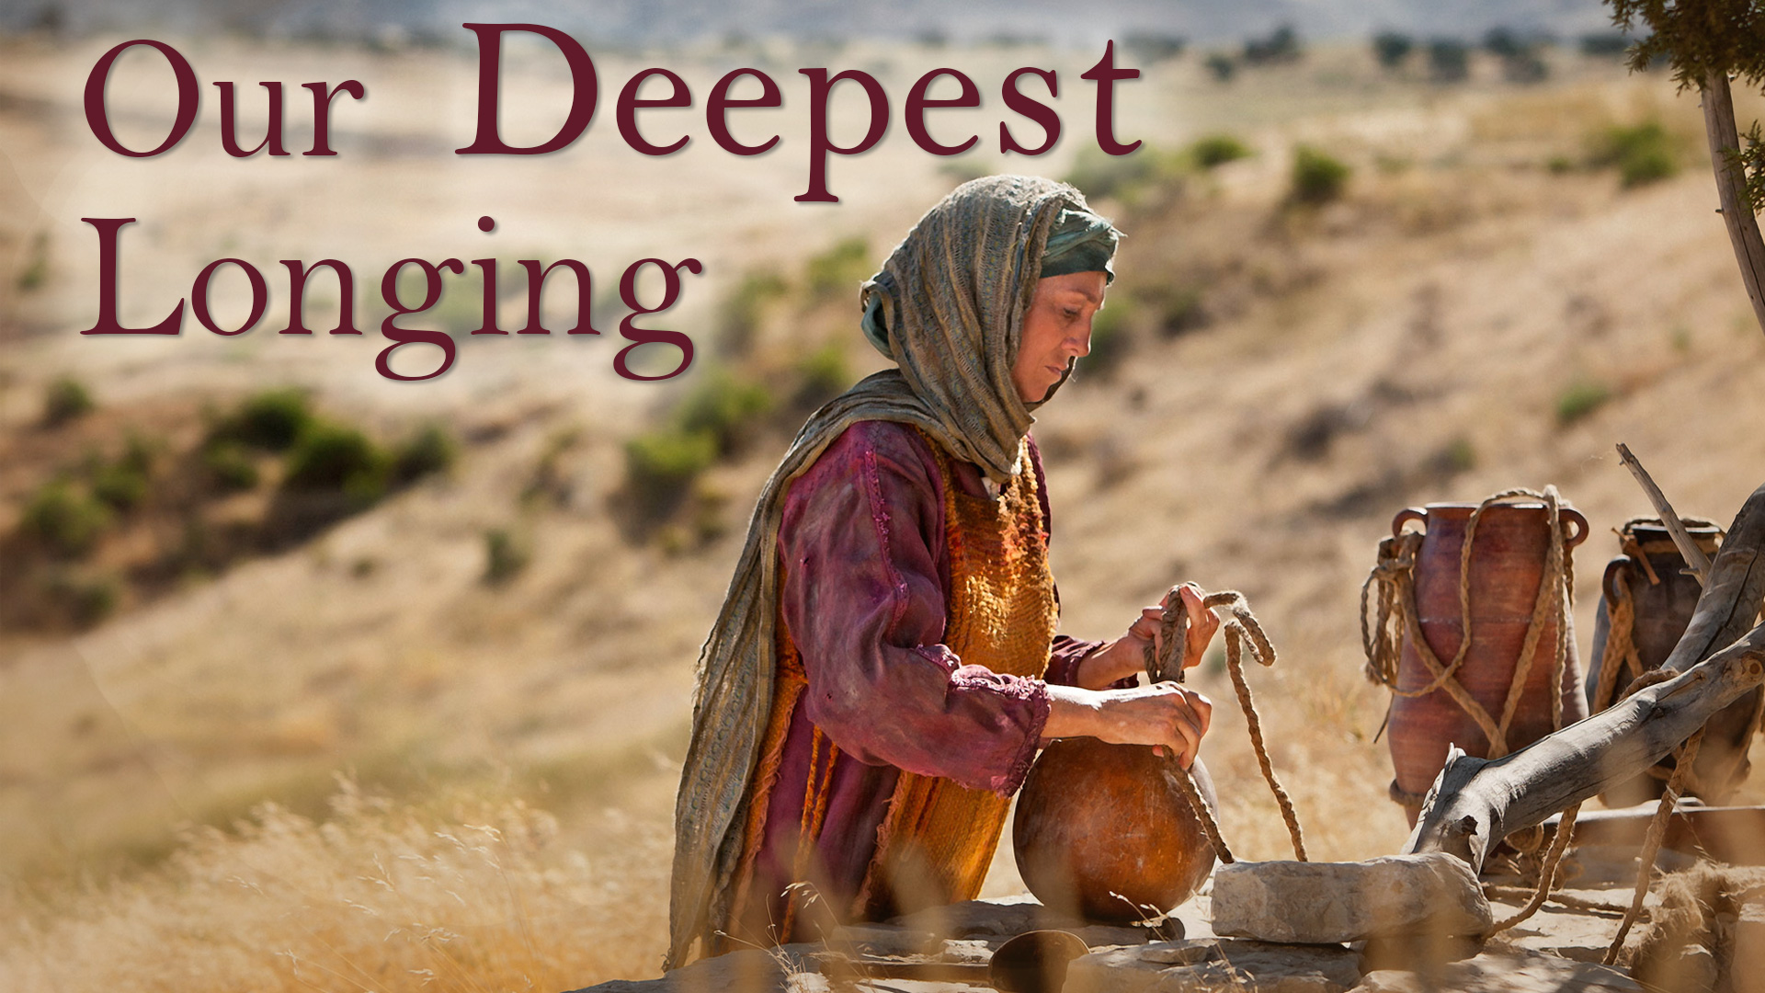

Slide 2
John 4:5-8
5 So He came to a city of Samaria which is called Sychar, near the plot of ground that Jacob gave to his son Joseph.
6 Now Jacob's well was there. Jesus therefore, being wearied from His journey, sat thus by the well. It was about the sixth hour.

Slide 3
John 4:5-8
7 A woman of Samaria came to draw water. Jesus said to her, "Give Me a drink."
8 For His disciples had gone away into the city to buy food.

Slide 4
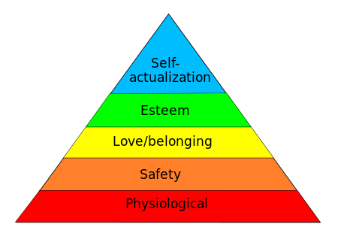
Maslow's hierarchy of needs

Slide 5
John 4:9
Then the woman of Samaria said to Him, "How is it that You, being a Jew, ask a drink from me, a Samaritan woman?" For Jews have no dealings with Samaritans.

Slide 6
John 4:10
Jesus answered and said to her, "If you knew the gift of God, and who it is who says to you, 'Give Me a drink,' you would have asked Him, and He would have given you living water."

Slide 7
John 4:11-12
11 The woman said to Him, "Sir, You have nothing to draw with, and the well is deep. Where then do You get that living water?
12 Are You greater than our father Jacob, who gave us the well, and drank from it himself, as well as his sons and his livestock?"

Slide 8
John 4:13-14
13 Jesus answered and said to her, "Whoever drinks of this water will thirst again,
14 but whoever drinks of the water that I shall give him will never thirst. But the water that I shall give him will become in him a fountain of water springing up into everlasting life."

Slide 9
John 4:15
The woman said to Him, "Sir, give me this water, that I may not thirst, nor come here to draw."

Slide 10
Ecclesiastes 3:11
He has made everything beautiful in its time. Also He has put eternity in their hearts, except that (without which) no one can find out the work that God does from beginning to end.

Slide 11
John 4:16-18
16 Jesus said to her, "Go, call your husband, and come here."

Slide 12
John 4:16-18
17 The woman answered and said, "I have no husband." Jesus said to her, "You have well said, 'I have no husband,'
18 for you have had five husbands, and the one whom you now have is not your husband; in that you spoke truly."

Slide 13
John 4:19
The woman said to Him, "Sir, I perceive that You are a prophet.

Slide 14
John 4:20-21
20 Our fathers worshiped on this mountain, and you Jews say that in Jerusalem is the place where one ought to worship."
21 Jesus said to her, "Woman, believe Me, the hour is coming when you will neither on this mountain, nor in Jerusalem, worship the Father.

Slide 15
John 4:22
You worship what you do not know; we know what we worship, for salvation is of the Jews.

Slide 16
Acts 17:23
for as I was passing through and considering the objects of your worship, I even found an altar with this inscription: TO THE UNKNOWN GOD. Therefore, the One whom you worship without knowing, Him I proclaim to you:

Slide 17
John 4:23-24
23 But the hour is coming, and now is, when the true worshipers will worship the Father in spirit and truth; for the Father is seeking such to worship Him.
24 God is Spirit, and those who worship Him must worship in spirit and truth."

Slide 18
John 4:25-26
25 The woman said to Him, "I know that Messiah is coming" (who is called Christ). "When He comes, He will tell us all things."
26 Jesus said to her, "I who speak to you am He."

Slide 19
Haggai 2:7
and I will shake all nations, and they shall come to the Desire of All Nations, and I will fill this temple with glory,' says the LORD of hosts.

Slide 20
Isaiah 5:26
He will lift up a banner to the nations from afar, And will whistle (call out) to them from the end of the earth; Surely they shall come with speed, swiftly.

Slide 21
John 4:27-29,39-42
27 And at this point His disciples came, and they marveled that He talked with a woman; yet no one said, "What do You seek?" or, "Why are You talking with her?"
28 The woman then left her waterpot, went her way into the city, and said to the men,

Slide 22
John 4:27-29,39-42
29 "Come, see a Man who told me all things that I ever did. Could this be the Christ?"

Slide 23
John 4:27-29,39-42
39 And many of the Samaritans of that city believed in Him because of the word of the woman who testified, "He told me all that I ever did."
40 So when the Samaritans had come to Him, they urged Him to stay with them; and He stayed there two days.."

Slide 24
John 4:27-29,39-42
41 And many more believed because of His own word.
42 Then they said to the woman, "Now we believe, not because of what you said, for we ourselves have heard Him and we know that this is indeed the Christ, the Savior of the world."

