Slide 2
The Unexpected happened!
Monday March 31, 2014

Slide 3
"He will not be afraid of evil tidings; His heart is steadfast, trusting in the LORD."
(Psalm 112:7)

Slide 4
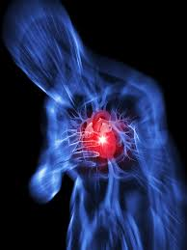
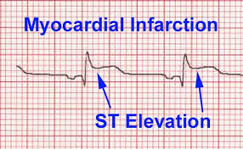

Slide 5
“Lord Jesus, I have served you faithfully all my life. Dear Holy Spirit, I thank you, you are my Comforter, and you are with me right now!”

Slide 6
“Lord Jesus, I need to live. I need to live for my wife. I need to live for my children. I need to live for the people. There is still so much work to be done.”

Slide 7
“Lord Jesus, I need to live. Thank you, you will help me live. Thank you, Lord Jesus!”

Slide 8
"He shall call upon Me, and I will answer him; I will be with him in trouble; I will deliver him and honor him." (Psalm 91:15)

Slide 9
The ICU

Slide 10
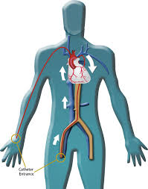
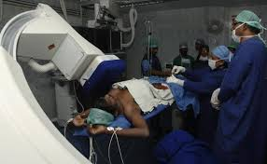
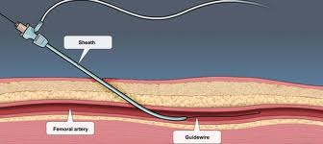
The Cardiac
Catheterization Lab

Slide 11
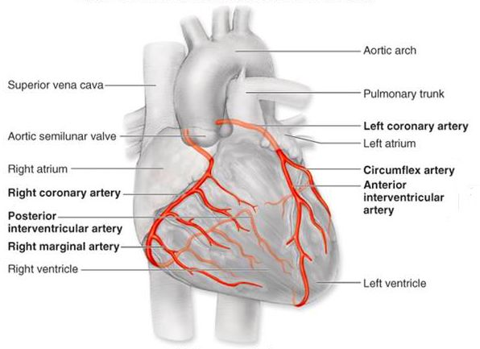

Slide 12
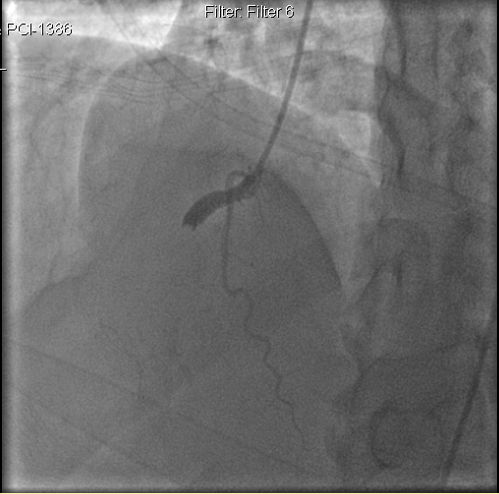
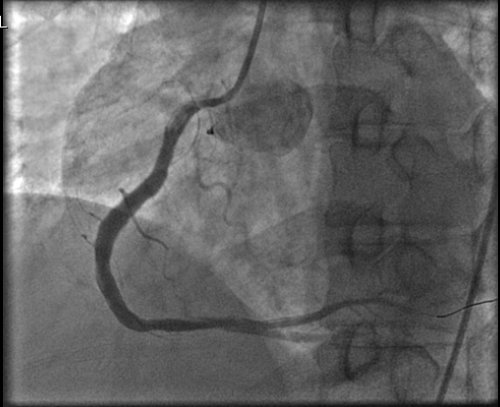
100% block of the
Right Coronary Artery
After angioplasty and stent placement

Slide 13
"For You have delivered my soul from death, My eyes from tears, And my feet from falling." (Psalm 116:8)

Slide 14
A lot to be THANKFUL for!
God is a GOOD God!
"God is our refuge and strength, A very present help in trouble." (Psalm 46:1)

Slide 15
A lot to be THANKFUL for!
God is a GOOD God!
"Yea, though I walk through the valley of the shadow of death, I will fear no evil; For You are with me;..." (Psalm 23:4)

Slide 16
A lot to be THANKFUL for!
God is a GOOD God!
"Praise the LORD! Oh, give thanks to the LORD, for He is good! For His mercy endures forever." (Psalm 106:1)

Slide 17
Reflections During The Recovery Period
#1, I refuse to question "WHY GOD?"
I only choose to "WORSHIP GOD"

Slide 18
Reflections During The Recovery Period
#1, I refuse to question "WHY GOD?"
I only choose to "WORSHIP GOD"
When you know Him for who He is, you don't need an explanation for everything. You simply walk knowing that God is a good God all the time.

Slide 19
Reflections During The Recovery Period
#1, I refuse to question "WHY GOD?"
I only choose to "WORSHIP GOD"
You enjoy the peace that is beyond understanding, even when you don't have an understanding of WHY something happened.

Slide 20
Reflections During The Recovery Period
"Surely you have things turned around! Shall the potter be esteemed as the clay; For shall the thing made say of him who made it, "He did not make me"? Or shall the thing formed say of him who formed it, "He has no understanding"?
(Isaiah 29:16)

Slide 21
Reflections During The Recovery Period
Possible reasons:
Hereditary + Lifestyle + Spiritual
Diet, Exercise
Rest, Stress
We are secure in Christ, unless we open doors

Slide 22
Reflections During The Recovery Period
#2, I refuse “negative” emotions
I choose to maintain only “positive” emotions
I refuse any form of bitterness or anger - toward God, toward life, etc.

Slide 23
Reflections During The Recovery Period
#2, I refuse “negative” emotions
I choose to maintain only “positive” emotions
I choose to rejoice, to be cheerful, to be thankful.

Slide 24
Reflections During The Recovery Period
#2, I refuse “negative” emotions
I choose to maintain only “positive” emotions
"A merry heart does good, like medicine, But a broken spirit dries the bones." (Proverbs 17:22)

Slide 25
Reflections During The Recovery Period
#2, I refuse “negative” emotions
I choose to maintain only “positive” emotions
"Rejoice always, ..in everything give thanks; for this is the will of God in Christ Jesus for you." (1 Thessalonians 5:16,18)

Slide 26
Reflections During The Recovery Period
#3, As I look ahead,
I refuse to operate out of FEAR
I choose to operate out of FAITH

Slide 27
Reflections During The Recovery Period
#3, As I look ahead,
I refuse to operate out of FEAR
I choose to operate out of FAITH
FEAR creates self-imposed limitations.

Slide 28
Reflections During The Recovery Period
#3, As I look ahead,
I refuse to operate out of FEAR
I choose to operate out of FAITH
FAITH receives God's plans and God's wisdom and empowering to fulfill them.

Slide 29
Reflections During The Recovery Period
"Now Joshua was old, advanced in years. And the LORD said to him: "You are old, advanced in years, and there remains very much land yet to be possessed."
- (Joshua 13:1)

Slide 30
Reflections During The Recovery Period
“….there remains very much land yet to be possessed."
- (Joshua 13:1)
We must move with FAITH and WISDOM to possess what is still to be taken.

Slide 31
Looking Ahead
#1, Pursue God's Presence to be a House filled with His glory so that we impact our city and cities across our nation with the supernatural power of God

Slide 32
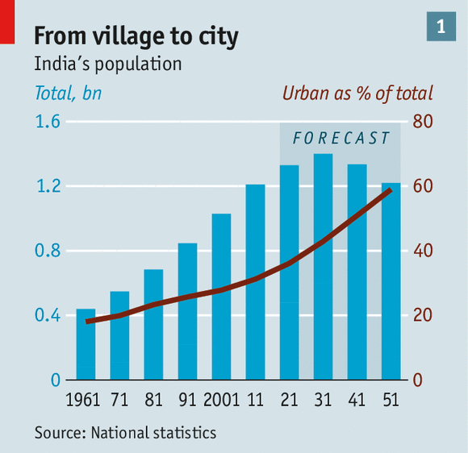
Looking Ahead
50 Indian cities have 1million+ residents
Some 300m people will move to town in the next 25 years
By 2051 about 60% of India's population will be in cities

Slide 33
Looking Ahead
The key to impacting our city and cities across our nation is the demonstration of the power of God through signs, wonders and miracles.

Slide 34
Looking Ahead
How will we go about this?
#1, We as a local church will need to press in and pursue God's Presence, so that we become a house filled with His glory

Slide 35
Looking Ahead
How will we go about this?
#2, Let's equip and empower pastors, local churches and believers all across our nation to impact their communities, cities and regions for the Kingdom of God.

Slide 36
Looking Ahead
How will we go about this?
#3, train up a new generation of ministers who can impact cities (APC's Institute for Urban Ministry)

Slide 37
Looking Ahead
#2, Prepare to go to the nations (March 19)

Slide 38
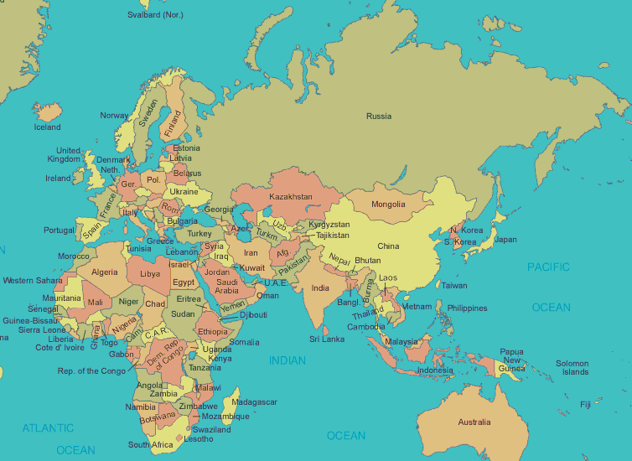

Slide 39
Looking Ahead
#2, Prepare to go to the nations (March 19)
Go to these nations and equip God's people to impact their nation
A, Bible College
B, Christian Leaders Conference
C, Marketplace Equipping
D, Worship School
E, Publications in local languages

Slide 40
Looking Ahead
#3, Three streams merged into one (March 22)
Prophetic & Deliverance
Miracles & Healings
Missions
APC’s Mandate

Slide 41
Let’s Pray Together

Slide 42
Are you ready to meet your Maker?

Slide 43
Those who may be questioning God "Why"?

Slide 44
Those who may be bitter about things that have happened

Slide 45
Those who are crippled by fear because of what has happened

